Slide 1

Owning Your Role as Advisor to Senior Leadership
APTA Marketing and Communications Conference
February 26, 2019

Slide 2

Developing Relationships
Make the initial call
Be friendly, outgoing and approachable
Be diligent with follow up and developing a relationship
Keep the fire alive!

Slide 3
Prepping for Success
Have an honest and open relationship with senior management
Provide talking points in advance of interview or news conference
Casual conversation is key

Slide 4
Community Matters
Be an integral part of the communities you serve
Matter to those who will never ride with you
Support organizations that support your transit system
Form key partnerships and nurture them

Slide 5
Broaden Your Scope
Think outside of the box with story ideas
Tie in community involvement
Senior leadership buy in

Slide 6
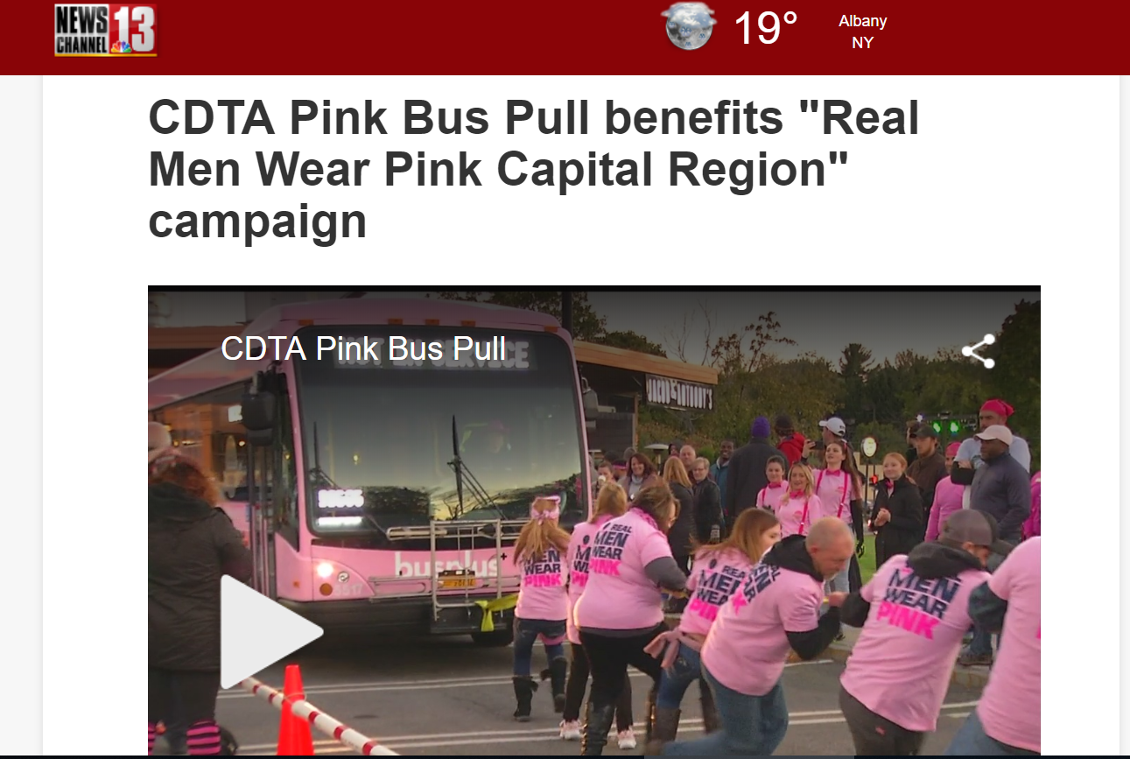
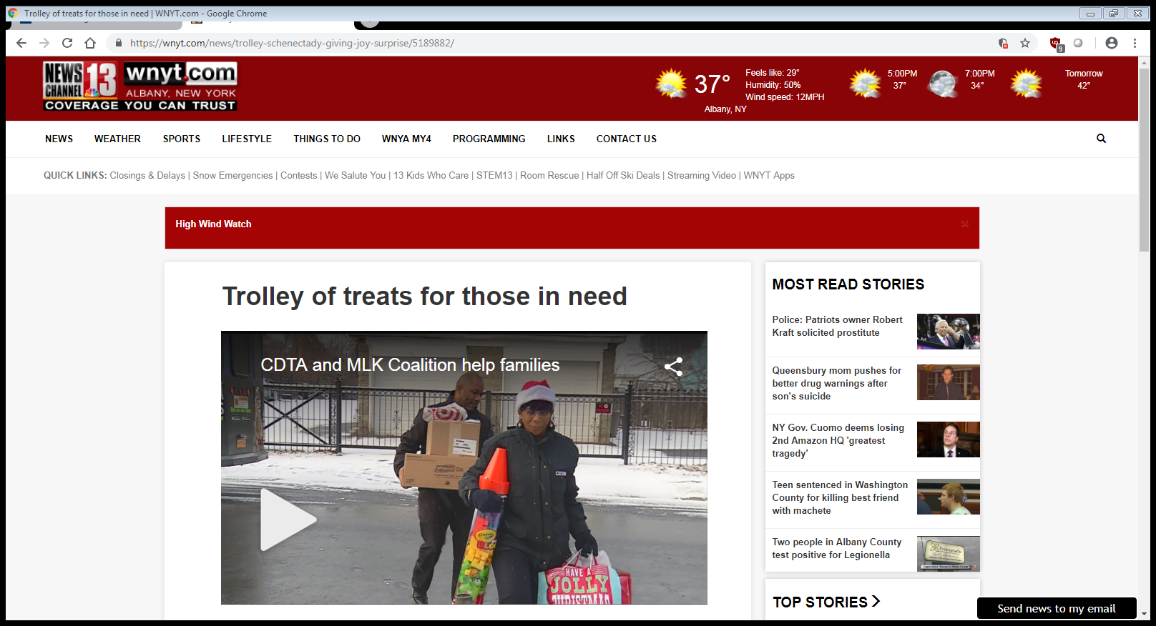
Media Highlights

Slide 7

Final Thoughts

