Slide 1
APTA Webinar Series:
Transit Bus Air Supply System
Presented by APTA Bus Technical Maintenance Committee

Slide 2
APTA Bus Technical Maintenance Committee Webinars
2019-2020 Webinar Series
10/22/19 Training Technicians for an Electric Bus Fleet
12/3/19 Diesel Aftertreatment Systems
3/31/20 Basic Electrical Troubleshooting
Today Transit Bus Air Supply System
Next: Air Control System & Air System Troubleshooting
Info and recordings found at https://www.apta.com/research-technical-resources/aptau/learning-and-development/webinars/committee-webinars/technical-services-and-innovation-webinars/

Slide 3
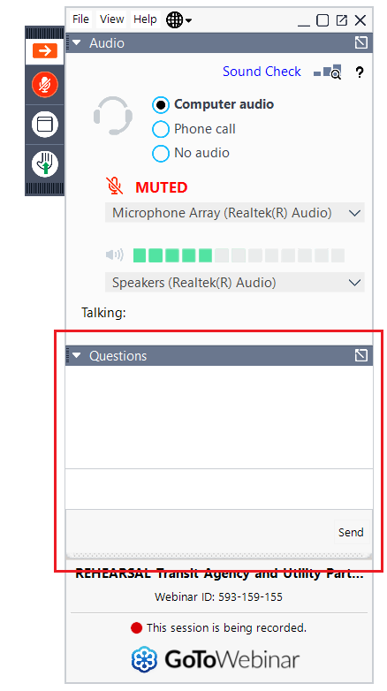
Housekeeping
All attendees are muted
To submit a question or comment to the moderator during the webinar, please type it into the Questions box in the menu panel.

Slide 4

Moderator
Obed Mejia
Senior Bus Equipment Maintenance Instructor
Los Angeles Metropolitan Transportation Authority
Los Angeles, CA

Slide 5

Brian D. Markey
Presenter
Chief Executive Officer
Custom Training Aids Inc.
La Verne, CA

Slide 6


Frank Forde
Panelists
John Brundage
Equipment Maintenance Instructor
Los Angeles Metropolitan Transportation Authority
Los Angeles, CA
Transit & Rail Vehicle Specialist
Jacobs
Boston, MA

Slide 7
Objectives
At the conclusion of this webinar, you will be able to:
1. Understand the operation of the air supply system
2. Demonstrate preventive maintenance practices
3. Demonstrate common diagnostic practices

Slide 8
Brian D. Markey
Presenter
Chief Executive Officer
Custom Training Aids Inc.
La Verne, CA

Slide 9

The information on this webinar is to be used in conjunction with the original equipment manufacturer (OEM) and air brake parts manufacturer service manuals.
Proper tools and safety equipment must always be used when working on brake systems.

Slide 10
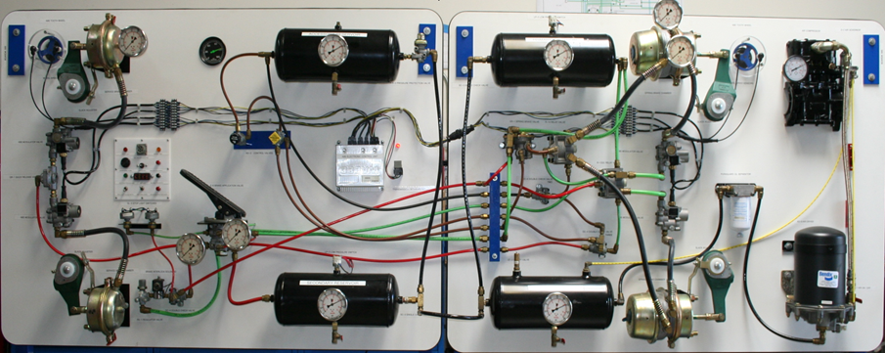
Air Brake System

Slide 11
System Layout
Air brake system is comprised of three sub-systems:
  Air Supply System
  Air Control System
  Foundation Brake System

Slide 12
Air Supply System
Supply system provides, conditions, and stores the compressed air which is the medium of control and power of the vehicle’s braking system

Slide 13
Shop Tips
Air Leaks are the root cause for the majority of air system problems
The condition of the supply system will indicate the health of the complete air system
A dirty supply system will result in a problematic control and foundation system

Slide 14
Air Loss
Maximum allowable static air loss is 2 PSI in one minute
Static air loss is with service brakes released and parking brake fully applied
Maximum allowable applied air loss is 3 PSI in one minute
Applied air loss is with service brakes fully applied and parking brake released

Slide 15
System Operation
Air leaks at connections and valve exhaust ports are acceptable if air loss does not exceed allowable limits
Air leaks at brake chambers are a violation of CVSA and meet/result in Out of Service Criteria
With the service brakes fully applied, 90% of the air pressure in the brake reservoir must be available at the brake chamber
32 oz is the maximum allowable limit for liquids in each reservoir

Slide 16
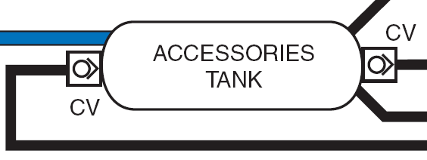
Typical Air System Schematic

Slide 17
Air Tubing and Line Colors
Green Supply and primary brake system
Red Secondary brake system
Brown Parking, Emergency, Spring Brakes
Yellow Governor control circuit
Black Accessory system, suspension system on some buses
Blue Suspension system some buses

Slide 18
Air Brake Tubing Specifications
Air brake plastic tubing must meet the following specifications:
All air brake plastic tubing is required to be DOT FMVSS 49CFR 571 .106 approved / certified
All air brake plastic tubing is required to be SAE J-844 certified
Damaged air brake tubing is recommended to be replaced with the same color and size
It is required to be for air brake systems

Slide 19
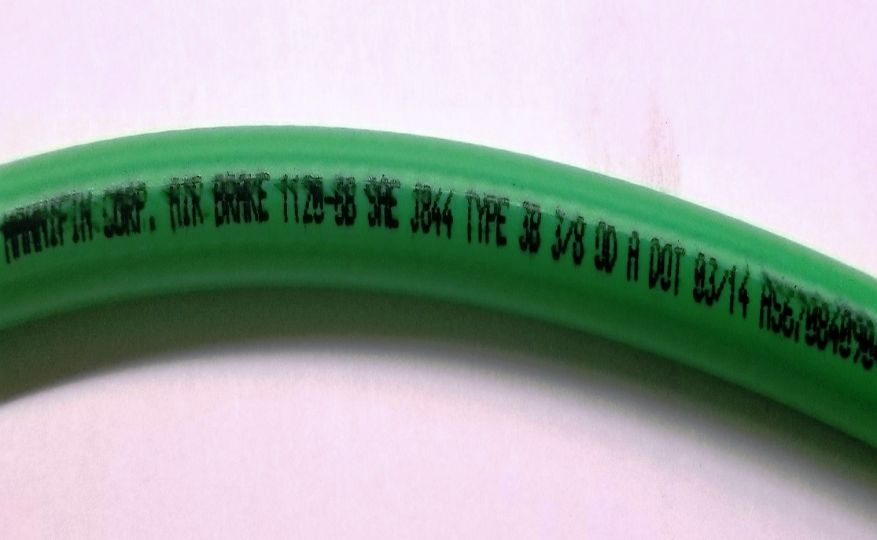

Air Brake Tubing Specifications
Air Brake Tubing SAE J-844 Type 3B 3/8 OD DOT
Air Brake Tubing SAE J-844 Type 3B 1/2 OD DOT

Slide 20
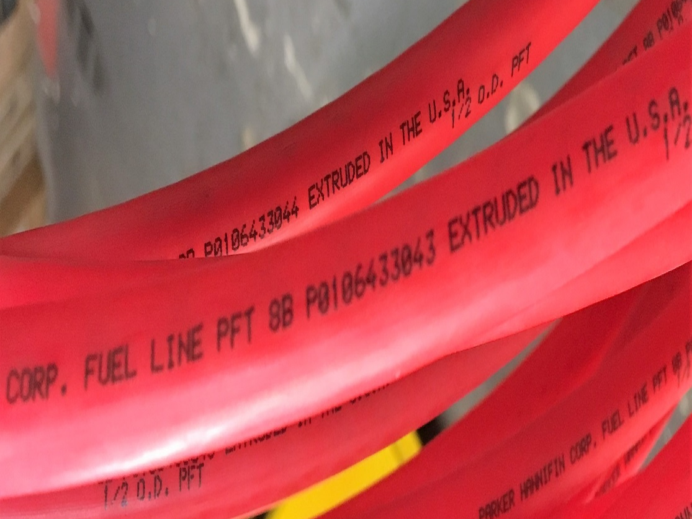

Air Brake Tubing Specifications
Plastic Fuel Line Tubing
Air Brake Tubing SAE J-844 TYPE B 1/2 OD DOT

Slide 21
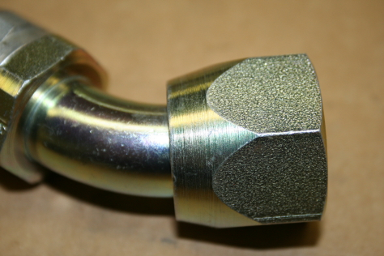
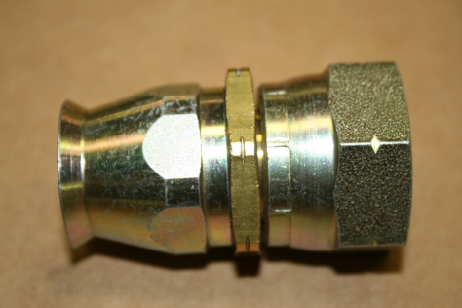
Fittings and Connections
Size identified by number
Number is size in 1/16th of inch increments
Example: #6 is 6/16” or 3/8”
Available in JIC and SAE
JIC fittings 37 degree flare
SAE fittings 45 degree flare
Identified by notch or lack of notch on wrench flat
Without notch is JIC
With notch is SAE

Slide 22
Air Brake Fitting Specifications
Air brake fitting must meet the following specifications:
All air brake fitting are required to be DOT approved / certified
All air brake fitting designed for air brake plastic tubing will have DOT stamped or engraved on the fitting

Slide 23
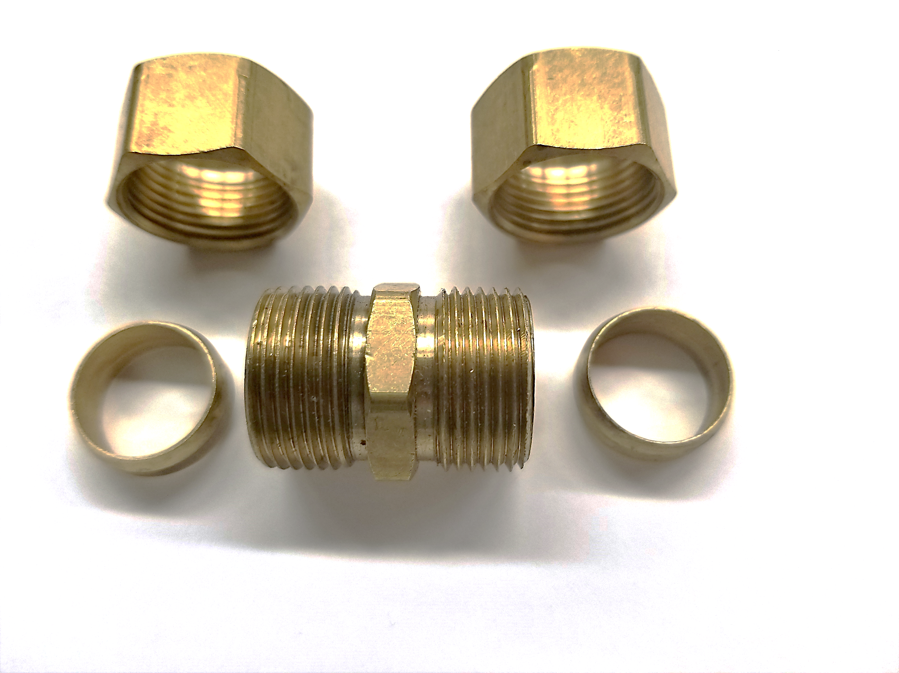
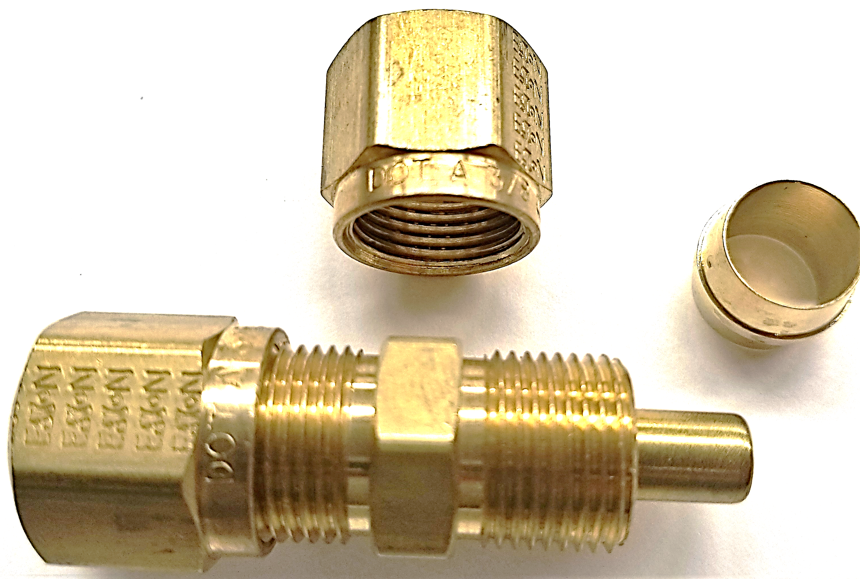
Compression Fitting Comparison
COPPER TUBE COMPRESSION FITTING
COMPRESSION D.O.T FITTING

Slide 24
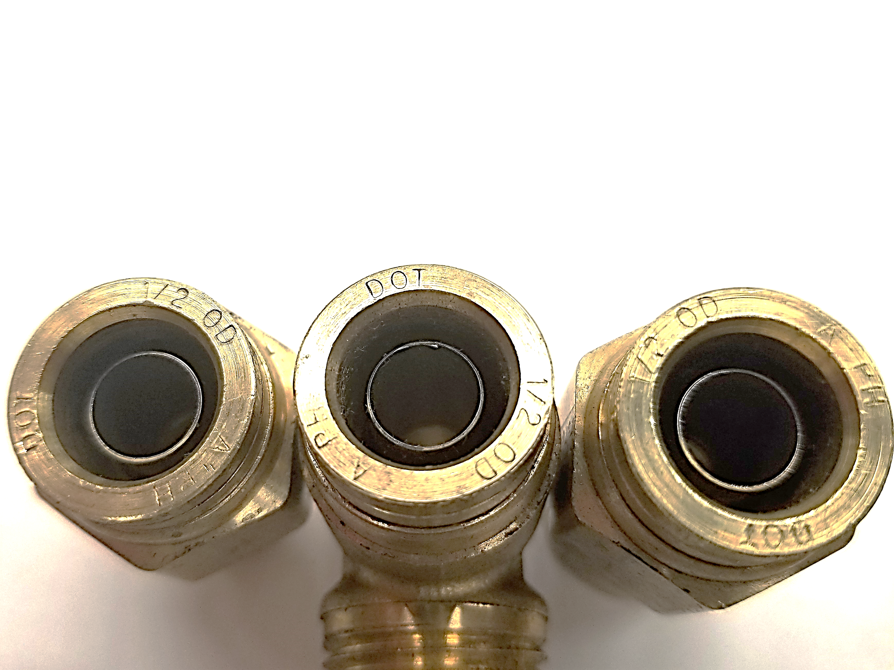
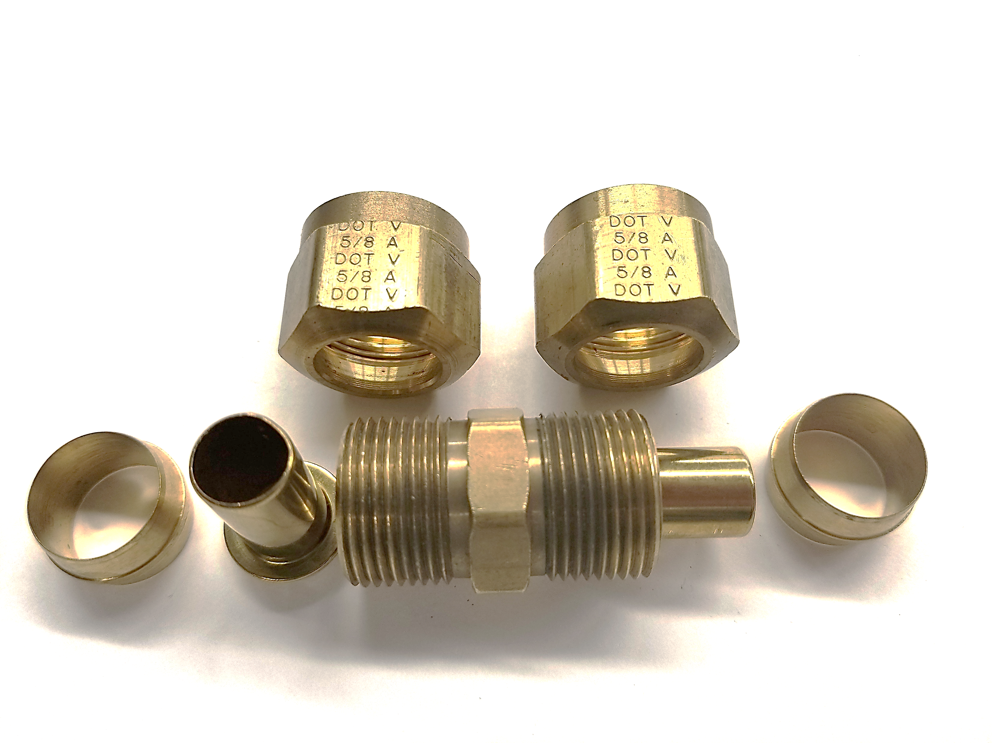
Air Brake Fittings
COMPRESSION D.O.T FITTING
BRASS PUSH-TO-CONNECT D.O.T. FITTINGS

Slide 25
Supply System Components
Air Compressor
Air Governor
Air Dryer
Reservoirs
Single Check Valves
Low Pressure Warning System
Safety Valve
Drain Valve
Pressure Protection Valve
Pressure Reducing Valve

Slide 26
Air Compressor
The air compressor is the heart of the air system
Air is compressed and heated by the air compressor, vaporizing moisture and storing energy
Air travels from the compressor through the discharge line where it is cooled and flows into the air dryer

Slide 27
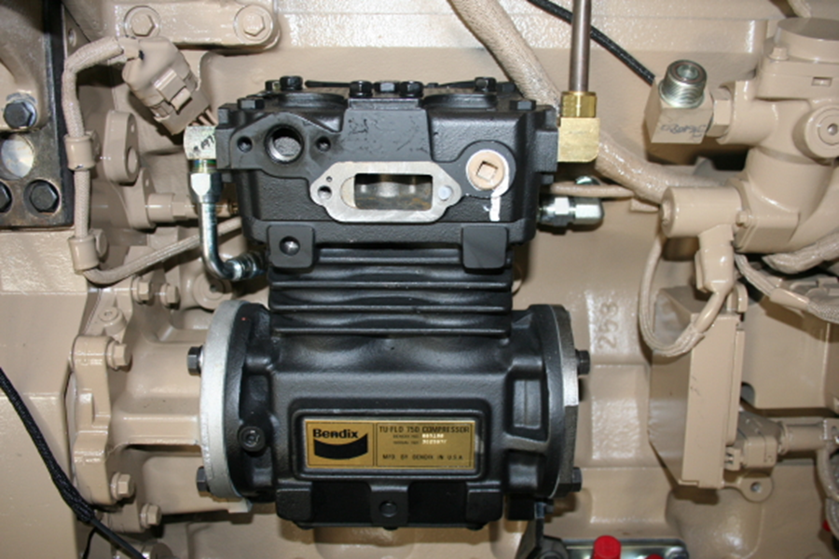
Engine Driven Air Compressor

Slide 28
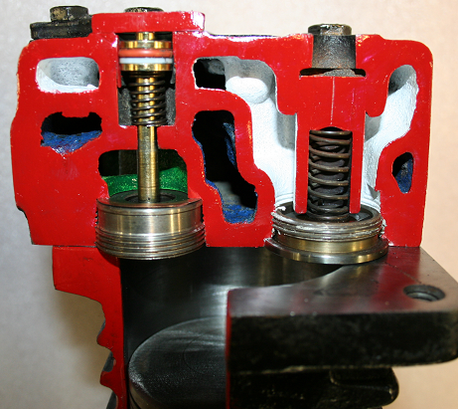
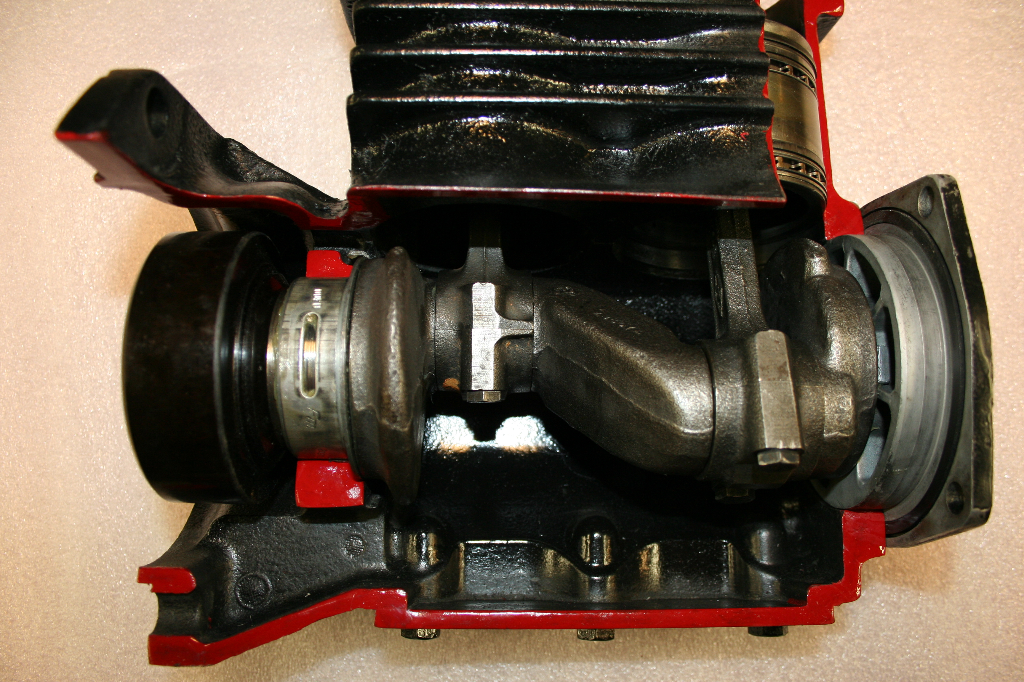
Engine Driven Air Compressor

Slide 29
Engine Driven Air Compressor
Operates in two modes:
Loaded and Unloaded
Loaded mode is when the air compressor is compressing air or building up air pressure
Unloaded mode is when the air compressor is not compressing air or not building up air pressure

Slide 30
Engine Driven Air Compressor Operational Modes
Intake
Discharge
Unloaded

Slide 31
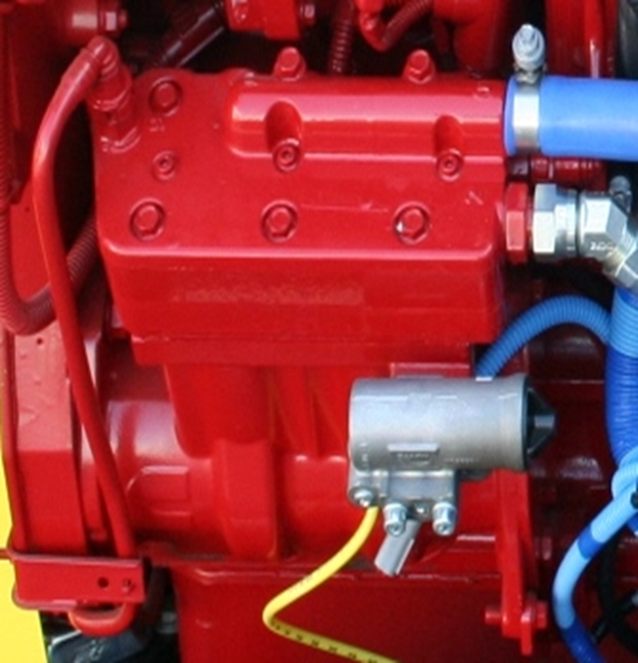
Engine Driven Air Compressor
In certain applications, Wabco and Holset air compressors are timed to prevent vibration
Improperly timed compressors can result in noise and vibration
Improperly timed compressors can trigger knock sensors in CNG engines resulting in engine power loss

Slide 32
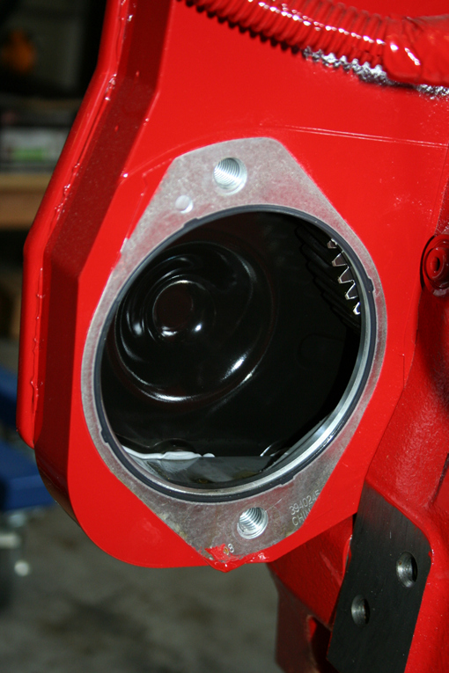
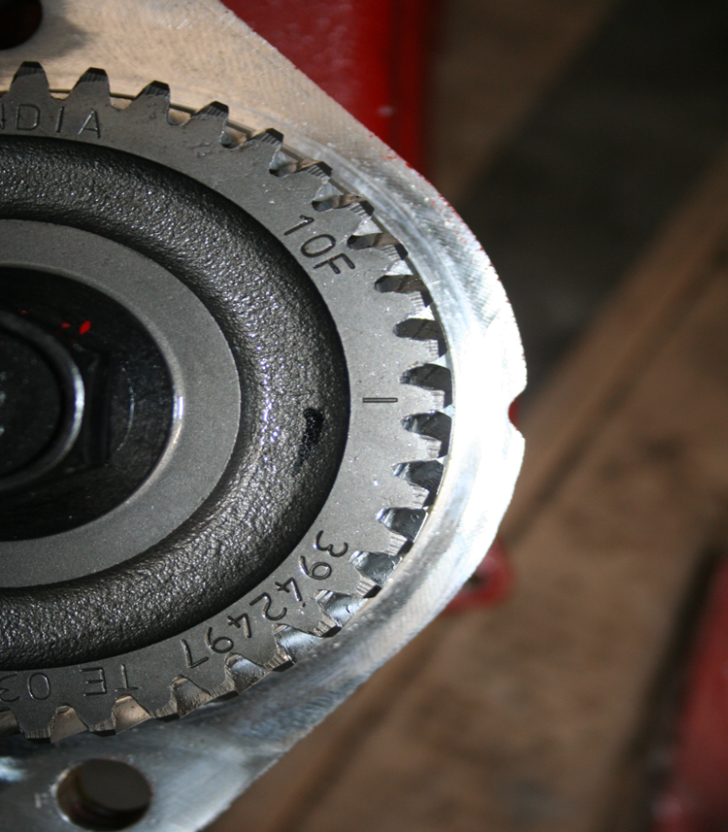
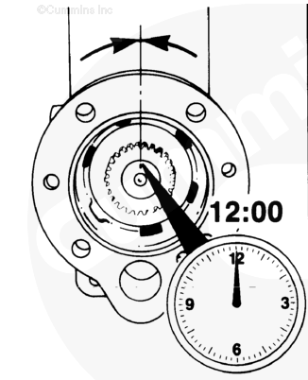

Engine Driven Air Compressor
Remove number 1 injector or spark plug then rotate crankshaft so number 1 cylinder is at top dead center. Reinstall injector or spark plug
Refer to the appropriate Troubleshooting and Repair manual for air compressor installation and timing procedures
Wabco compressor timing
Holset compressor timing

Slide 33
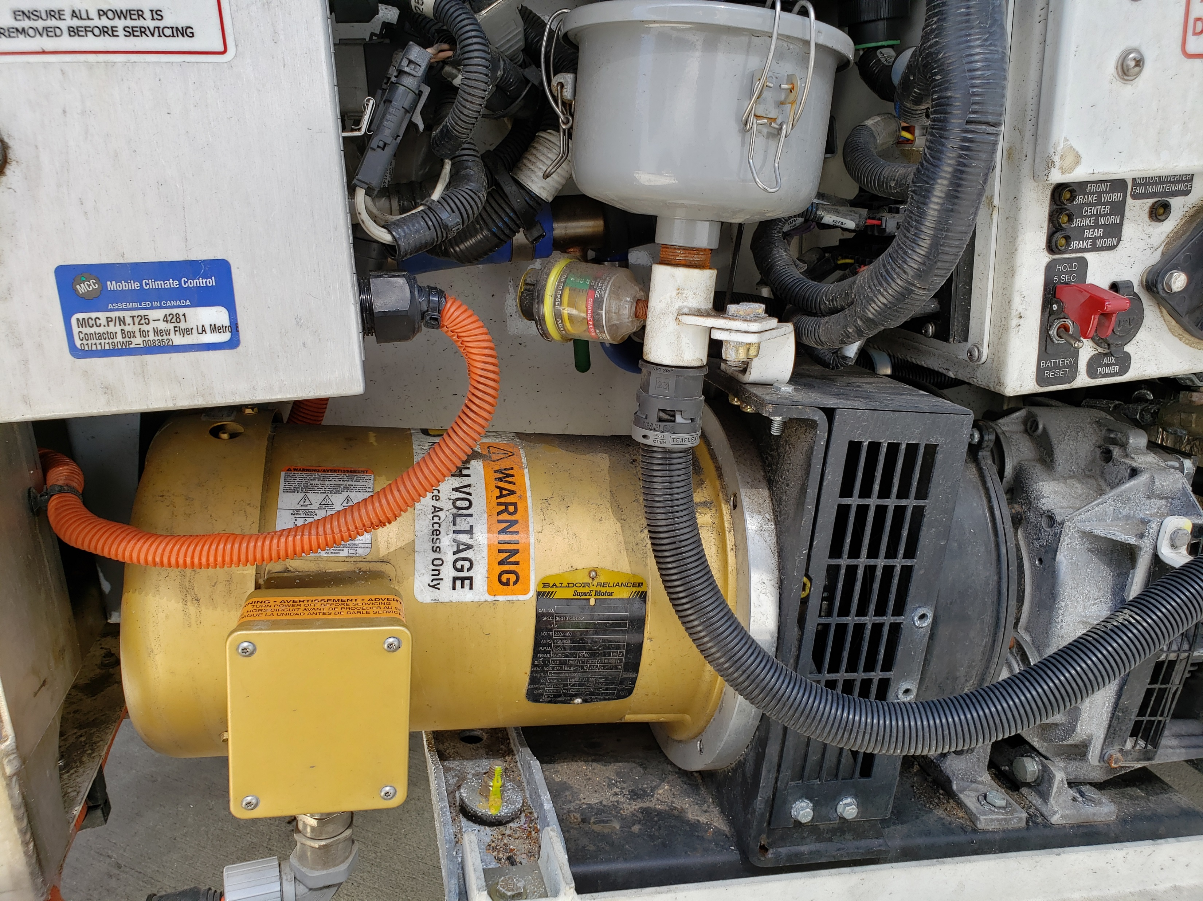
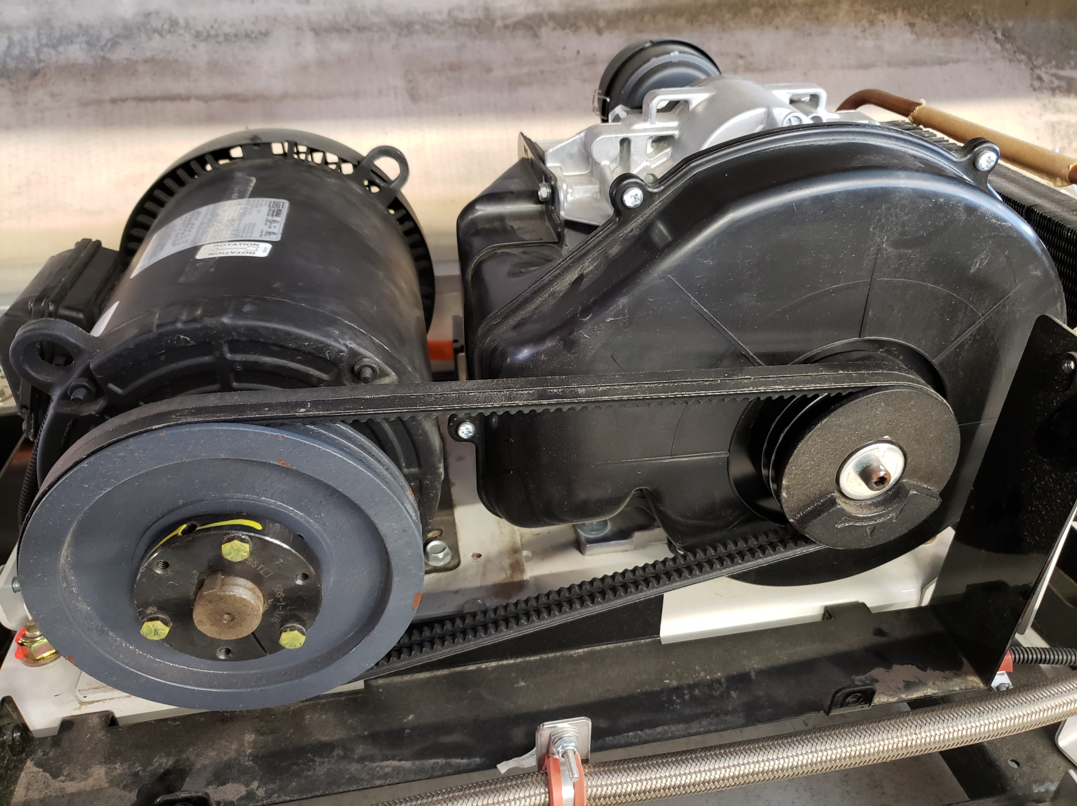
Electric Scroll Air Compressor
Scroll compressors are oilless eliminating oil and carbon contamination in the air system
Electric scroll compressors can be direct or belt driven
Belt guard removed for display purposes

Slide 34
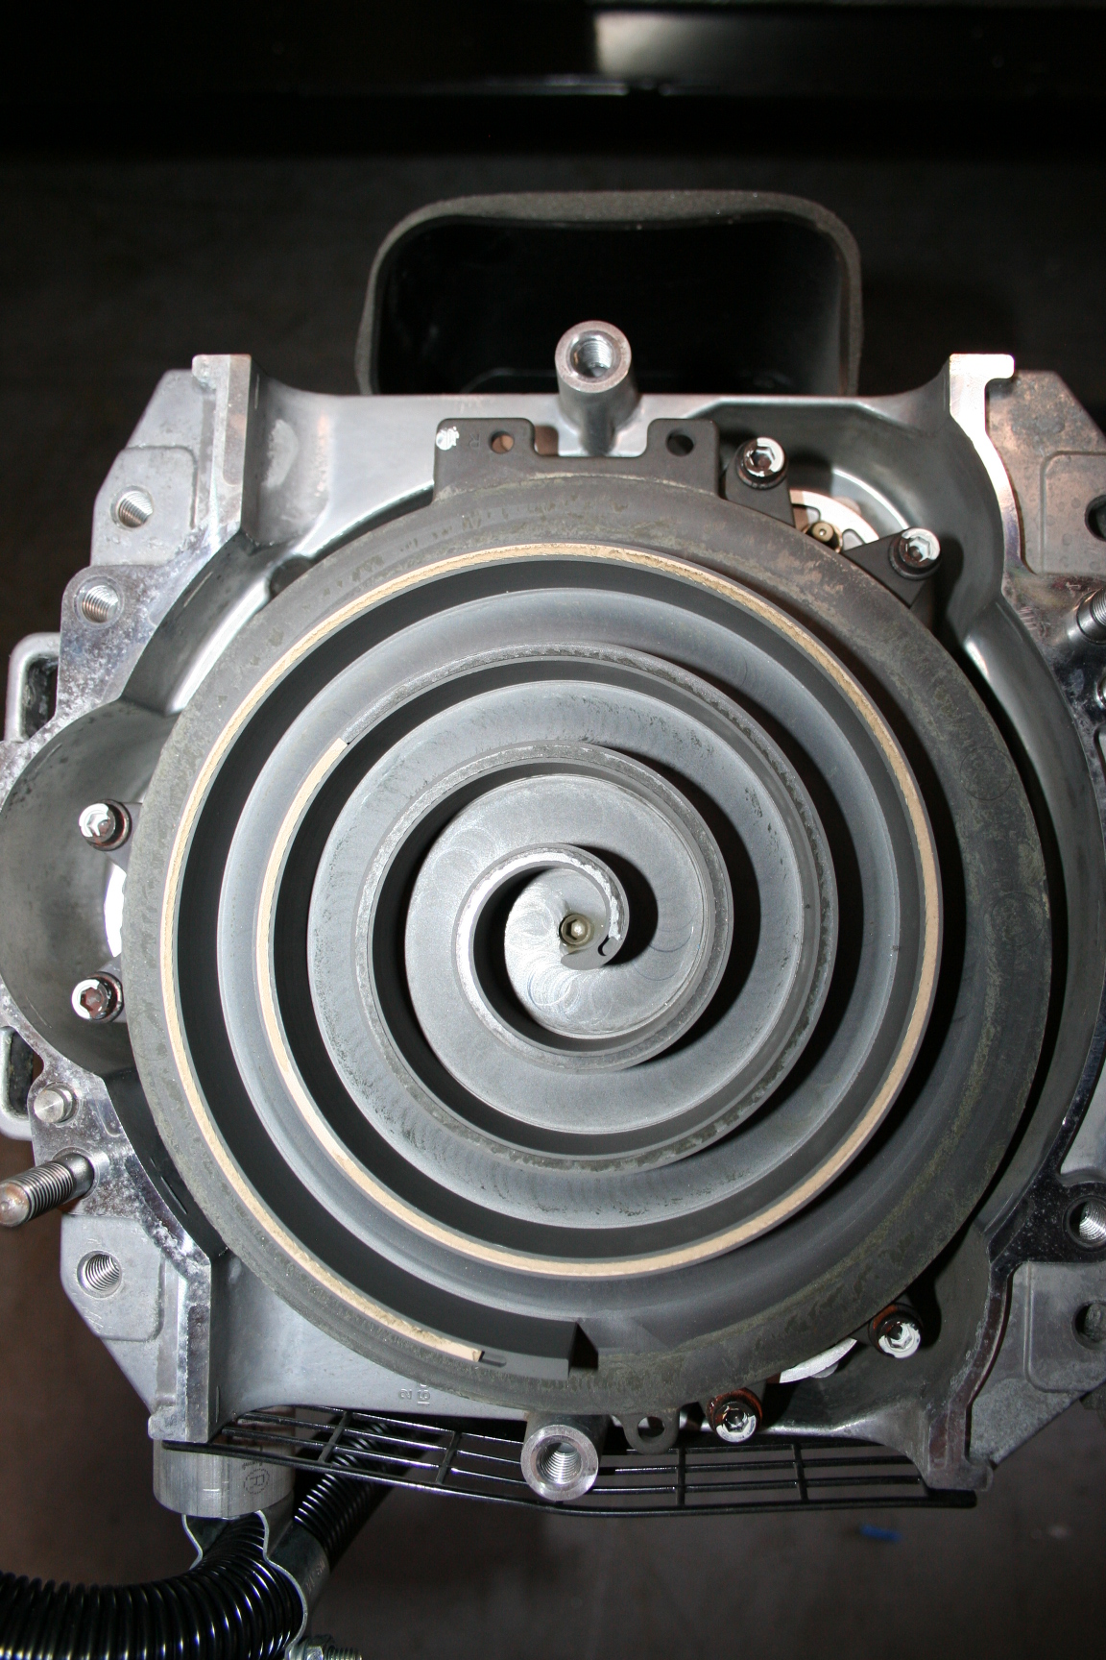
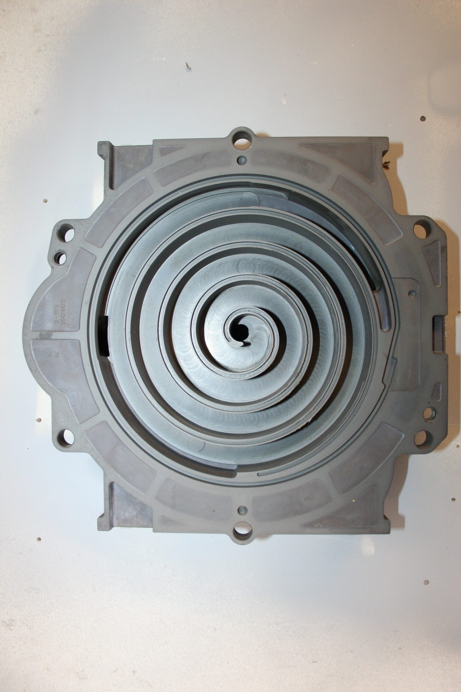
Electric Scroll Air Compressor
The basic compression element of a scroll compressor, is made up of two identical spirals which form right and left-hand parts
One of these scroll components is indexed or phased 180 degrees with respect to the other so the scrolls can mesh
Crescent-shaped gas pockets are formed and bounded by the spirals and the base plate of both scrolls
As the moving scroll is orbited around the fixed scroll, the pockets formed by the meshed scrolls follow the spiral toward the center and diminish in size
Air enters the spiral from the outer edge and is discharged out the center of the spiral
Moving Scroll Plate Driven by Motor
Fixed Scroll Plate attached to Housing

Slide 35

Electric Scroll Air Compressor
The tip seal on the scroll compressor is self-lubricated and allows the unit to operate efficiently without oil and expensive filtration
Tip seals are serviceable and should be replaced as part of your periodic maintenance schedule based on severity of service
Tip Seal Installed in Scroll
Typical Tip Seal Kit

Slide 36
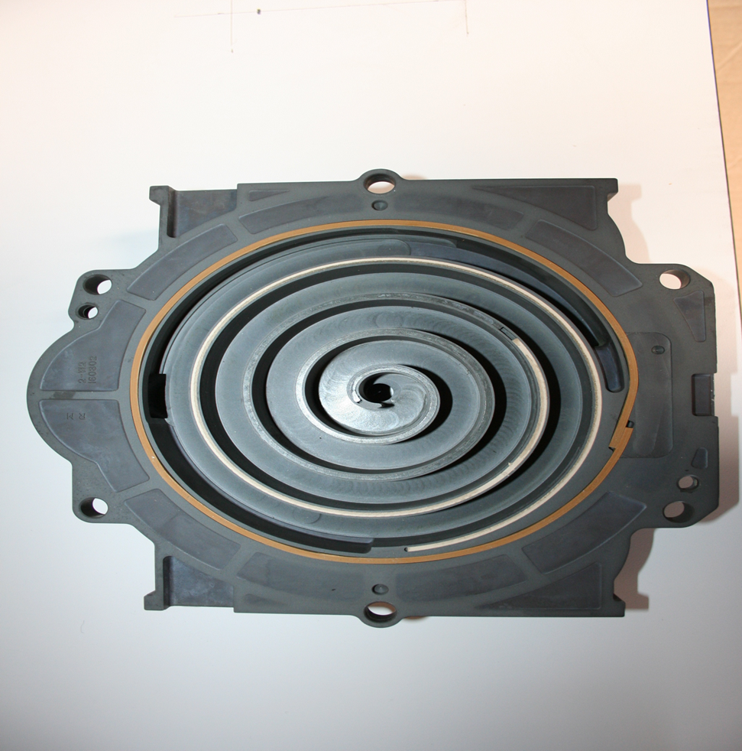
Electric Scroll Air Compressor
To ensure proper operation and quick air buildup tip seals must be installed with ends butting up against each other
Incorrectly installed Tip seal

Slide 37
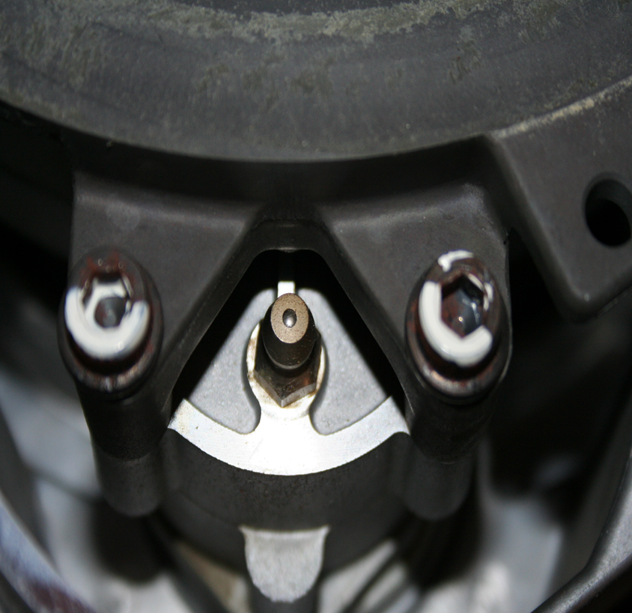
Electric Scroll Air Compressor
The bearings on the scroll compressor are lubricated with grease and are greaseable to allow extended compressor life.
Bearings should be greased as part of your periodic maintenance schedule based on severity of service

Slide 38
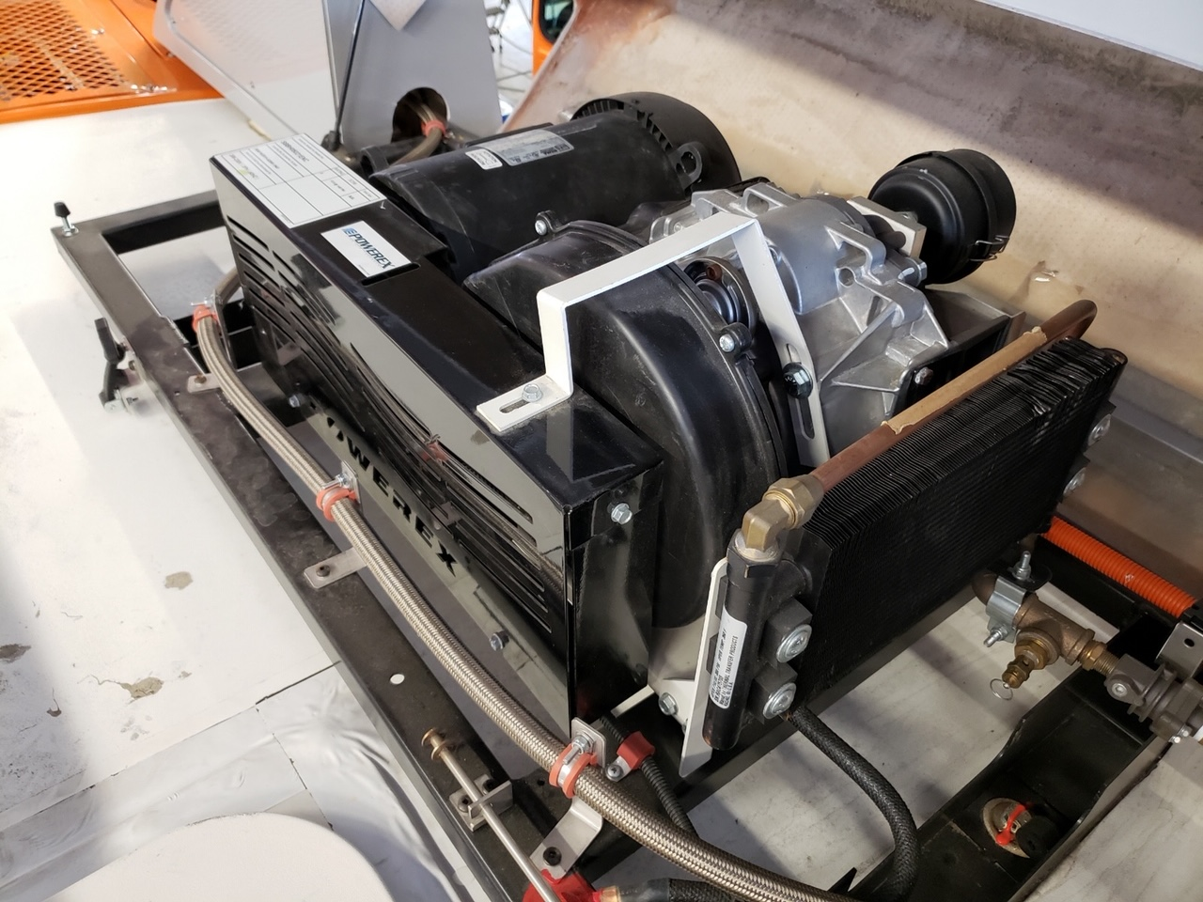
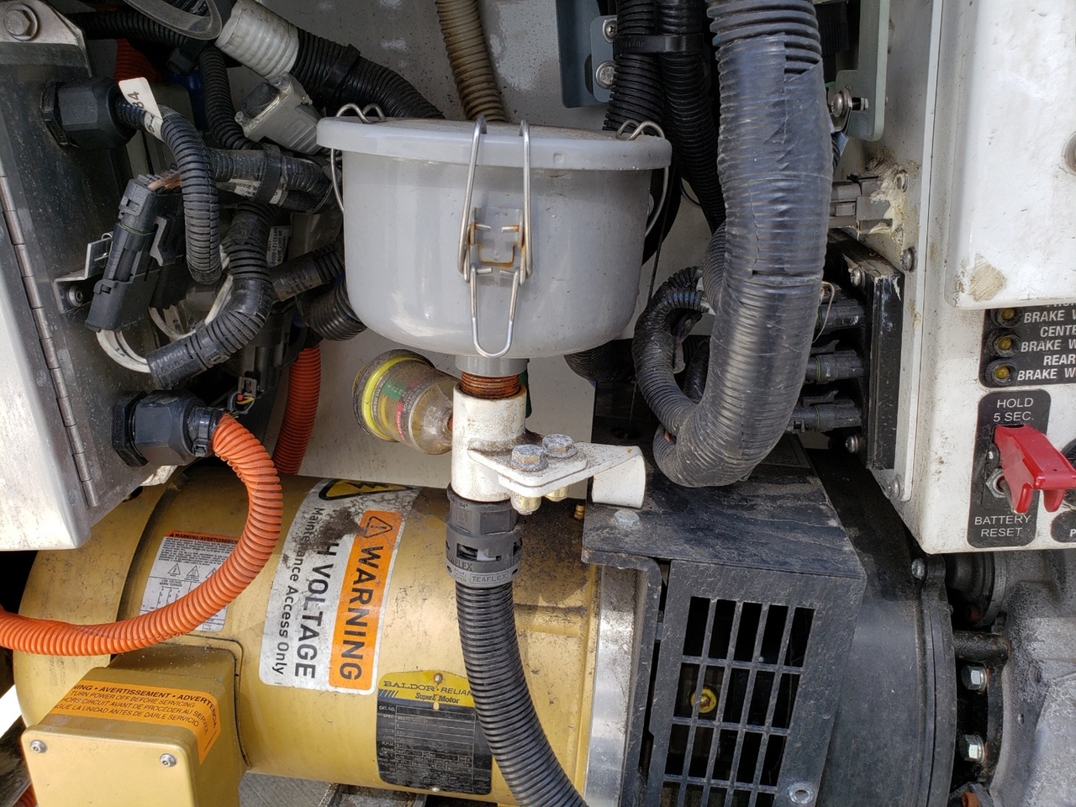
Electric Scroll Air Compressor
The scroll compressor will have its own air filter which will require periodic replacement

Slide 39
Shop Tip
Air Compressor Troubleshooting
5 main reasons for slow air build up
1. Air leaks
2. Restricted discharge line
3. Restricted intake system
4. Stuck unloader valve
5. Bad air compressor

Slide 40
Air Governor
Controls air compressor
Monitors supply reservoir pressure
Cut out pressure adjustable
Cut in pressure is not adjustable
Cut in pressure is 15-25 PSI below cutout
Never plug the exhaust port

Slide 41
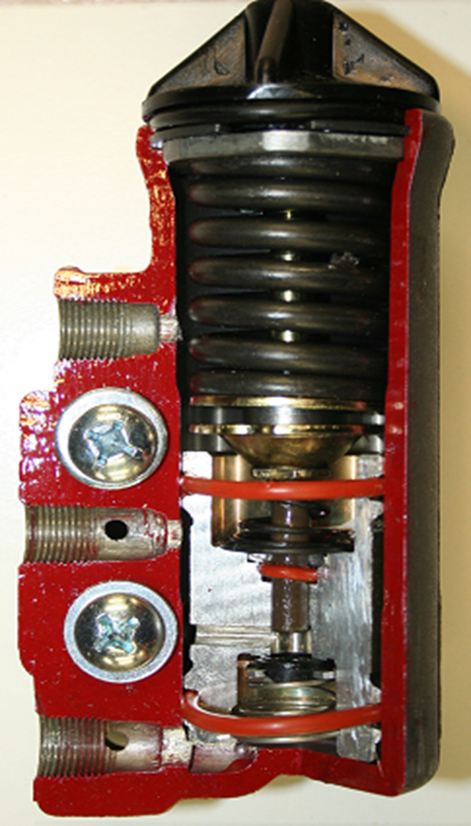
Air Governor
Exhaust Port
Unloader Port
Reservoir Port

Slide 42
Air Governor Operation
Cut-in
Cut-out

Slide 43
Air Compressor Discharge Line
The Air Compressor Discharge Line is designed and sized to allow hot compressor air, water vapor, and oil vapor mixture to cool between the compressor and the dryer
The line must maintain a constant downward slope between the compressor and the dryer
A change of state from vapor to moisture occurs in the line
The dryer is then able to collect oil droplets in the desiccant cartridge and remove water vapor before it reaches the ‘wet tank’

Slide 44
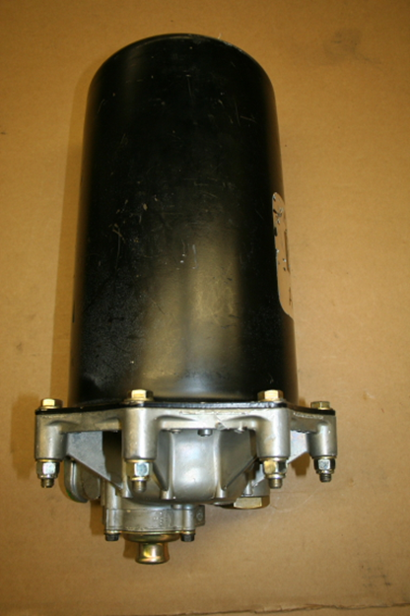
Air Dryer
    Collects and removes system contaminants
    Provides clean dry air to system components
Reduces reservoir draining frequency
Operates in Charge and Purge modes

Slide 45
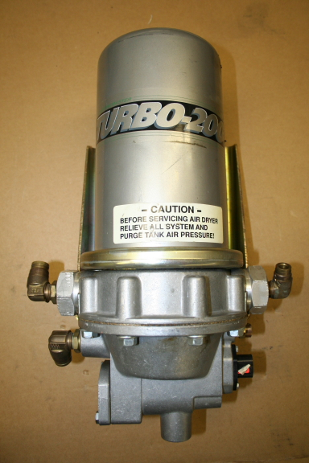

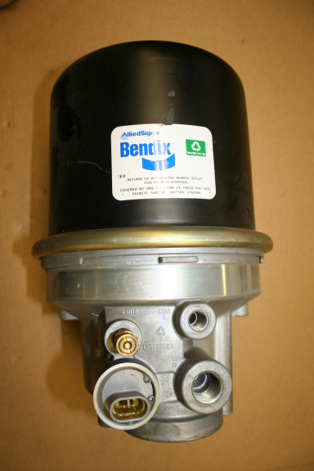
Air Dryer

Slide 46
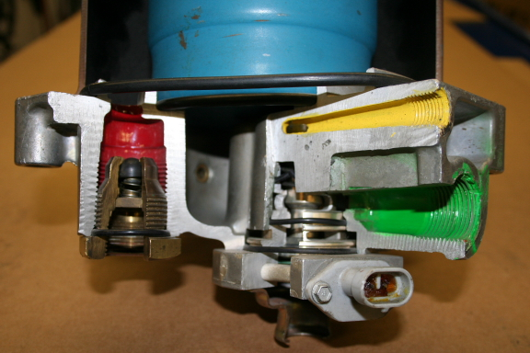
Air Dryer
Control Port
Supply Port
Delivery Port
Purge Valve

Slide 47
Air Dryer Charge Cycle
Charge cycle is when the air compressor is loaded or compressing air
Air, oil, oil vapor, carbon and water flow from the discharge line through oil separator and desiccant
Clean dry air flows from desiccant through a check valve and out the delivery port
Maximum charge time is 90 seconds

Slide 48
AD-9
CHARGE
CYCLE

Slide 49
Air Dryer Purge Cycle
During the purge cycle the air compressor is unloaded
Air pressure from the air governor opens the purge valve
Air in the sump exits to atmosphere taking water and contaminants with it
Single check valve on top of desiccant cartridge causes air to slowly escape through the desiccant becoming super dry and removing remaining moisture
Minimum purge time is 25 seconds

Slide 50
AD-9
PURGE
CYCLE

Slide 51
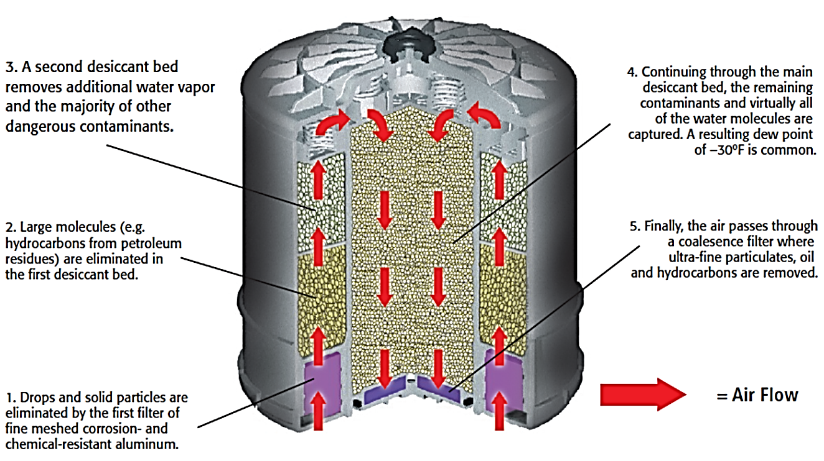
Haldex Air Dryer

Slide 52
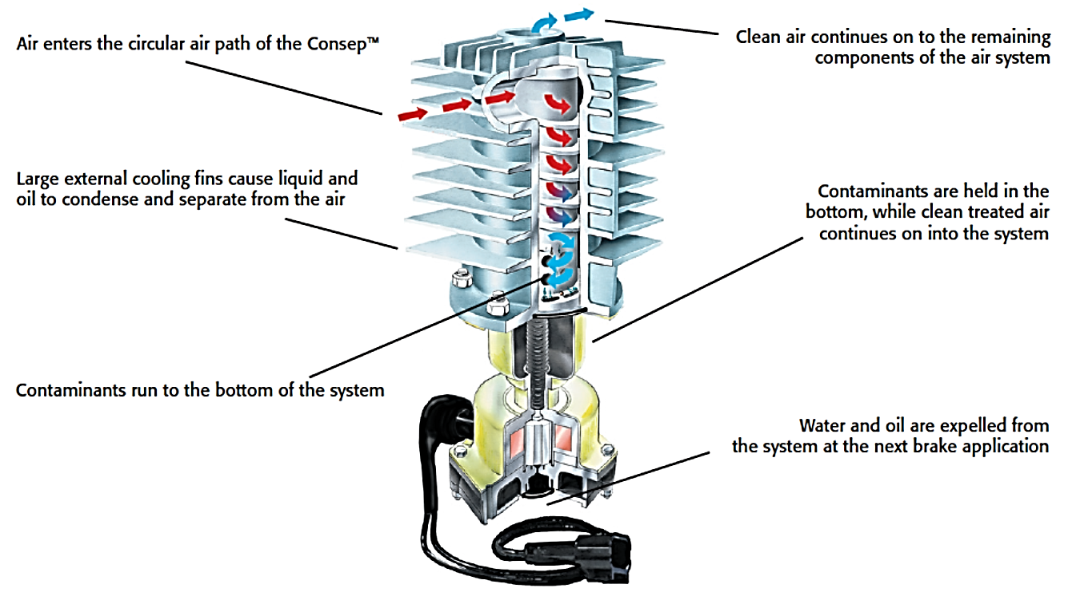
Haldex Consep

Slide 53
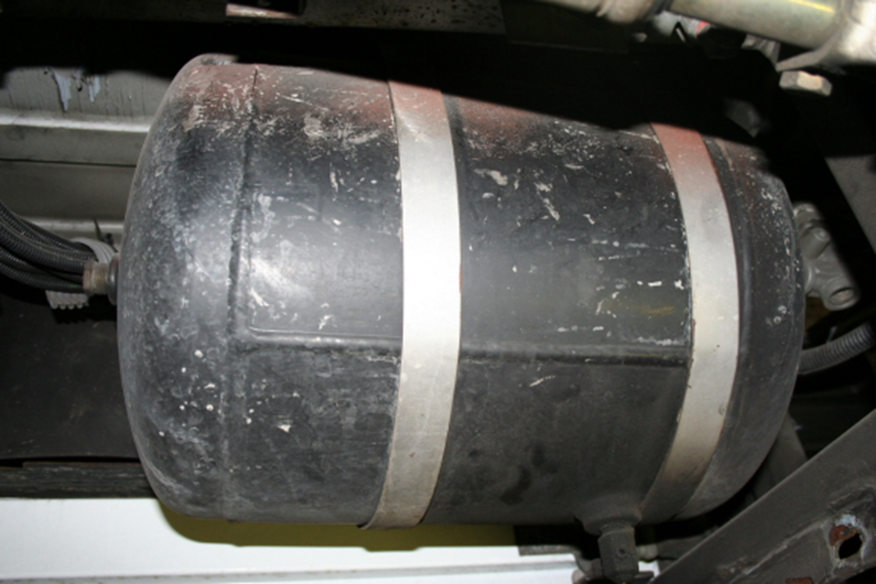
Air Reservoir
The reservoir is a storage tank
Provides volume of compressed air for braking or component operation

Slide 54
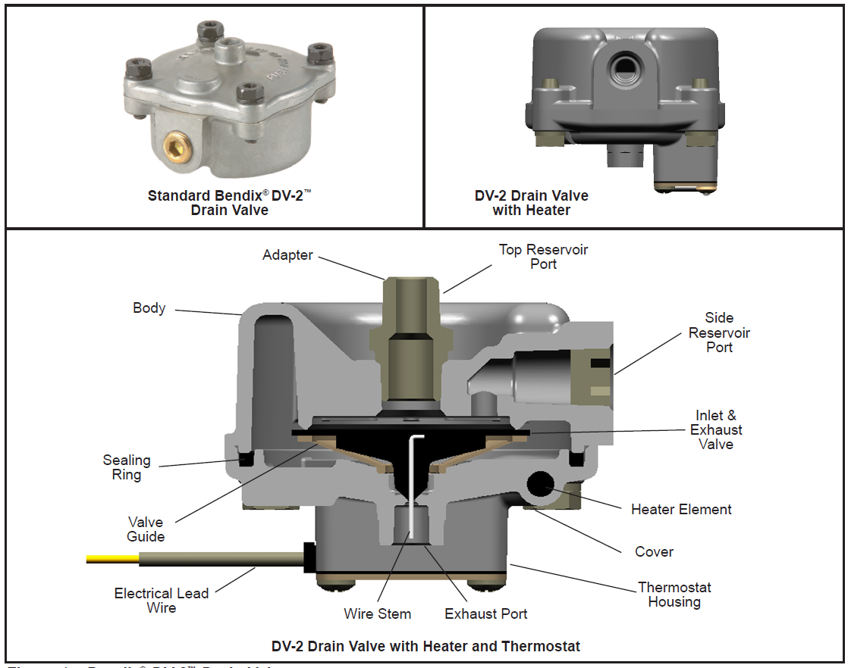
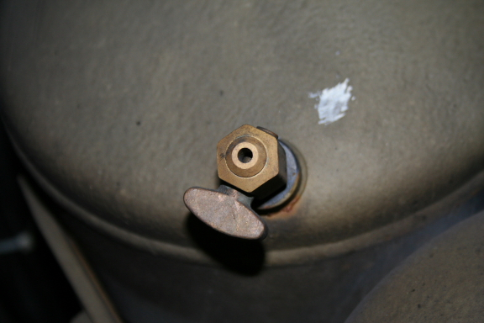
Reservoir Drain Valve
Air Reservoir Drain Valves can be manual or electronic and may contain heaters.
Typical Manual Drain Valve

Slide 55
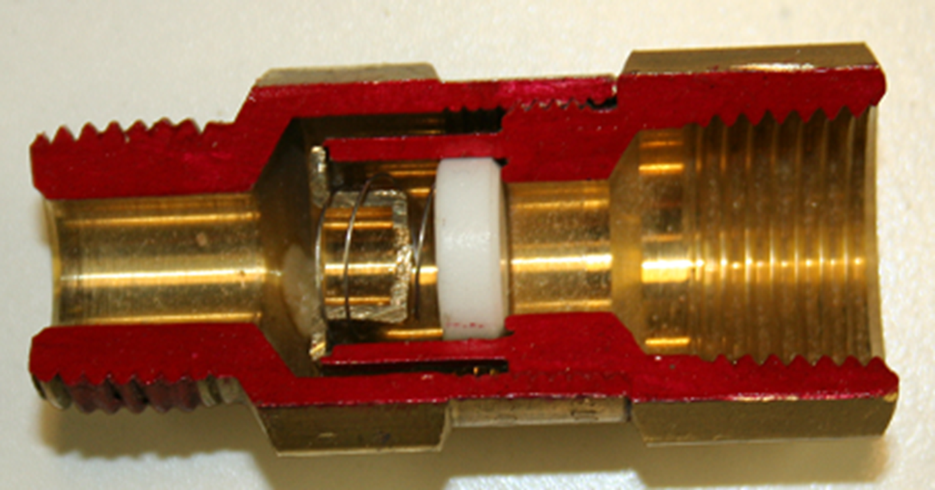
Single Check Valve
Allows air to flow in one direction only
Allows air to flow only when supply side pressure exceeds delivery side pressure
Protects air reservoir from air loss if supply air system looses pressure

Slide 56
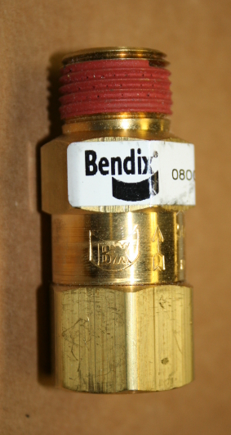
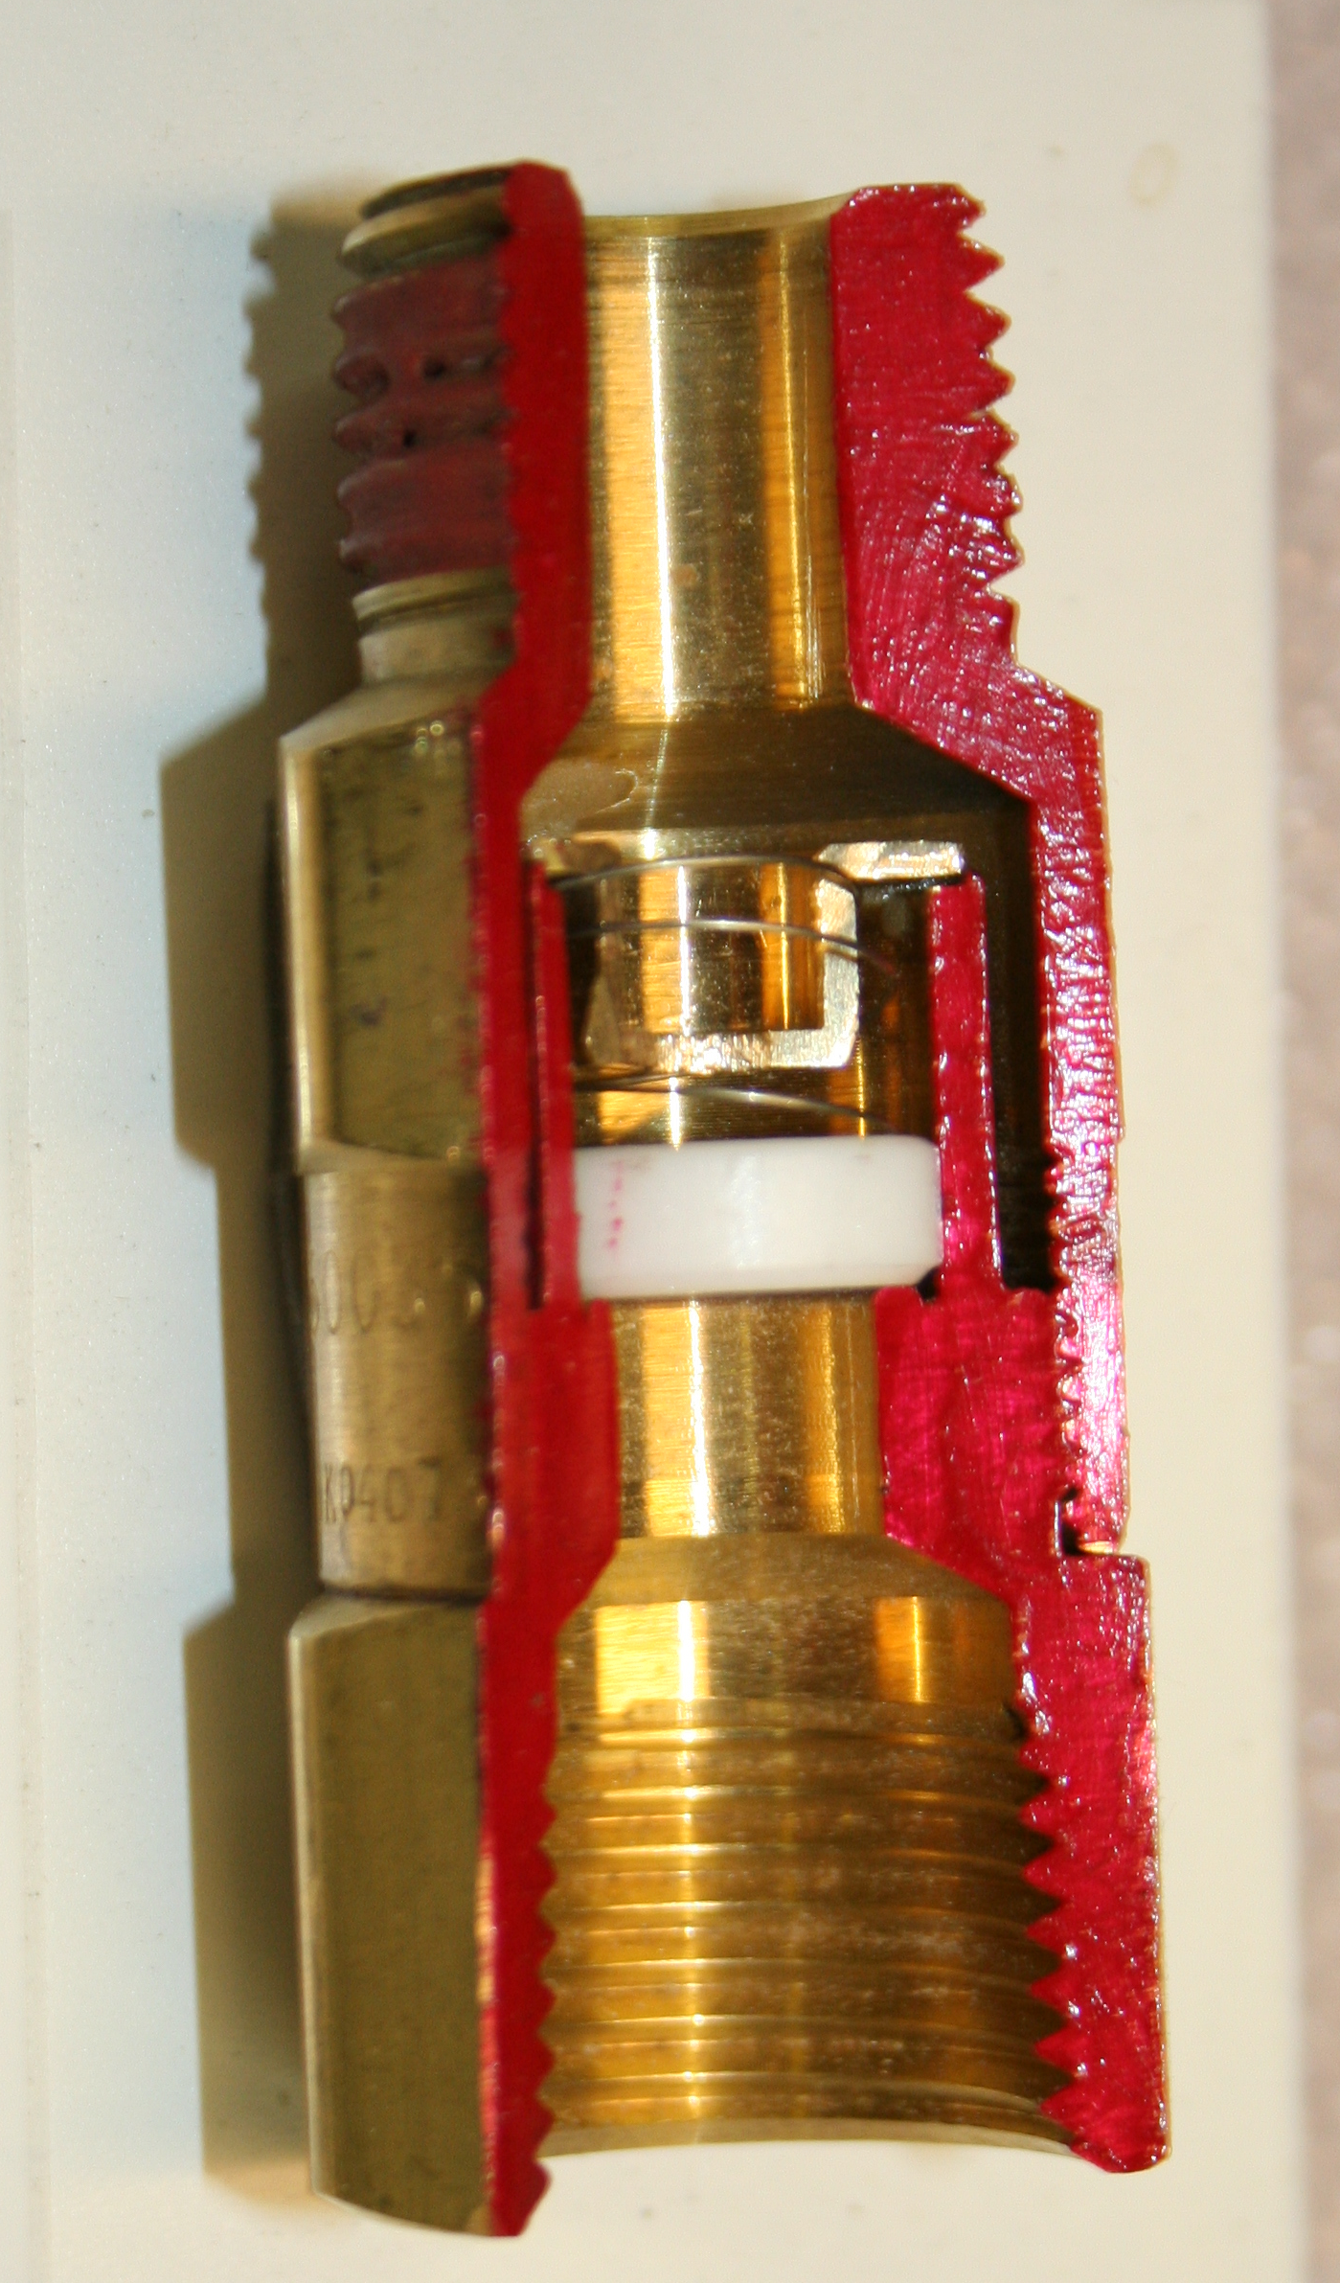
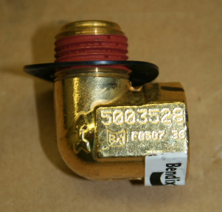
Single Check Valve

Slide 57
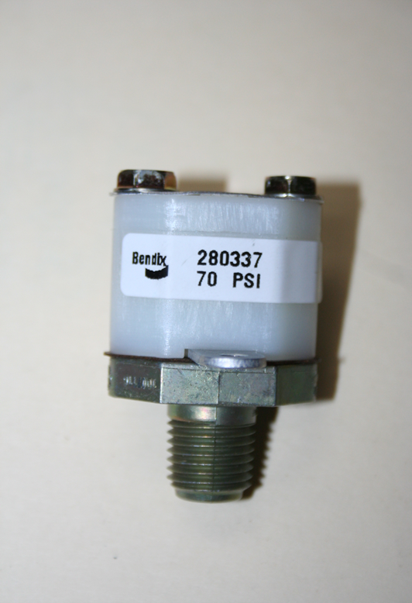
LP-3 Low Pressure Switch
Safety device designed to warn driver of low air pressure in the brake system
Operates low air warning light and buzzer
Minimum activation pressure is 60 PSI
Contacts open 15 PSI above activation pressure
Normally closed contacts
Continuity should be measured across contacts when no pressure is present

Slide 58
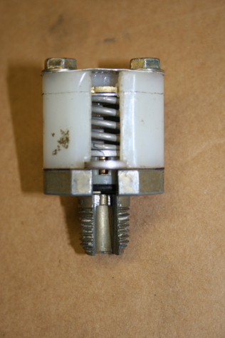
Low Pressure Switch
Air pressure works against spring tension
Contacts closed when air pressure is below spring pressure
Contacts open when air pressure is above spring tension

Slide 59
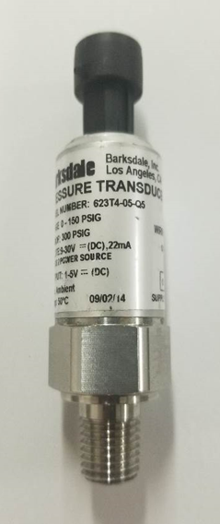
Pressure Transducer
The pressure transducers transmit an analog signal to the multiplexing system which the multiplexing system converts into pressure readings.
They are used for low air warning system pressure switches mounted directly to the brake system reservoirs

Slide 60
Pressure Transducer
They are used for brake lights and signal both the retarder system, brake interlock system and the brake drag system
Pressure range 0 – 150 psi
Supply voltage 10–32 VDC
Output voltage 1-5 VDC

Slide 61
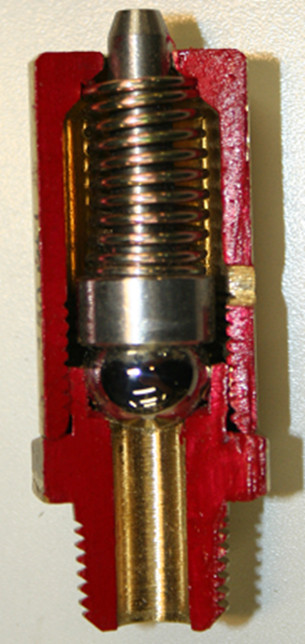
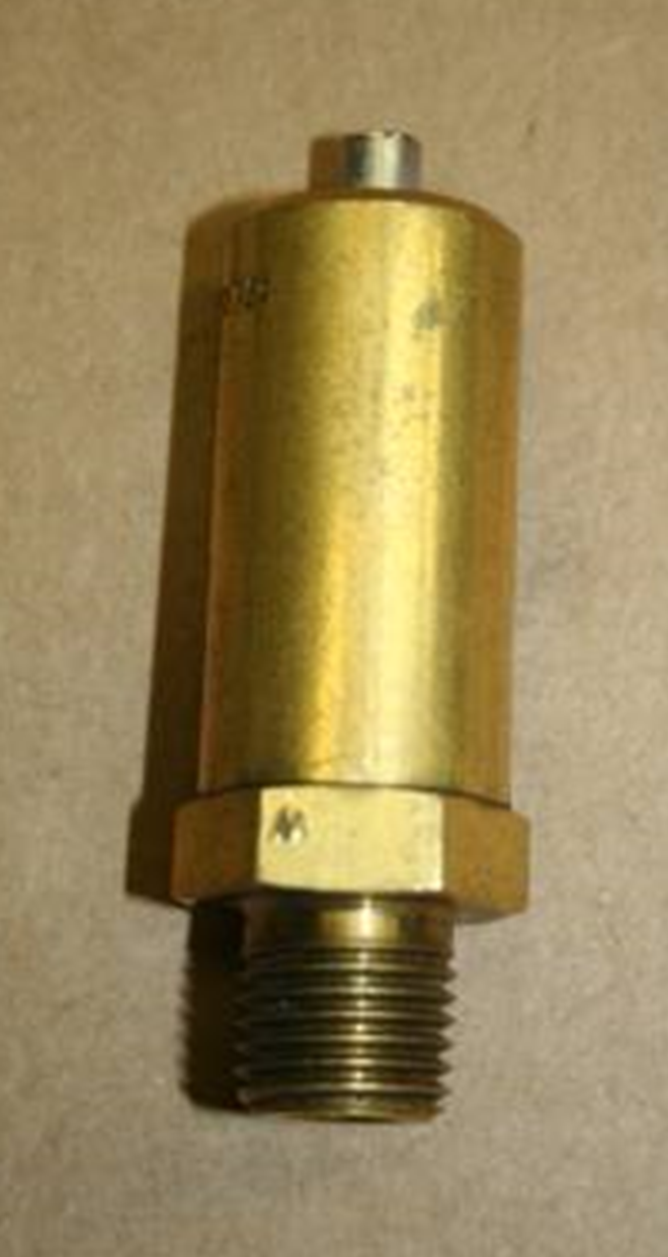
Safety Valve

Slide 62
Safety Valve
Protects air system against excessive air pressure build-up
Releases excess pressure to atmosphere
Located at areas of restriction
    150 PSI valve located on supply reservoir
175 PSI valve located on air dryer
250 PSI valve located on air compressor
Test by pulling up on stem at full system pressure

Slide 63
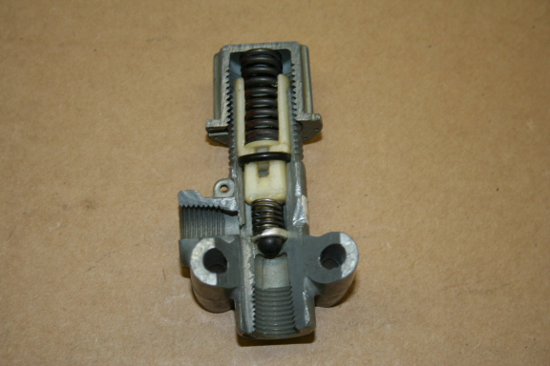
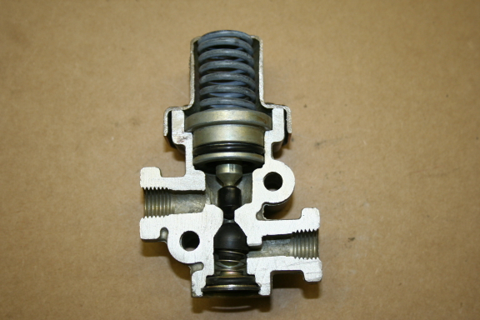
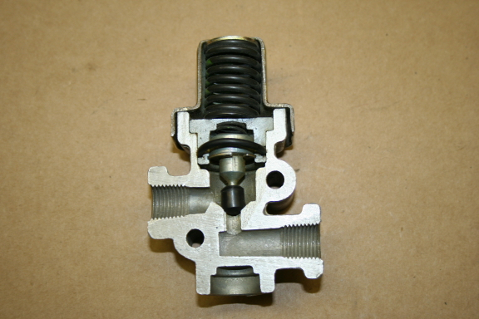
Pressure Protection Valves
PR-2
PR-3
PR-4

Slide 64

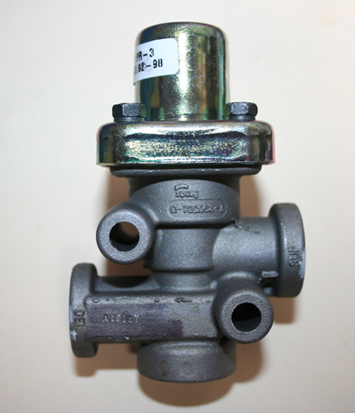
Pressure Protection Valve
PR-3
The pressure protection valve is a normally closed pressure control valve which can be referred to as a non-exhausting sequence valve.

Slide 65

Pressure Protection Valve
PR-3
PR-4
The PR-3 Pressure Protection Valve has check valve designed to retain maximum pressure in downstream reservoir

Slide 66
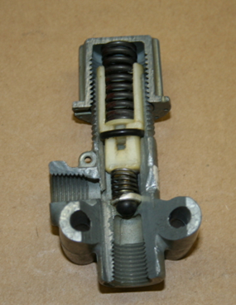
Pressure Protection Valve
PR-3
PR-2
The PR-2 Pressure Protection Valve is externally adjustable. The PR-3 and PR-4 pressure settings are fixed

Slide 67

Pressure Reducing Valves
Pressure Reducing Valves can be either adjustable or non-adjustable
RV-1 Adjustable
RV-3 Non-Adjustable

Slide 68
Pressure Reducing Valve
Delivery line pressure is allowed to flow unrestricted until supply pressure exceeds valve setting
When supply pressure exceeds delivery pressure, air pressure is regulated to predetermined setting

Slide 69

Pressure Reducing Valve
The RV-1 pressure reducing valve is used to reduce air pressure and maintain it at a constant specified pressure below that of the supply pressure
Supply port is located on the bottom of the valve and delivery port is located on the side

Slide 70

Pressure Reducing Valve
The pressure setting of the RV-1 pressure regulating valve is determined by the turning the adjusting cap, which exerts a force on the spring on top of the piston
Then passes out the delivery port
Compressed air enters the supply port

Slide 71


Pressure Reducing Valve
The RV-3 pressure reducing valve is a normally open pressure control device that reduces system air pressure and maintains a constant, specified, pre-set pressure on its output
The RV-3 pressure reducing valve is not field adjustable and is typically set at 70 psi ± 5 psi
Various pressure settings are available
Typically used for interlock air circuits

Slide 72

Dash Air Pressure Gauge
Duplex gauge measures primary and secondary brake reservoir pressure
Two single gauges can be used in place of a duplex gauge
Green needle shows primary pressure
Red needle shows secondary pressure

Slide 73

Dash Air Pressure Gauge
60’ Buses may have three air gauges; one each for front axle, middle axle, and rear axle brakes
Some buses may also have an auxiliary air gauge indicating accessory air tank pressure

Slide 74
Q & A

Slide 75
The APTA Bus Technical Maintenance Committee would like to thank you for joining our Webinar.
Please join us for the next Webinar in the series which will cover the Air Control System, followed by Air System Troubleshooting.
Keep an eye out for a survey on today’s webinar!
Pictures, drawings and technical information courtesy of Custom Training Aids, LA Metro, Bendix, Haldex, MAN, ZF, Meritor, Knorr-Bremse, MGM Brakes, New Flyer, Jacobs, Link Engineering, Expello, and other members of the APTA Brake and Chassis Work Group

Slide 76



Related APTA Standards
APTA BTS-BC-RP-005-10, Rev. 1: Troubleshooting Common Transit Bus
S-cam and Air Brake Complaints
APTA BTS-BC-RP-006-17: Transit Bus Air Disc Brake Operation and Wheels On Inspection
APTA BTS-BC-RP-007-17: Transit Bus Air Disc Brake Wheel Off Inspection and Reline
For additional resources visit: https://www.apta.com/research-technical-resources/standards/bus-transit-systems-standards-program/

