Slide 1
2019 APTA Workshops
World of Customer Care
Leveraging Social Media to Enhance the Customer Experience Through Backtracking and Outreach
Mark Bariglio – Director, Customer Service Department
Dennis Zorzi –Technology Supervisor, Customer Service Department

Slide 2
Social Media in Call Centers
Areas of Focus
Background
Who We Are
Staying Engaged
Processes
Social Media in SEPTA
Daily Activity
Daily Assignments
Types of Outreach
Current S.M. Team
Customer Outreach
Goals
Response: Positive & Negative
Look Beyond the “@”
Read Everything
Takeaways
Broaden Your Scope

Slide 3
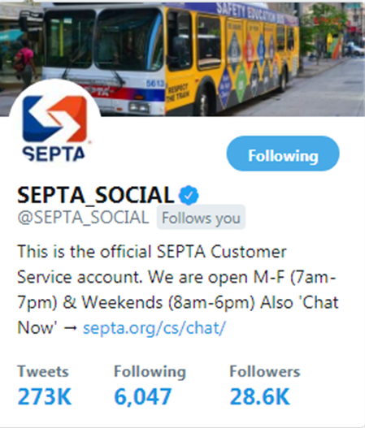
Background
Who We Are
SEPTA = Southeastern Pennsylvania Transportation Authority
6th-largest U.S. rapid transit system
Services Philadelphia and surrounding counties
FY 2018 Ridership 303 Million Trips
Multi-Modal Service:
Bus (150 Lines)
Trolley (8 Lines)
Light Rail (3 Lines)
Regional Rail (13 Lines)

Slide 4
Background
Social Media in SEPTA
Customer Service began a pilot to monitor Social Media chatter in June 2012
Launched as a full engagement platform in January of 2013 with the creation of @SEPTA_SOCIAL
In June of 2016, SEPTA began full engagement on a second Twitter via @SEPTAKey
Facebook: SEPTA
(CS engages w/users)
Social Media Monitoring
Twitter: ISEPTAPHILLY
Twitter: @SEPTA_SOCIAL
Instagram: SEPTA_Social
Facebook: SEPTA (No engagement)
Facebook: ISEPTAPHILLY
Twitter:
@SEPTAKey
Twitter Alerts & Advisories
Instagram: ISEPTAPHILLY
Dec. 2008
February 2011
September 2012
June
2012
September 2012
January 2013
May 2013
May 2013
February 2015
June 2016

Slide 5
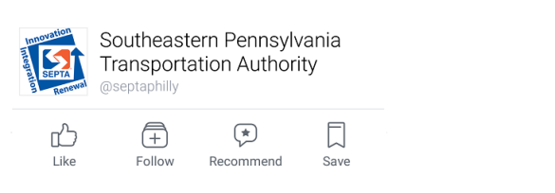
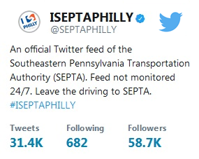
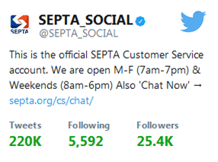
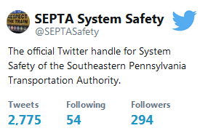
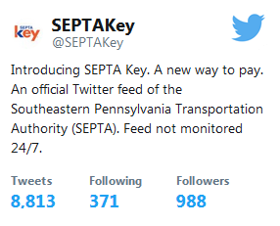
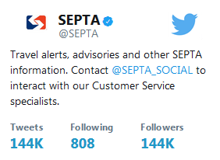
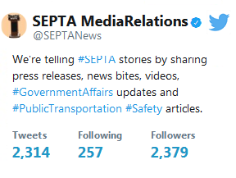
Background
Social Media in SEPTA
COMMUNICATIONS
MARKETING
CUSTOMER SERVICE
CONTROL CENTER
MEDIA RELATIONS

Slide 6
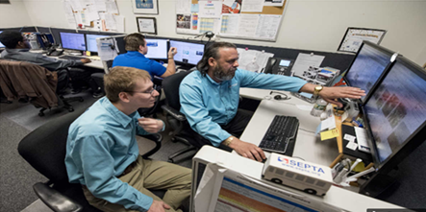
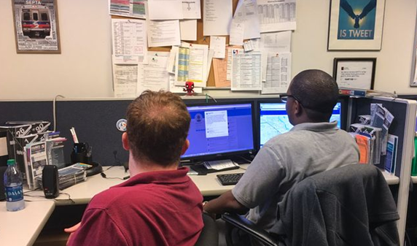
Background
Current Social Media Team
Started with 2 Social Media Specialist….grown to the current 6
Highly knowledgeable of SEPTA service area
Bus (150 Lines)
Trolley (8 Lines)
Light Rail (3 Lines)
Heavy Rail (13 Lines)
Consistently interact with other departments:
Operations/Control Center
Marketing
Media Relations
Hours - Social Media operates:
M-F 7am-7pm
8am-6pm Sat & Sun

Slide 7
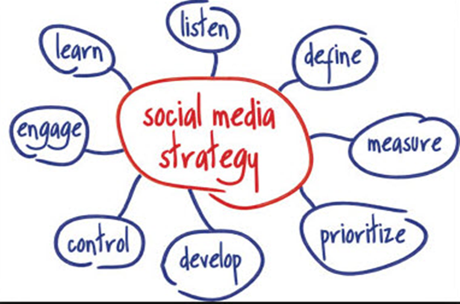
Stay Engaged
Processes
Monitor….Listen to everything
Engage everyone including difficult customers:
Lateness – Detours –– Annulments
Rate of Response – SM needs to be quick
Develop a relationship with our followers:
Try to provide a personal experience

Slide 8
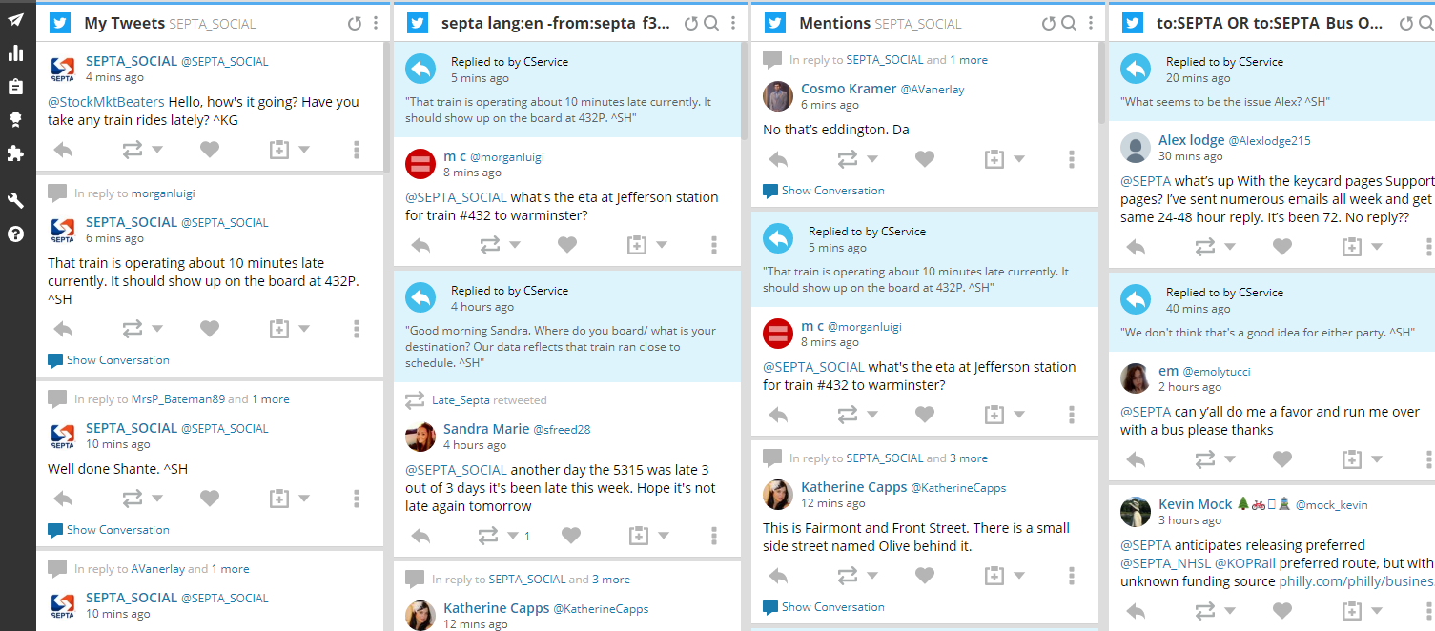
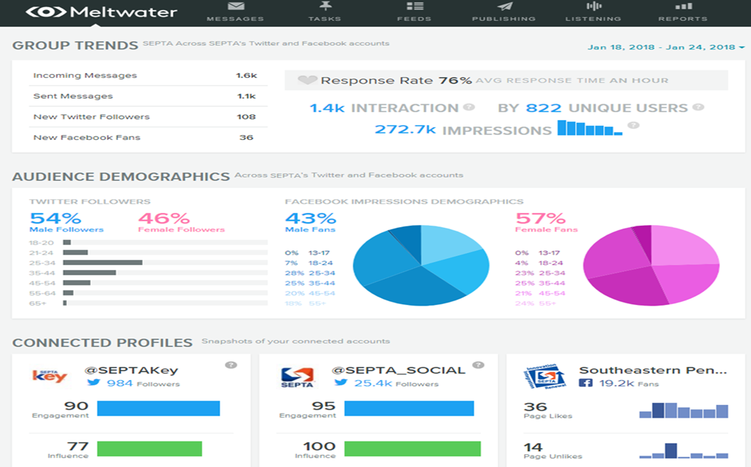
Stay Engaged
Processes
Monitoring Tools
Hootsuite
Meltwater

Slide 9
Stay Engaged
Daily Activity
Average Weekday Twitter Activity
Daily Assignments

Slide 10
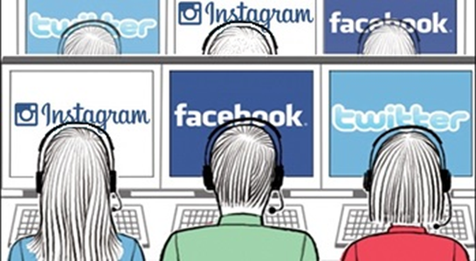
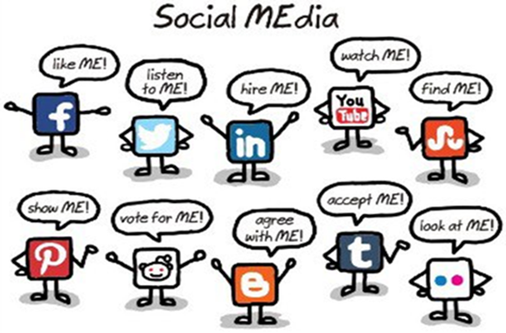
Stay Engaged
Daily Assignments
Engagement Posts
Broadcast & Announcement Posts
Backtracking (After Hours Review & Customer Outreach)

Slide 11
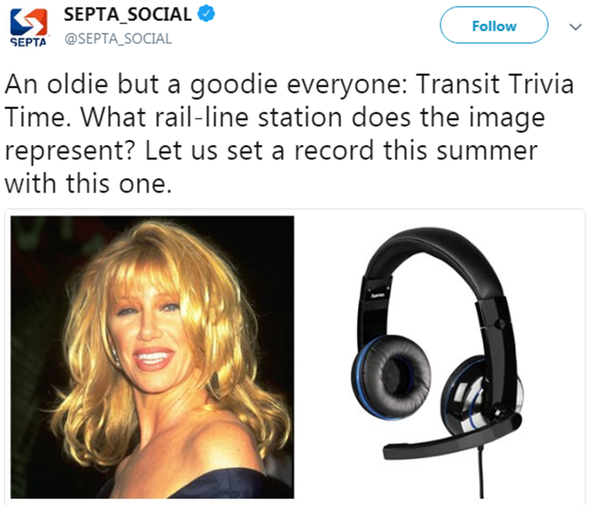
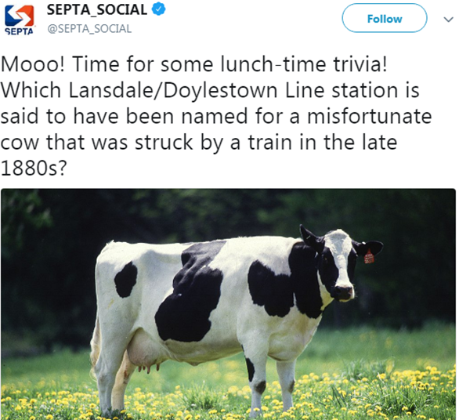
Stay Engaged
Daily Assignments
Engagement Posts
Posts that the team puts out to engage our customer base, such as Trivia, Riddles, Instagram stories or polls asking customers transit related questions.
The team targets sending at least 3 per week.

Slide 12
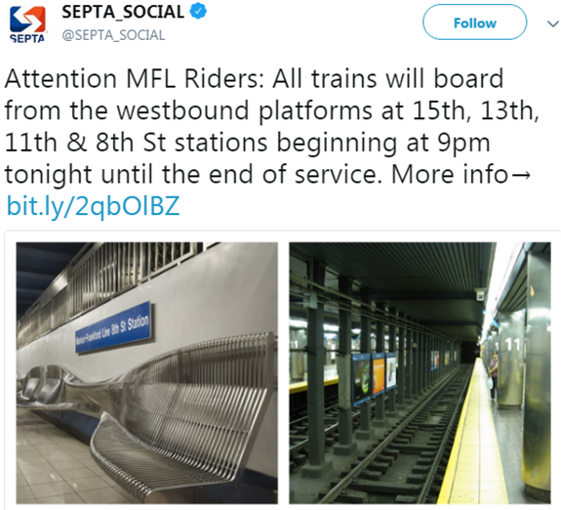
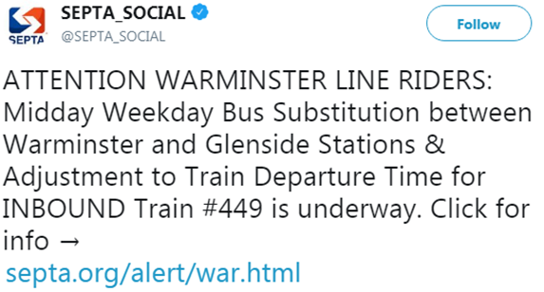
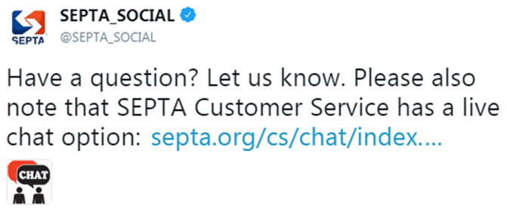
Stay Engaged
Daily Assignments
Broadcast & Announcements Posts
A message is posted to provide our customers with information about:
An upcoming schedule change
Service advisories
Tools or services, such as the App or our Live Chat feature
The team targets sending at least 7 messages per week.

Slide 13
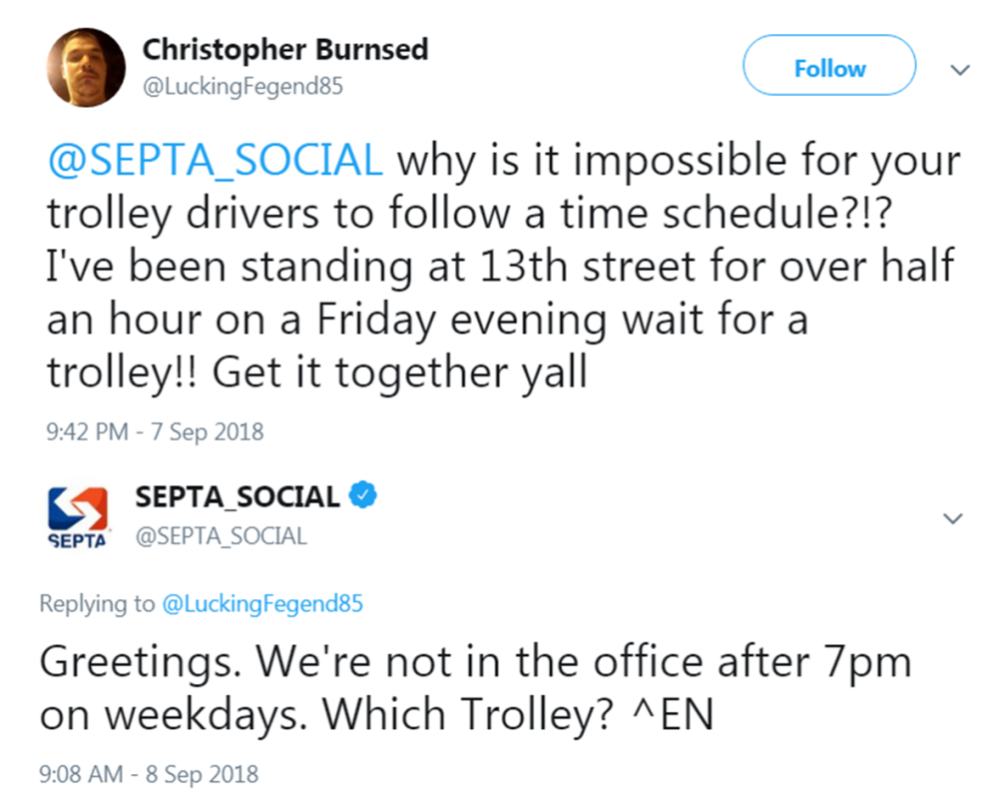
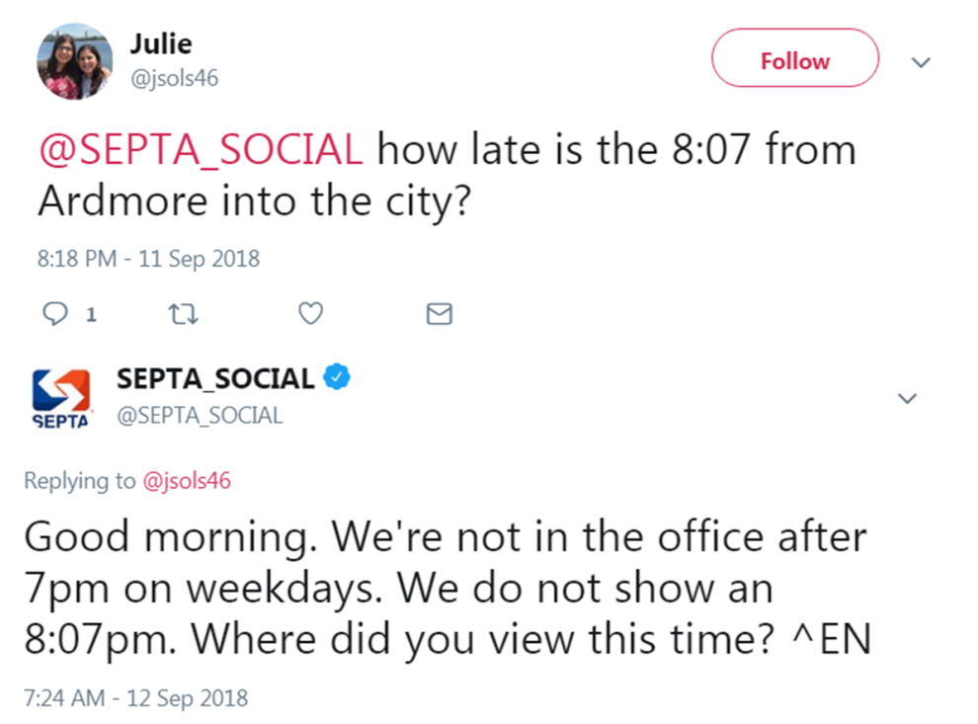
Stay Engaged
Daily Assignments
Backtracking – Review After Hours Mentions
Going back and searching throughout our social media handles to look for posts that came in after-hours, so that we can make sure that we catch any incoming posts that we missed.
The team does this daily.

Slide 14
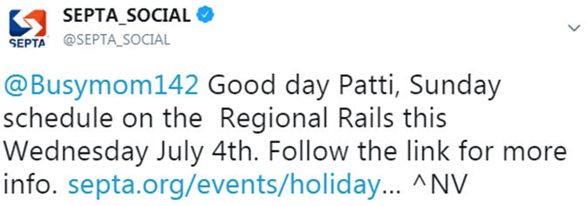
Stay Engaged
Daily Assignments
Backtracking – Customer Outreach
In addition to our real-time responses, the team has a standard practice of following up with past contacts. This provides customer relationship advantages not available via other communication channels within the CS Contact Center.
The team targets sending out at least 5 messages per week.

Slide 15
Customer Outreach
Goals
Goals of Customer Outreach:
Foster customer loyalty
Stimulate conversations
Opportunities to enhance customer intelligence
Gather customer experience data

Slide 16
Customer Outreach
Types of Outreach
Types of Tweets We Send:
Upcoming Projects or Major Changes to Service
Personally notify/remind individual customers of events that will impact their specific route, based on their conversation history. Events such as infrastructure projects, schedule changes, holiday schedules in effect, etc.
“Long Time, No Tweet” Customers
Identify users who have mentioned us in the past, but have not mentioned us recently.
This reminds customers that we are here to address any inquiries and issues they may have.
Service Disruption Follow-Up
Kindly follow up with customers who stated they were directly impacted by a recent service disruption.
Express empathy, an explanation and reassure SEPTA is committed to minimizing future incidents.

Slide 17
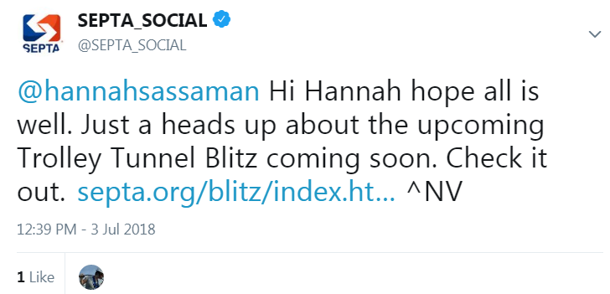
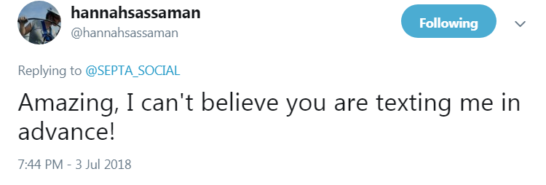
Customer Outreach
Types of Outreach
Types of Tweets We Send:
Upcoming Projects or Major Changes to Service
Personally notify/remind individual customers of events that will impact their specific route, based on their conversation history. Events such as infrastructure projects, schedule changes, holiday schedules in effect, etc.

Slide 18
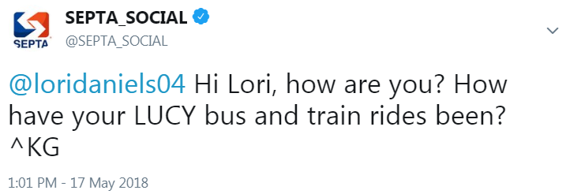
Customer Outreach
Types of Outreach
Types of Tweets We Send:
“Long Time, No Tweet” Customers
Identify users who have mentioned us in the past, but have not mentioned us recently.
This reminds customers that we are here to address any inquiries and issues they may have.

Slide 19
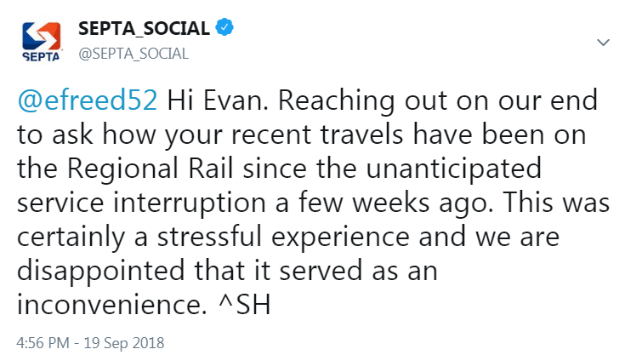
Customer Outreach
Types of Outreach
Types of Tweets We Send:
Service Disruption Follow-Up
Kindly follow up with customers who stated they were directly impacted by a recent service disruption.
Express empathy, an explanation and reassure SEPTA is committed to minimizing future incidents.

Slide 20
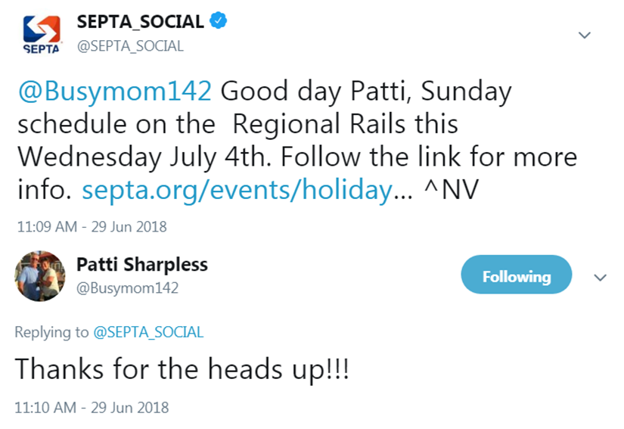
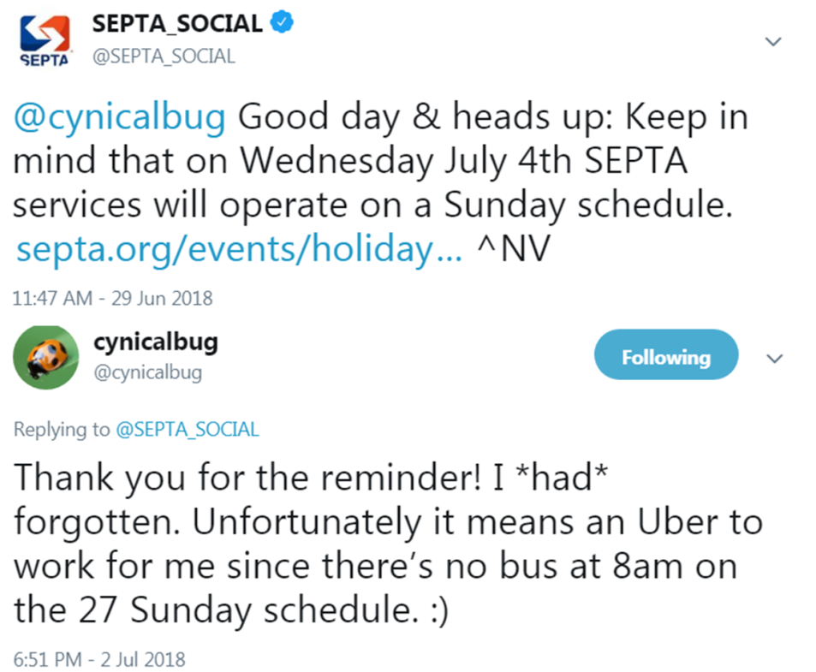
Customer Outreach
Positive Results
Customer Outreach for a Regional Rail
special schedule change:

Slide 21
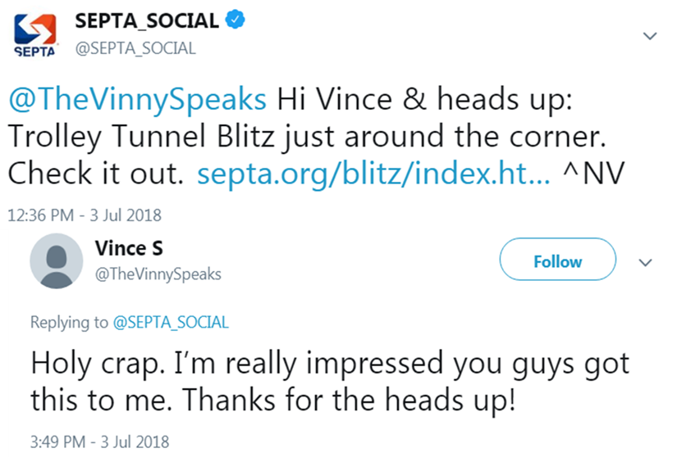
Customer Outreach
Positive Results
Customer Outreach for an upcoming event
affecting Trolley service

Slide 22
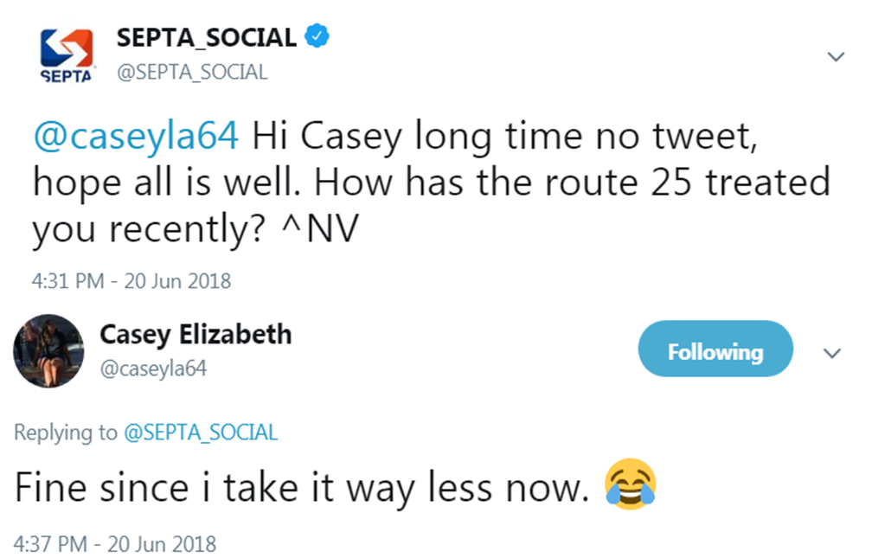
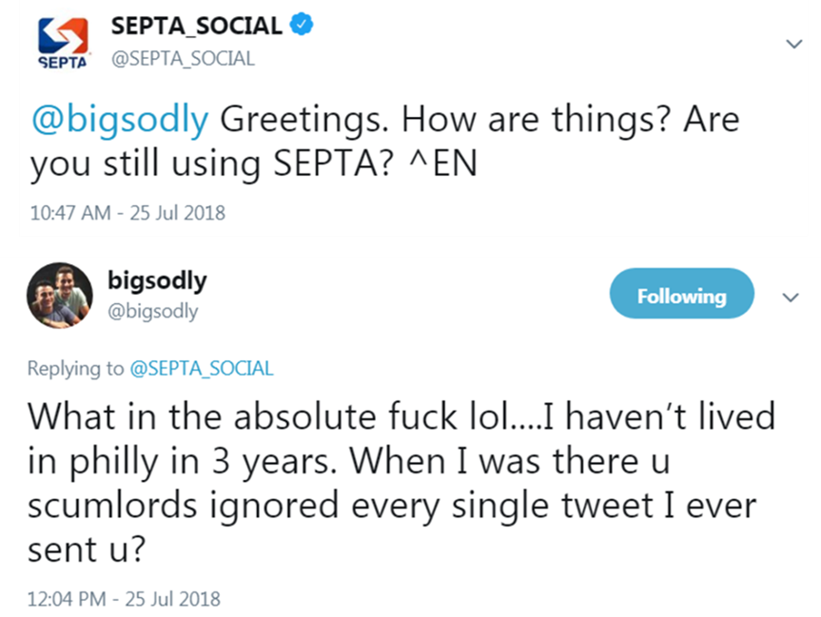
Customer Outreach
Negative Results
Customer Outreach that was not well received:

Slide 23
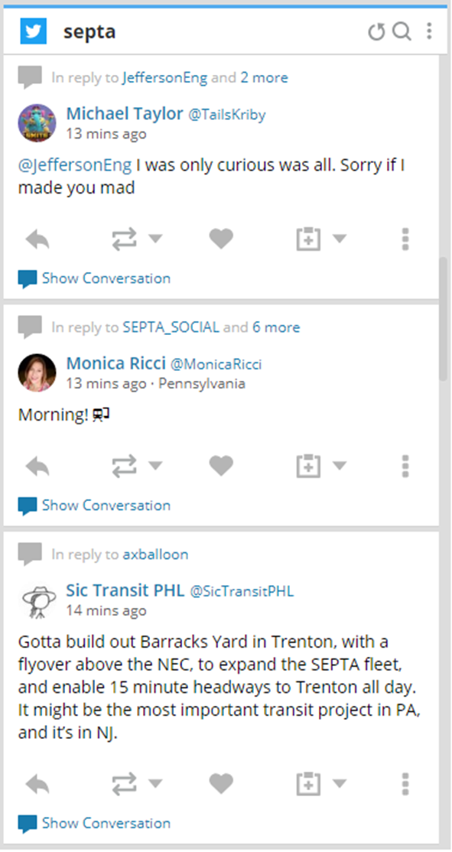
Broaden Your Scope
Looks Beyond the “@”
Monitor your Mentions:
Do not just wait for customers to send things directly to your handle, there are several ways and tools available that allow you to see customers who mention either your company name or a product.

Slide 24
Broaden Your Scope
Read Everything
Look Beyond Twitter:
While almost 85% of our interactions occur on Twitter, our team is daily checks on:
Facebook
Instagram
Blogs and discussion forums
New blogs pop up often, and can contain important customer questions or opinions.
(Blogs & Forums)

Slide 25
Broaden Your Scope
Takeaways
Stay Engaged:
Make efforts every day to reach out to your customer base
Connect with your customers:
Find things to open up conversations
Broaden Your Scope:
Do not limit your view to just the customers who come to you

Slide 26
Thank You

