Slide 1
ENGAGING LIMITED-ENGLISH PROFICIENT CUSTOMERS
2019 APTA Marketing and Communications Workshop
Hendy Satya | Foothill Transit

Slide 2
Pomona and San Gabriel Valleys (eastern Los Angeles County)
About Foothill Transit
37 fixed route local and commuter bus lines
14 million rides per year
373 total buses
(30 electric buses)

Slide 3
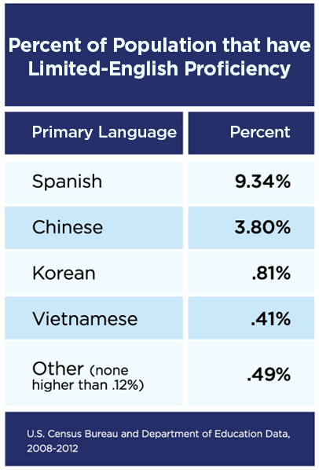
About Our Customers
Title VI
Majority of our customers speak English
98.29% total English, Spanish, and Chinese speaking households.

Slide 4
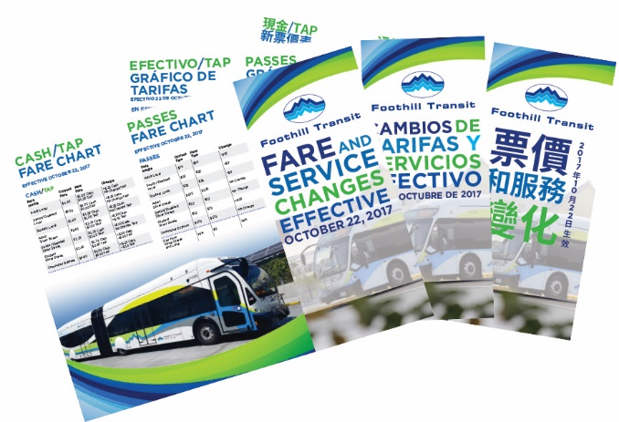
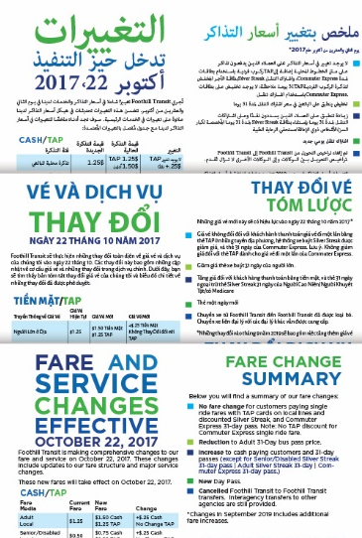
Marketing Collateral
Brochures
Flyers
Bus Stop
Transit Store

Slide 5
Interior
Bus Cards
& Advertising

Slide 6
In-house staff assistance with interpretation at:
Engagement Events
Workshops
Bus Stop Tours
Transit Centers
Community Centers

Slide 7
Provide support in multiple languages via 1-800-RIDE-INFO
Customer Service
Spanish Speaking Agents
Interpretation Services

Slide 8
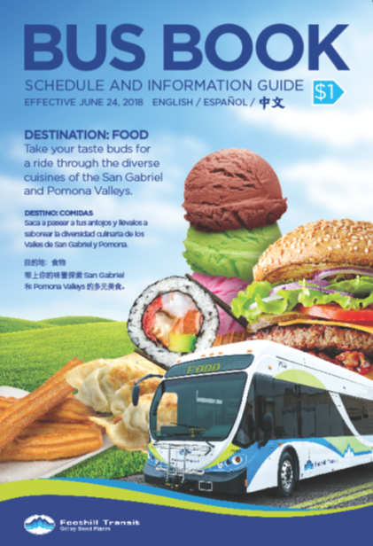
Bus Book and Website

Slide 9
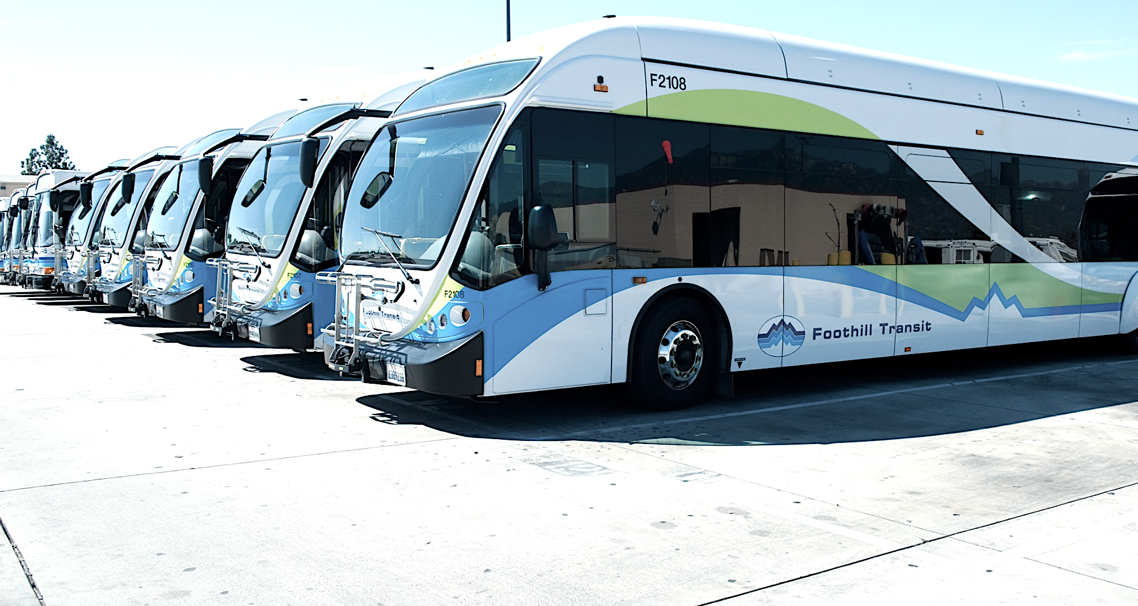
THANK YOU! I will be happy to answer any questions.
HENDY SATYA | hsatya@foothilltransit.org

