Slide 1
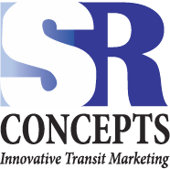
Have you ever implemented a marketing program or introduced a new route with disappointing results?
Conducting simple research first will help you develop and produce successful marketing strategies and materials.

Slide 2
Design by Research: Steps to Success
RESEARCH:
Before – Determines:
What customers want and how to make it easy for them to use your service.
After – Determines:
Effectiveness of the service and of the products developed.

Slide 3
1 – Identify the Challenge
2 – Research & Assess
3 – Develop the Product
4 – Review the Results
5 – Expand Your Horizons

Slide 4
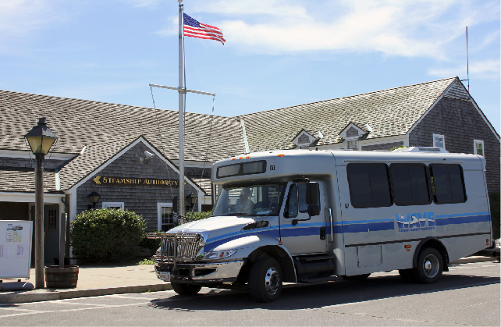
Identify the Challenge
Making Things Happen…FAST!
The Fast Ferry Connector
Introduction of a new route: The Fast Ferry Connector to alleviate parking around the ferry terminals on Nantucket
Privately funding by local businesses.
Requested by public officials
30 days to make it all happen

Slide 5
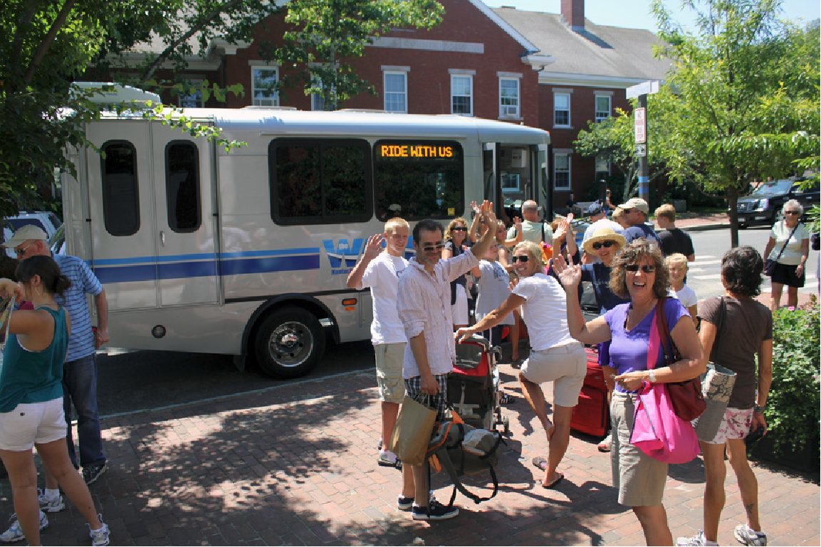
Research and Assess
Public Outreach
Study conducted by the University of Connecticut.
Previous on site and on line surveys of passengers
Contest to rebrand the system

Slide 6
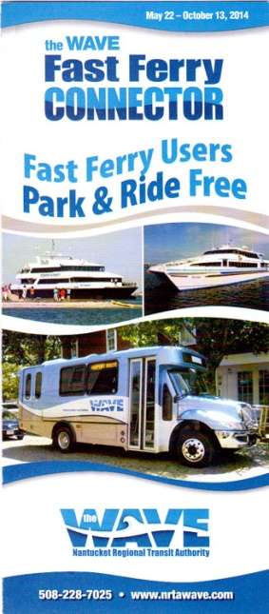
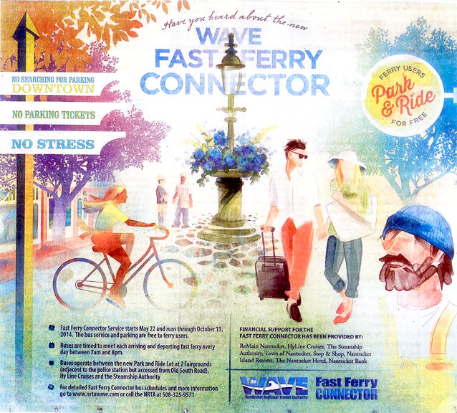
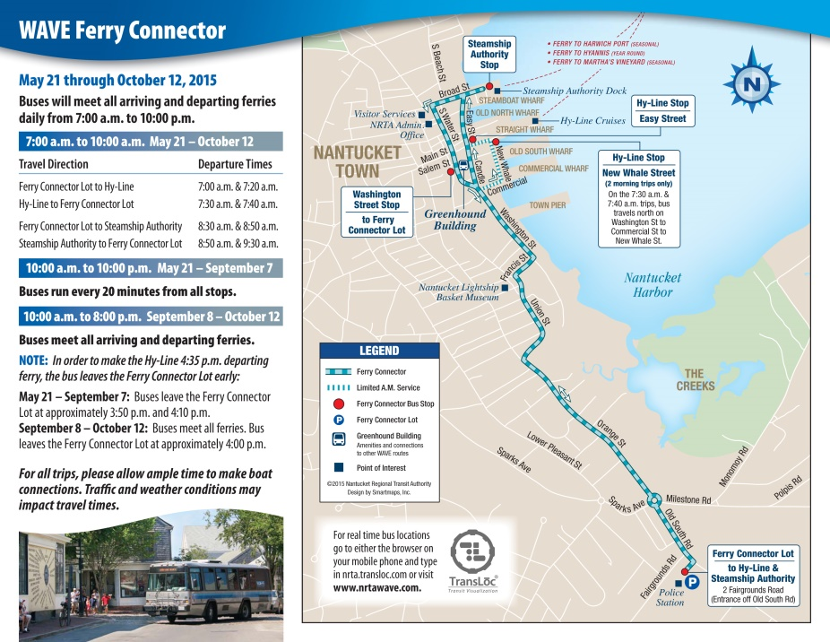
Develop the Product
Fast Ferry Connector Products – Year 1

Slide 7
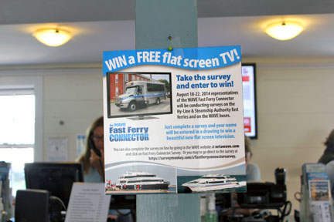
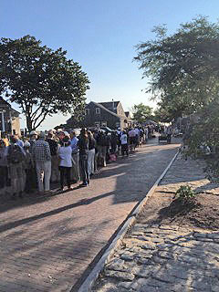
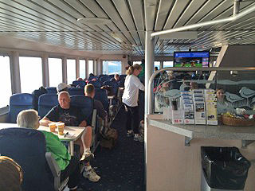
Review the Results
Public Follow Up
Follow up research project to determine effectiveness of new service and products.
Surveys on board the ferries/buses/on the street/online.

Slide 8
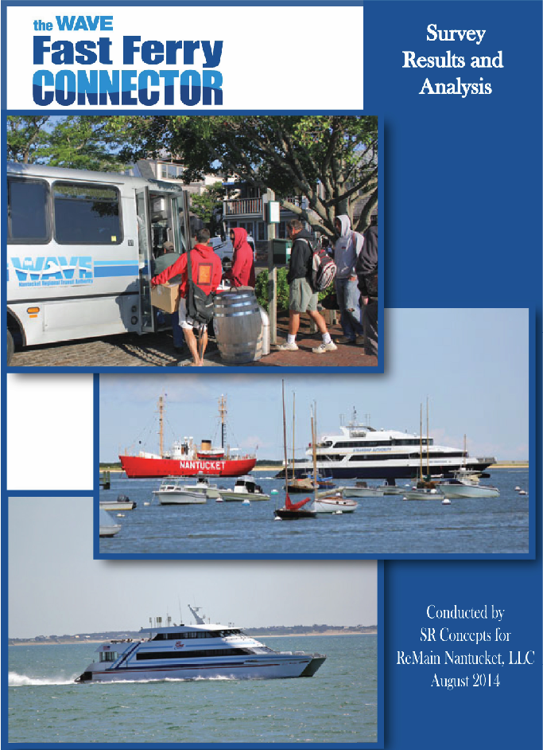
Review the Results
Review the Results
Results – Year 1
Ridership steadily increased over a 4 month period
Increased visibility and knowledge of the service/amenities
Stakeholder support continued for a second year
Identification of more effective marketing strategies
Refining the service to address customer needs

Slide 9
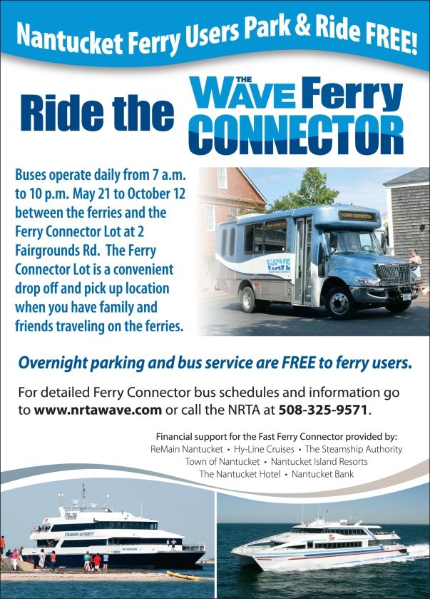
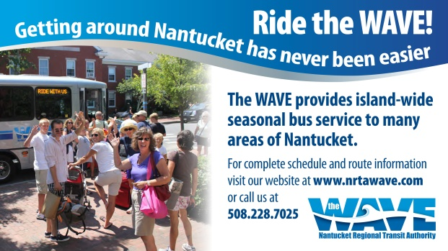
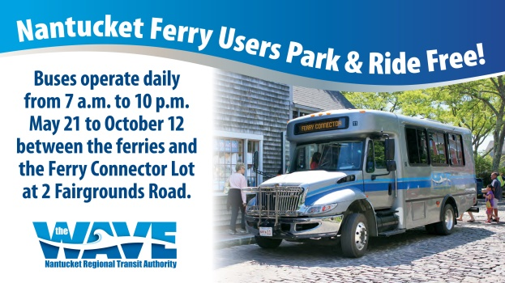
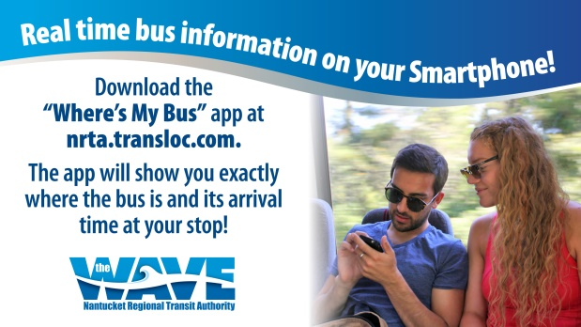
Expand Your Horizons
New and Improved – Year 2
The WAVE Ferry Connector
Change in service requiring new name and product updates
Print and web ads with new information
Brochure about service changes
On-board flyers, posters and boat monitor ads

Slide 10
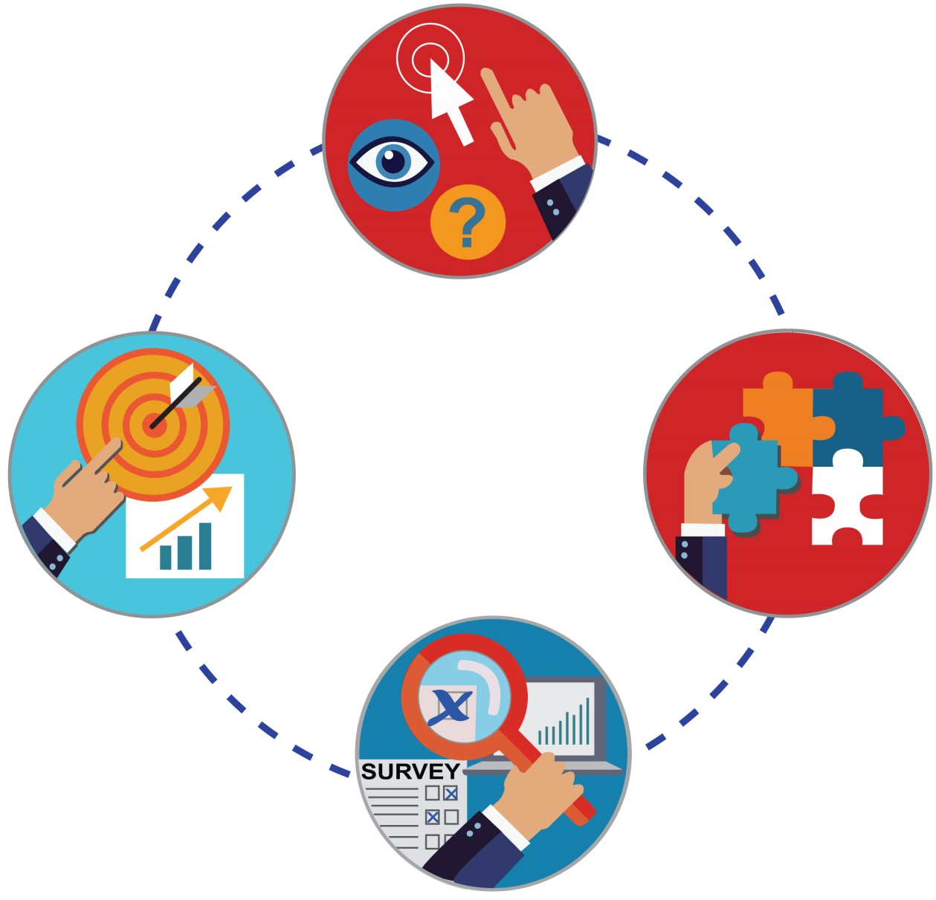
Design by Research: Steps to Success
1
Identify the Challenge
2
Research & Assess
4
Review
the Results
3
Develop
the Product

