Slide 1
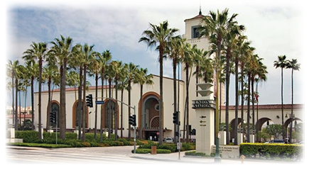
Exercise Station Guardian 2016 Crisis Communications Case Study
Dave Sotero, Communications Manager
February 27, 2017

Slide 2
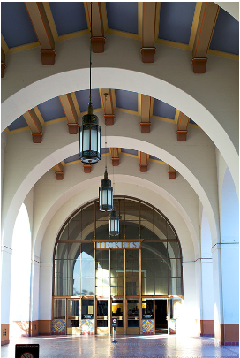
About Metro
Los Angeles County Metropolitan Transportation Authority
Third largest transit agency in the U.S.
1.2 million riders per day on Metro Bus and Rail System
170 bus routes
105 miles of rail lines
Union Station “Last of Great Train Stations”
Largest public transportation hub in L.A. County
90,000+ passengers per day
480 trains arrive/depart on a daily basis
Transit agencies/facilities are soft targets
Identified by DHS, FBI, LASD, LAPD
Threats pose potential impact across Southern California

Slide 3
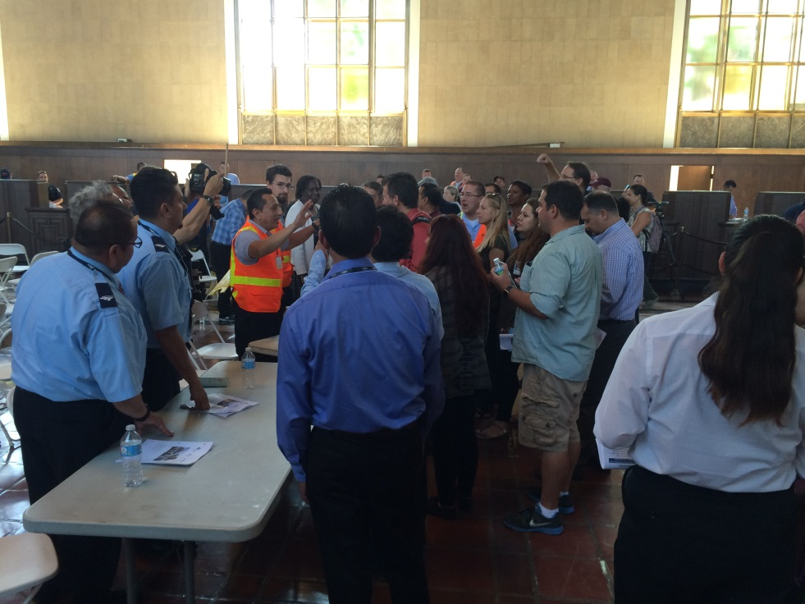
Exercise Station Guardian 2016
Objective
Full-scale exercise to test Emergency Action Plan
Active shooter scenario
Focus on post-tactical response, recovery and evacuation
Exercise applies to all types of emergencies
Scenario
Three fatalities, 18 injuries
Evacuation, shelter in place, triage/treatment/transport
Mass care services, family assistance center, traveler assistance center
Exercise partners: Metro, Los Angeles Union Station, Morlin Asset Management, LP

Slide 4
The Crisis Communications Challenge
“This is only an exercise”
Exercise conducted at start of morning rush hour period
Alert public but do not create a panic
Reassure public that agencies have received no threats to Union Station
Reiterate Union Station is safe and all agencies working together
Counteract false media reports and social media rumors in real time

Slide 5
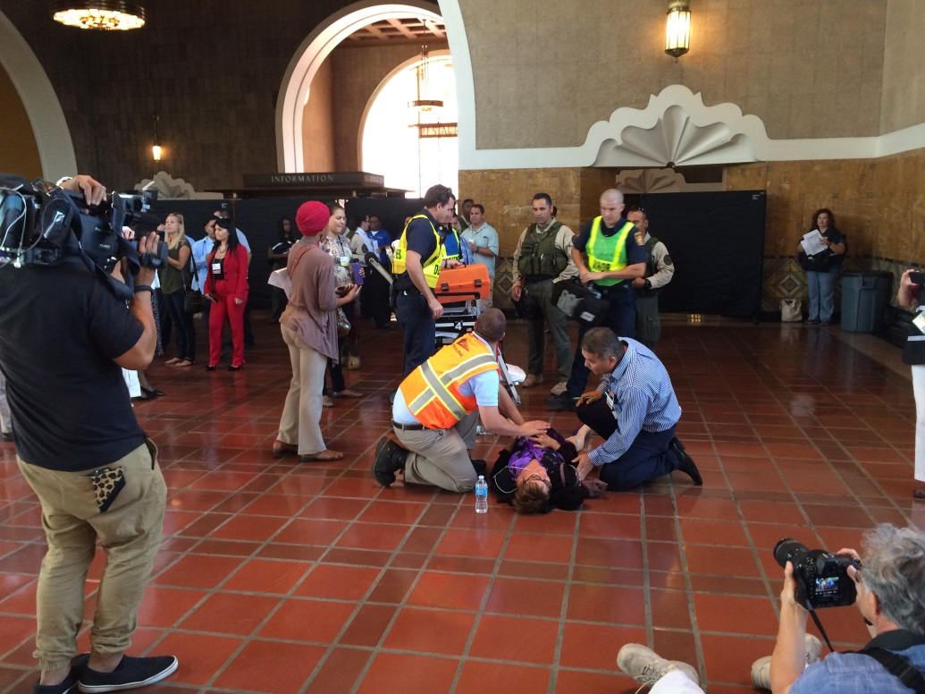
Crisis Communications Approach
Get in front of the message
Give reasonable advance notice
Develop media & public information plan
Invite news media to observe actual exercise
Activate Joint Information Center
Establish Twitter handle specifically for exercise
Immediately stage post-exercise media briefing with major agency partners to confirm scenario

Slide 6
Exercise Station Guardian: Key Takeaways
Set expectations for messaging early
Develop robust social media strategy with pre-made tweets and reminders
Engage media outlets to ensure realistic scenario and accurate reporting
Involve all participating PIOs and give them a task or responsibility
Activate Joint Information Center to rehearse Unified Command protocols
Post-exercise press conference

Slide 7
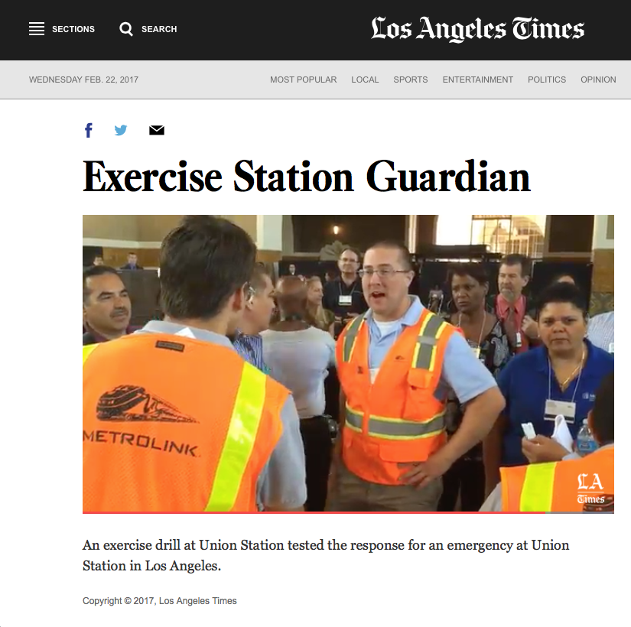
Results
No negative media coverage
No social media viral rumors
Media focused on actors and scenario, not risk
Metro, agency partners shown as proactive and prepared

Slide 8
Thank you
Dave Sotero
Communications Manager
Los Angeles County Metropolitan Transportation Authority
soterod@metro.net
www.metro.net

