Slide 1
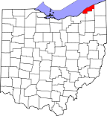
Lake County, OH
30 miles east of Cleveland
Population: 290,000

Slide 2
Dial-a-Ride
Local Routes
Park-n-Ride
Ridership – 765,000
315,000 – Local Routes
290,000 – Dial-a-Ride
160,000 – Park-n-Ride
Employees – 186 (140 drivers)
Buses – 120 (80 paratransit, 18 local routes, 22 coach)
Notes:
Background

Slide 3
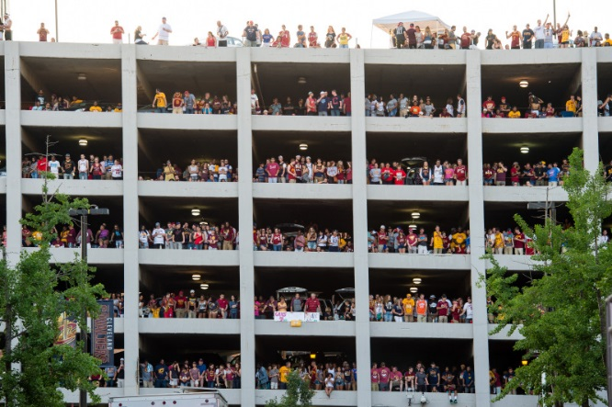
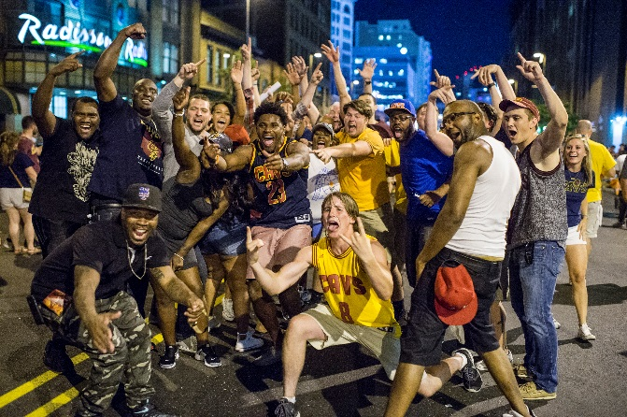
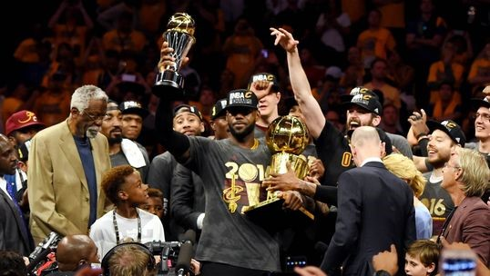
Sunday, We are the Champions
June 19
11:00pm
Notes:
Share a story about why social media is important – It all started on June 19 last summer. We were the Champions of the World…52 years in the making…
My GM always prioritized our media presence – traditional media/PR…. but never valued the impact of social media and completely recognized the 24/7 news cycle

Slide 4
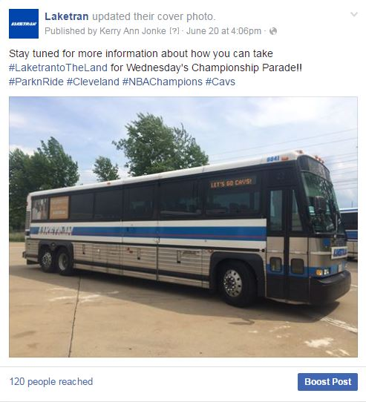
Monday,
June 20
2:30
Notes:
City announced Championship parade will be Wednesday – no other details.
There was a lot of anticipation about parade details…. Adding to suspense... No website… (average daily hits 330 and had 635 visits) -- went to social platforms to communicate.
Developed more concrete plan Monday – Found 14+ extra drivers to work 12+ hour shift, wristbands, megaphones, barricades, water/snacks for 12+ hour day, set-up security, Eastlake/Mentor, baracades, fuel and prep 14 1998 MCIs, pre write press release, charged extra radios,
Prepped signage, driver memos about destinations signs, routes, fare payments..

Slide 5
Tuesday morning
Notes:
Phone calls and web traffic was overwhelming… we needed to put something out to the public.
Created script for customer service…. Nothing is official until parade route is released.

Slide 6
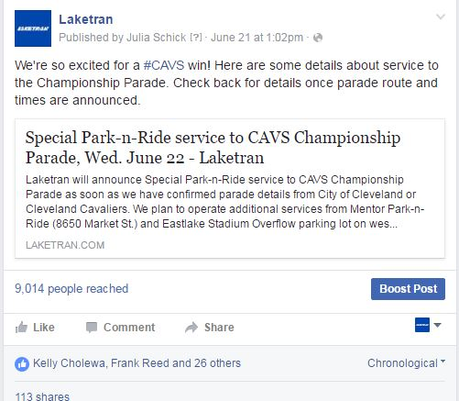
Tuesday,
June 21
1:00 pm
Notes:
Phone calls and web traffic was overwhelming… we needed to put something out to the public.
Created script for customer service…. Nothing is official until parade route is released
Gave info on Park-n-Ride locations, time, fare, rules – cash only, strollers, subscribe to text alerts
People didn’t like.. They shared.. No boost
Mobilized our forces.. Waited for parade route, road closures and parking bans.

Slide 7
Notes:
Art was decided, hashtags, post teaser to website… we just needed a parade route .. “I kept coming back to you site and hitting refresh”
Finally about 2:30pm details were released…. Completely different than rumored routes, road closures forceddetours/

Slide 8
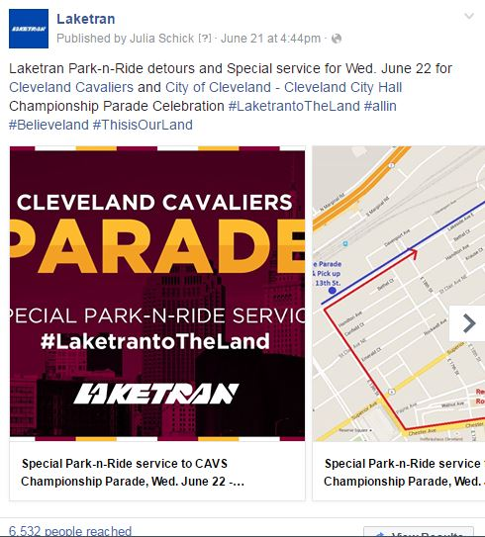
Tuesday,
June 21
4:44 pm
$15.27
Notes:
GM thought.. It’s so late in the day, I’m not sure there’s enough notice. We may not even have many people come.
Over 680 Subscribe to Rider Alert Text program
Use of Text Alerts and Social Media (be phones quit working)
Wickliffe PNR filled
Wait times at lots
Return service began at 12:30 (planned about 2pm)
Extended service until 6:45PM (originally planned for 5:00pm)

Slide 9
11,743
Customer Service = 1,110 phone calls (daily average 547)
Notes:
We normally get about 350 hits to our website, here we surpassed 11,000

Slide 10
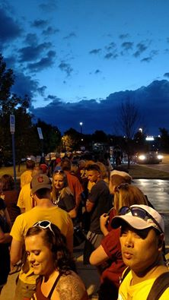
Notes:
Served over 5,000 residents above the regular 350 average daily commuters AND maintained all our normal Dial-a-Ride and Local Route operations over 13,000 total trips; daily average is less than 3500

Slide 11
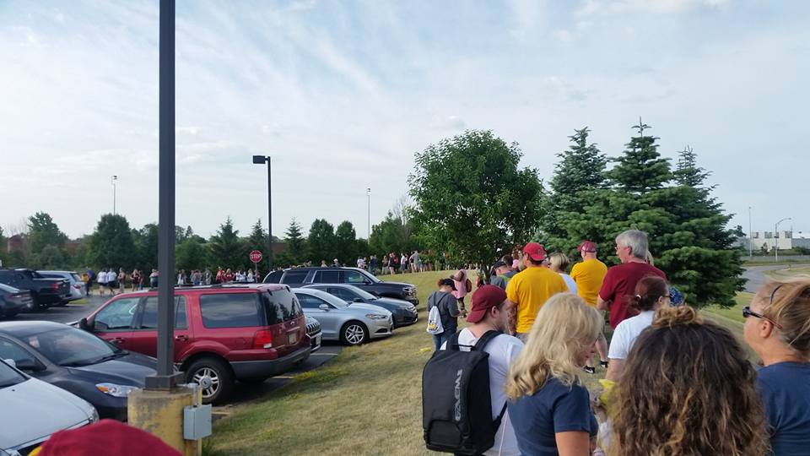
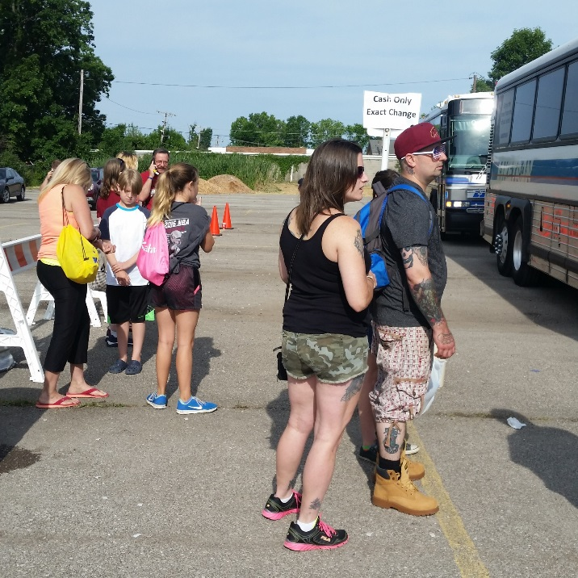
Notes:
Maintenance prep the lot with barracades and cones allowed lines to form seamlessly and control the crowd.

Slide 12
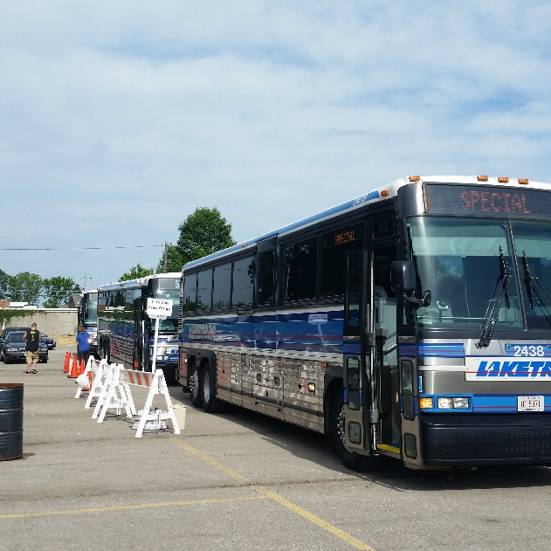
28 MCI Coach buses, 2 New Flyers, 2 Dial-a-Ride
Over 10,000 passenger trips
Notes:
Served over 5,000 residents above the regular 350 average daily commuters AND maintained all our normal Dial-a-Ride and Local Route operations over 13,000 total trips.

Slide 13
1855 cars parked in two overflow
Park-n-Ride lots
Notes:
Over 1800 cars off the road…. Inbound traffic to Cleveland was not a story on Wednesday.

Slide 14
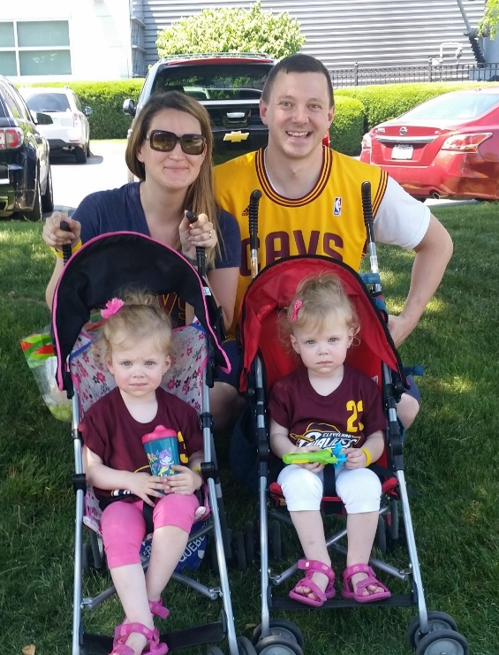
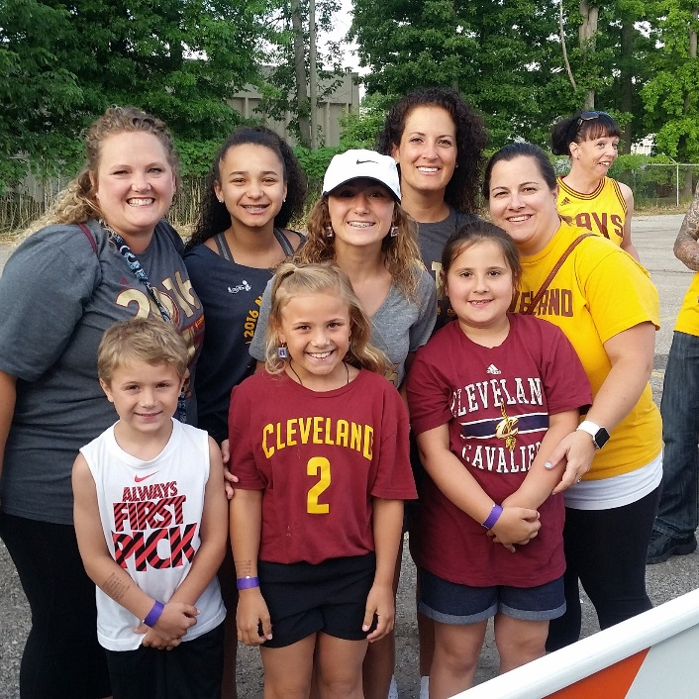
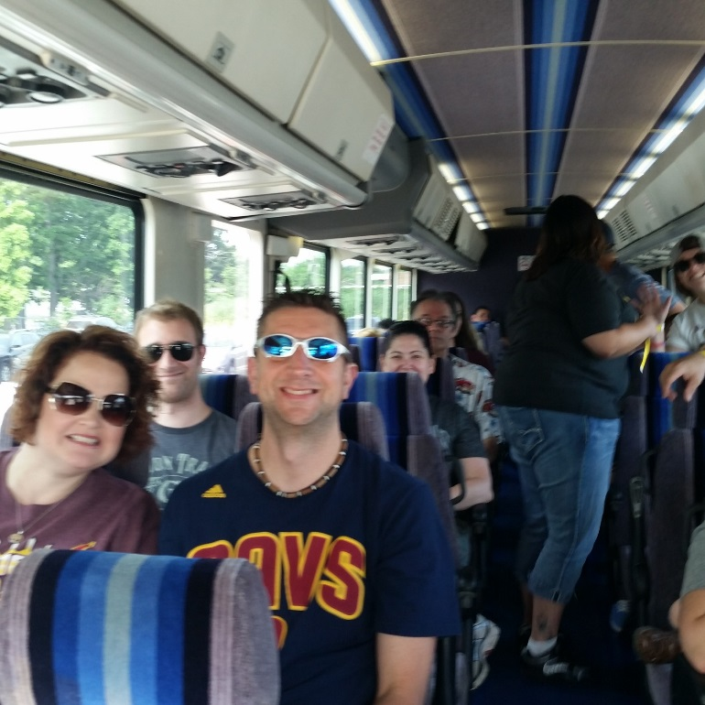
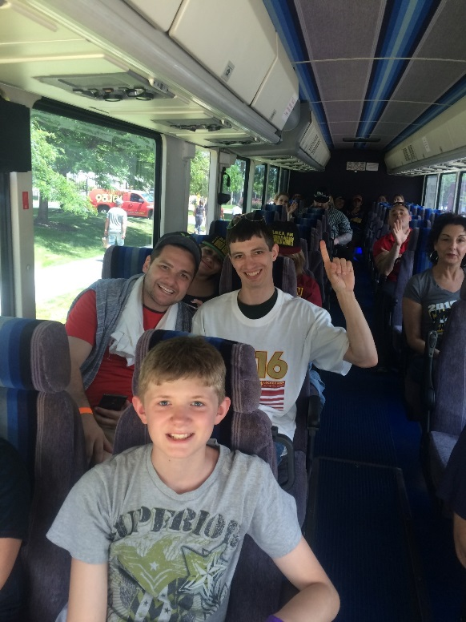
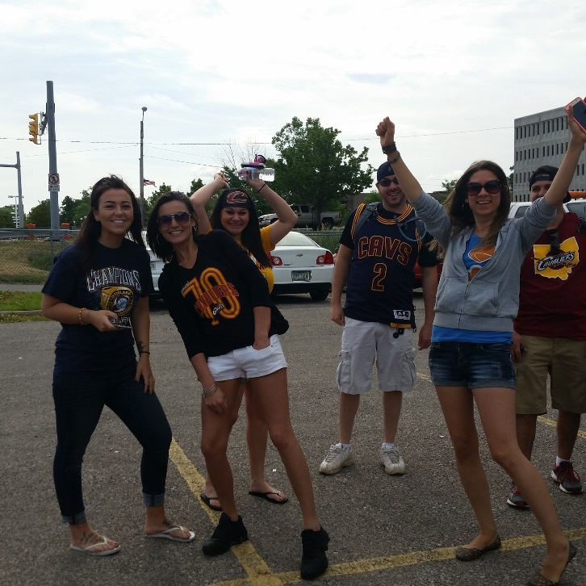
Notes:
Day provide rich social media content– happy fans, fun videos, service updates, operators and staff working hard, having fun

Slide 15
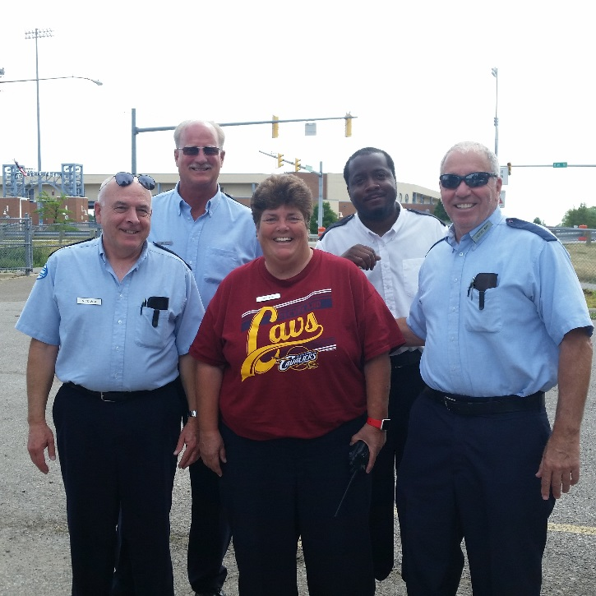
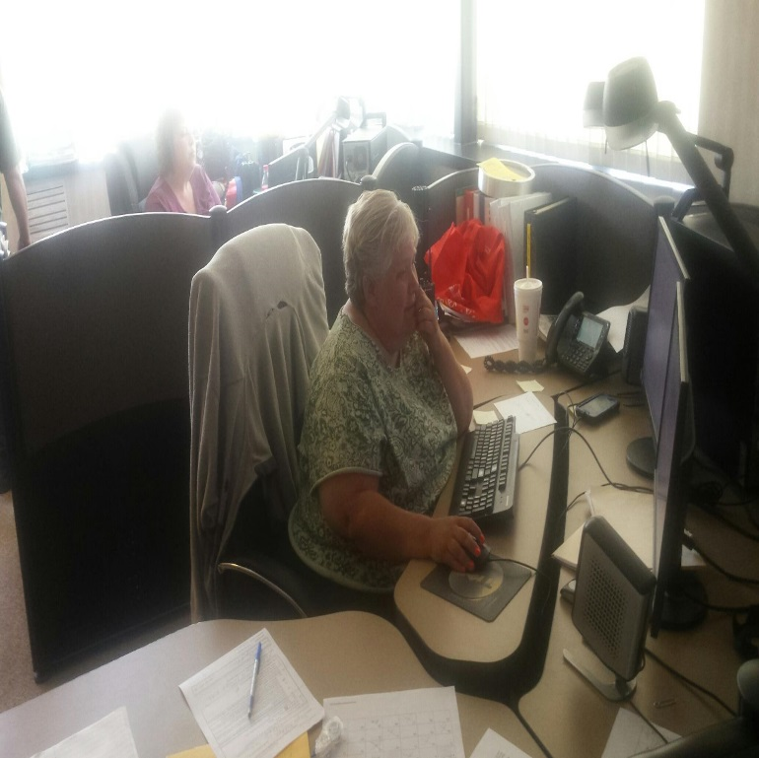
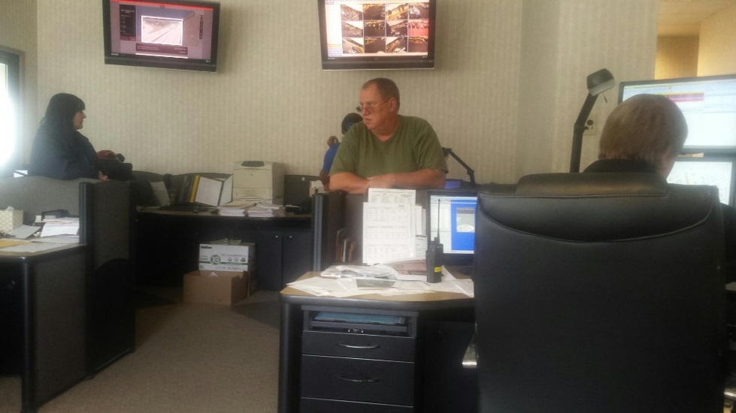
Notes:
Proud Staff

Slide 16
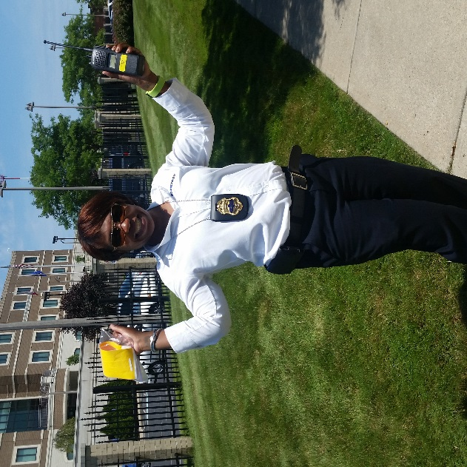
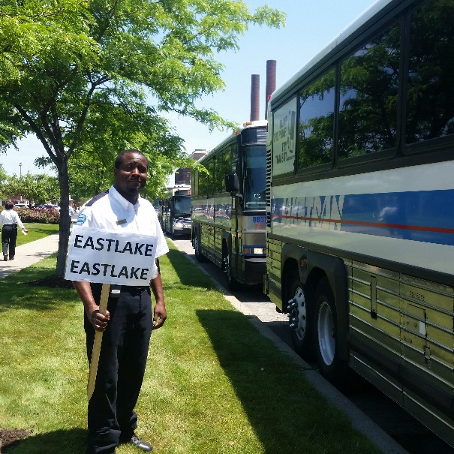
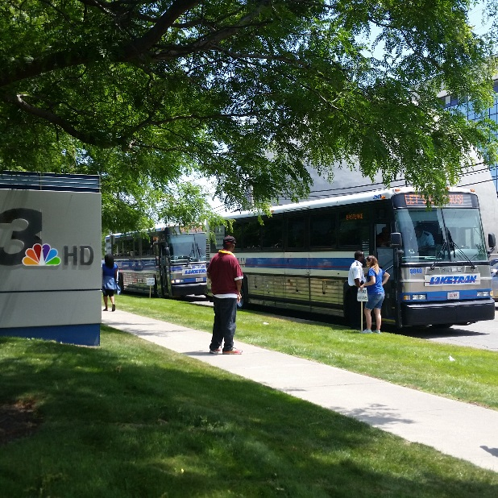
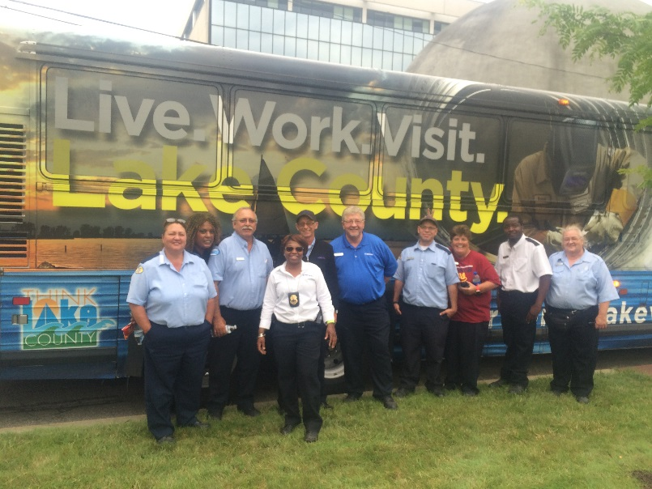
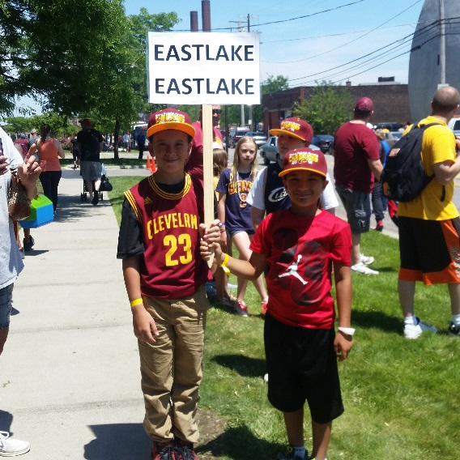
Notes:
Served over 5,000 residents above the regular 350 average daily commuters AND maintained all our normal Dial-a-Ride and Local Route operations over 13,000 total trips.

Slide 17
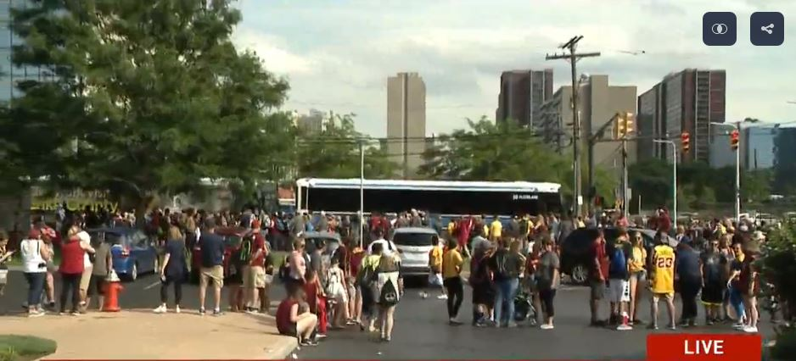
2:30PM - 4,000 PEOPLE WANT TO GO HOME
http://www.wkyc.com/news/local/massive-crowds-overwhelm-rta/252373866
Notes:
Served over 5,000 residents above the regular 350 average daily commuters AND maintained all our normal Dial-a-Ride and Local Route operations over 13,000 total trips.
SMS stopped working, text alerts weren’t being received.. Again had to rely on social to push service changes.. Move final departures back to 6:45

Slide 18
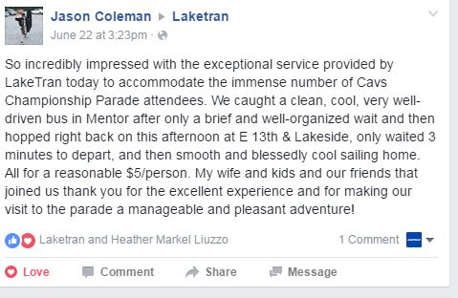
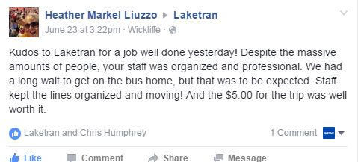
New Transit Friends!!
Notes:
Visitor who posted back to fb page - Haven’t lost any of them on fb as far as likes,
Once someone likes a post, go back and invite them to like your page – do this with every post I boost

Slide 19
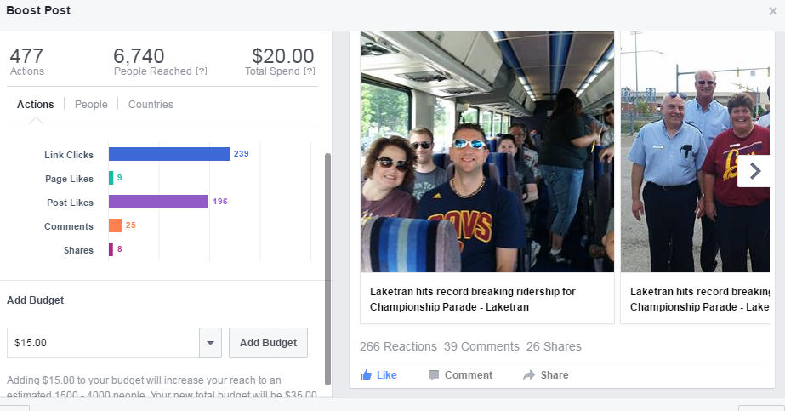
Notes:
TY for riding post with announcement of our record breaking ridership – 39 comments
The internal win – GM recognized the value of social media presence

Slide 20
Notes:
None of this would have been possible with a follower foundation we had previously established on social media prior to Cavs Parade
We launched our fb page in 2011..5 years to reach 1100 and 3 days to reach 1700 “Likes”
“I’ll think of Laketran as an option more often”
Economic Driver in the Community
Here for LC residents, even those who don’t ride us every day.
Increase value of Laketran to the community

Slide 21
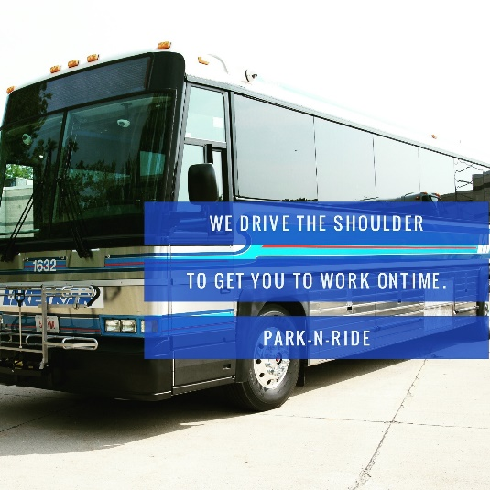
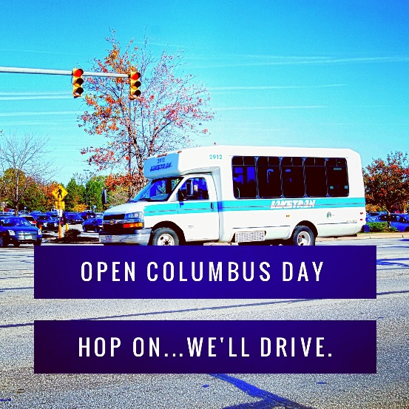
Notes:
Facebook – Started with prizes/contests, Human Resource - retirements, employee of months, travel trainings, special events (14 administrative staff, 160 bus drivers)
Twitter – recycled content
Instagram –
Youtube – House videos – Anniversary Videos, How to Ride, and old commercials
Linked In – Very rarely and basically have some business news
Me & Communications Specialist – Marketing, PR, Graphic Design, Advocacy, Travel Training, Community Outreach
Word Swag & Canva – Two favorite free apps

Slide 22
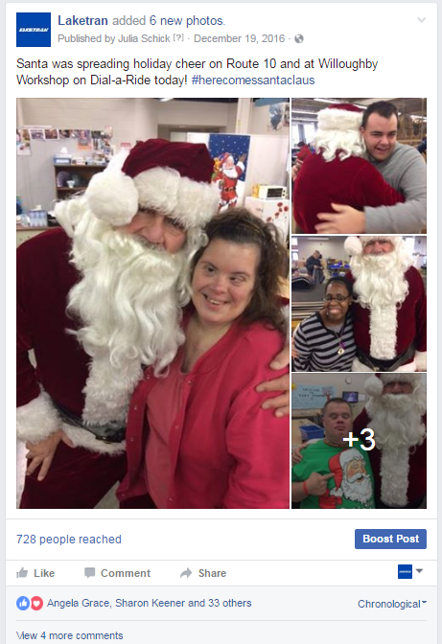
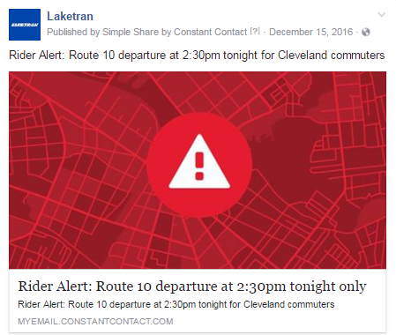
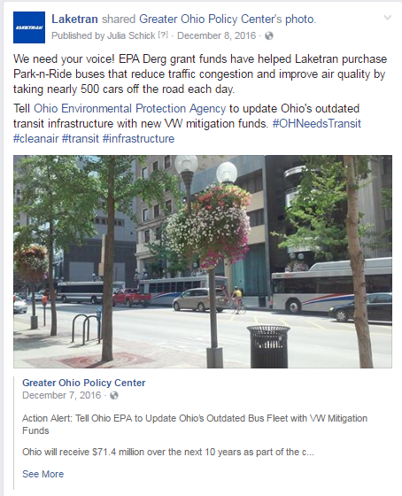
Facebook
Rider Alerts
Employee Recognition
Advocacy
Community News
PSA – Roads
Notes:
Facebook – Started with prizes/contests, Human Resource - retirements, employee of months, travel trainings, special events (14 administrative staff, 160 bus drivers) – got staff involved are really liking posts. followers; 1,738
We try to post a few time as a week, 65-75% is shared content usually relative focus on service change, Laketran news, articles/content related to pwd, government, community issues, funding
Boost almost all our content between $10-$50 depending on time/relevance – such a small market, hit all of Lake County for $50 .. Rarely spend over $200/mo.

Slide 23
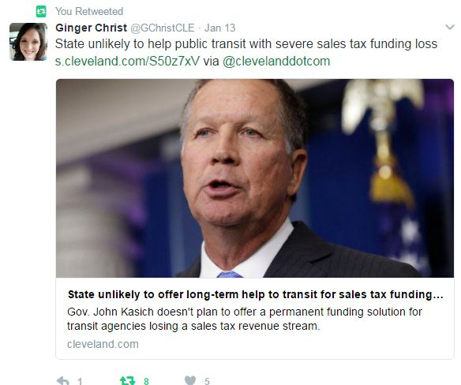
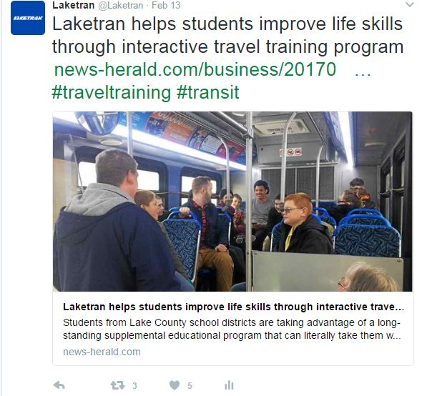
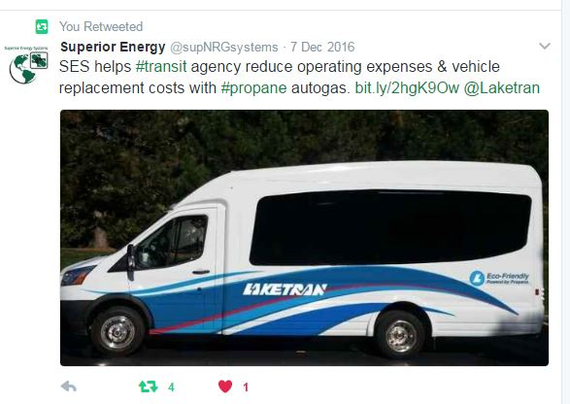
Twitter
Community News
State & Federal News/Funding
Networking with Vendors/Agencies
Notes:
Twitter – 800 followers, follow about 600, don’t boost, network with other agencies, advocacy, push info, rarely – MPO,
Recycled content – Community Events & Achievements, PSA – Code Blue – Warming Shelters open, connect with vendors
Direct content of riders alerts, newsletter is really only original content and doesn’t really get strong response.
Networking - Giving a little love to newspaper reports, vendors, community agencies/partners
Less than 15 post/year we need to interact with – complaints or compliments.
Weekly – Laketran search to keep up with - -tried hoot suite, we’re too small
Do no paid advertising on twitter

Slide 24
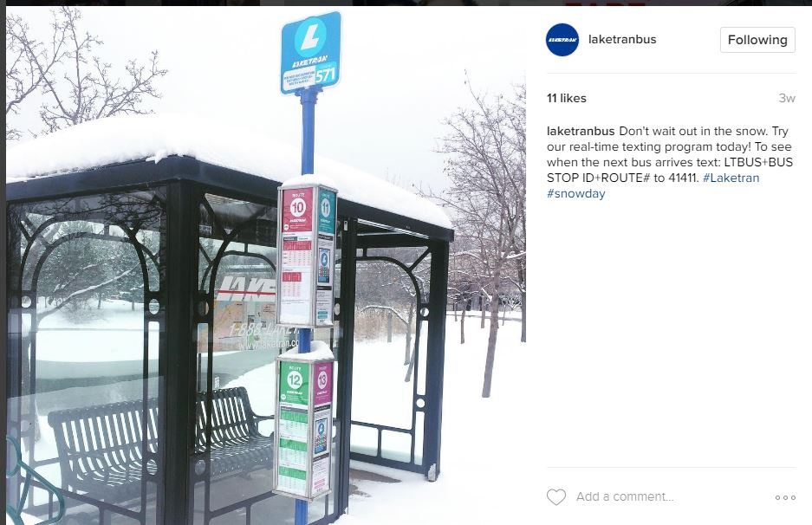
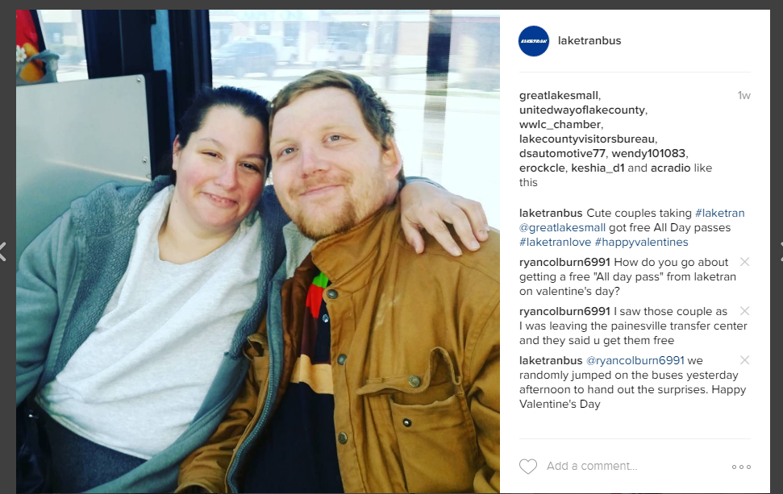
Instagram
Notes:
Instagram – Networking with other transit systems, local community news,
Planning: Don’t give monthly goals based on accomplishments, but use the tools when it best option to reach a goal.
Once a month some fun content – Community Art, local event - you can always fall back on holidays – Valentine’s Day – push new texting program and All Day Pass -

Slide 25
Julia Schick
Laketran
jschick@laketran.com
facebook: @Laketran
twitter: @Laketran
instagram: @laketranbus
Notes:
Instagram – Too long of gap
Once a month some fun content – Community Art, local event - you can always fall back on holidays – Valentine’s Day – push new texting program and All Day Pass -

