Slide 1

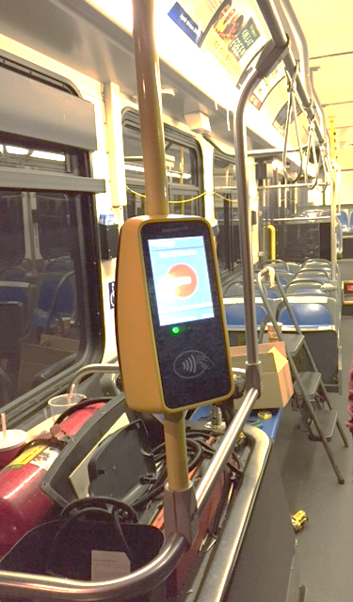
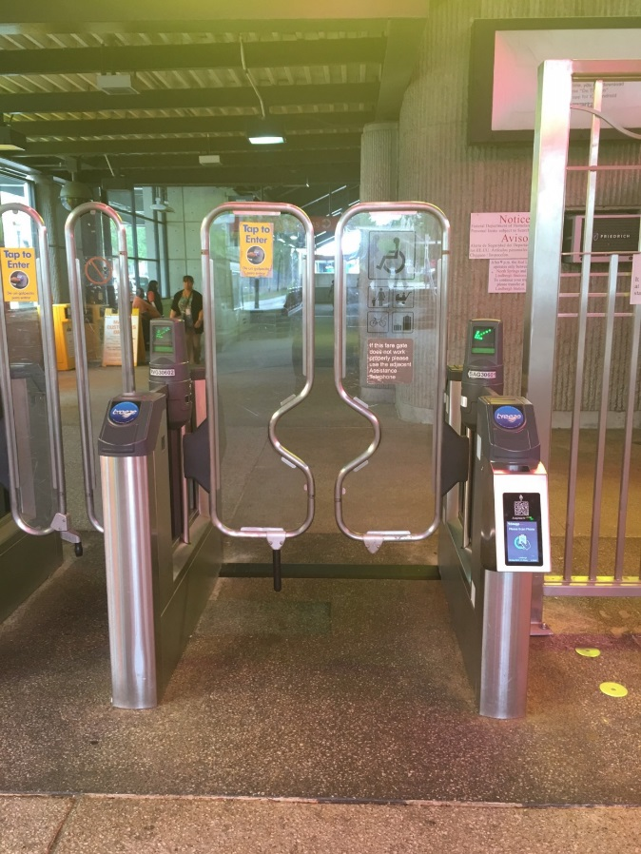
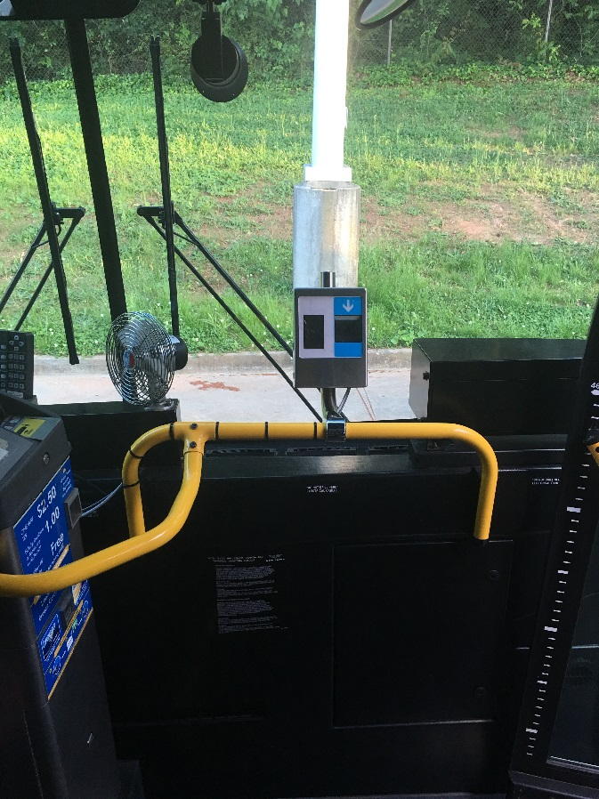
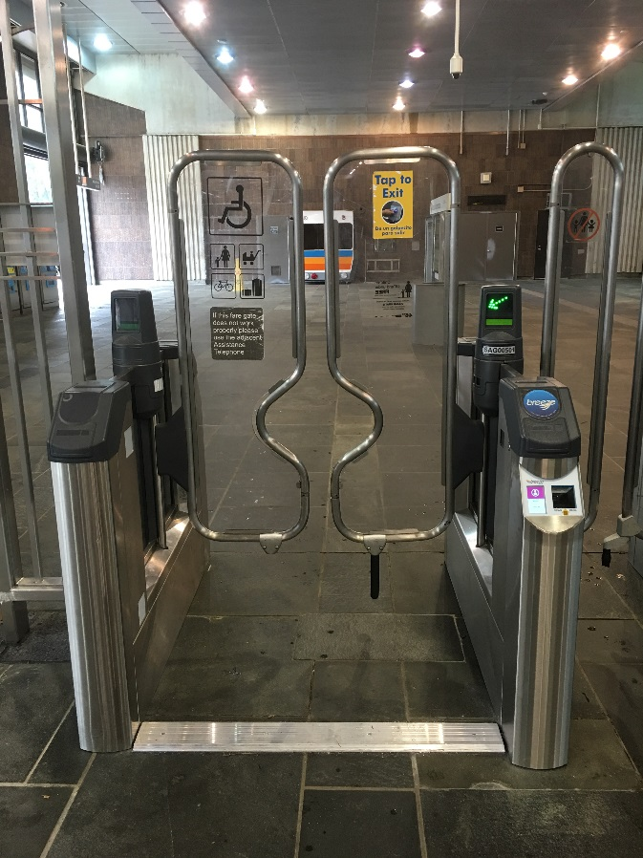
Using Research to Test New Technology:
MARTA Office of Research & Analysis
February 2017

Slide 2


Background
IT Department contracted 2 tech companies:
  Pilot test
  Competition for system wide contract
Kept company identities anonymous
  “Breeze BLU”
  “Breeze YELLO”

Slide 3
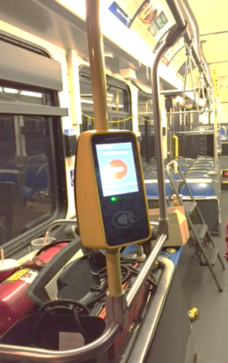
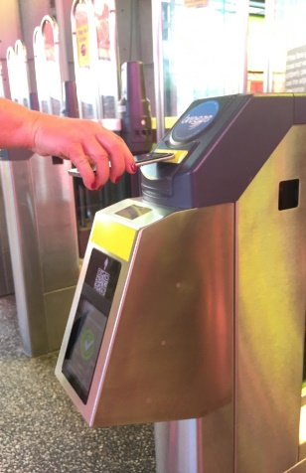
Role of R&A
Test with IT protocols
Employee test (14 days)
Customer Test (30 days)
  Recruitment
  Tracking
  Analysis:
    Performance ratings
    Problems

Slide 4


Outcomes & Next Steps
Customers were happy with both products
Satisfaction with MARTA overall was higher among patrons participating in test
Over 90% of agreed to participate in a follow-up test
Installation begins in March for September launch

