Slide 1
APTA Early Career Program 2016
Creating an organization capable of excellence: how to keep up with the changing transportation industry.

Slide 2
It is not your job to think of the next ‘great thing’ but to cultivate the people who can do it under this culture…

Slide 3


Slide 4
Hot Topics
What does progress mean for the current workforce?
What does advancement look like?
With the Baby Boomers retiring, how do agencies retain their knowledge?
How to develop your millennials into leaders of your agency?

Slide 5
Progress
What does that mean for the current workforce?

Slide 6
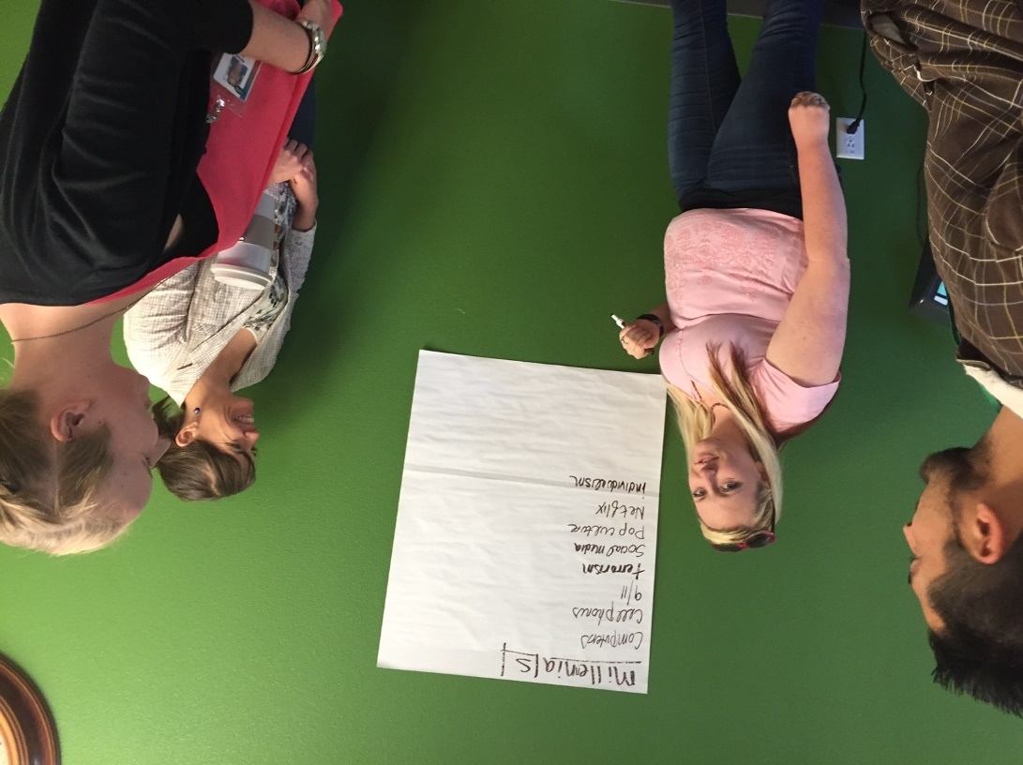

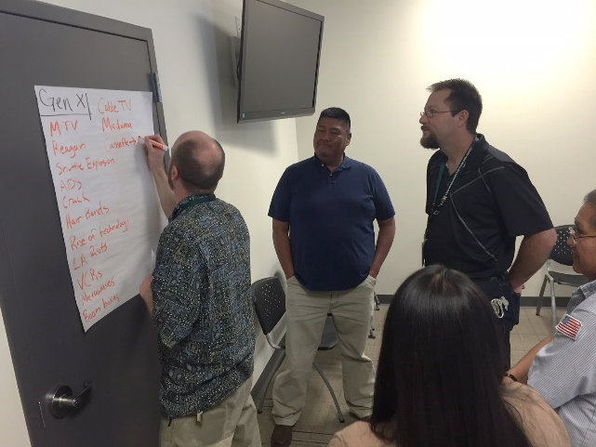
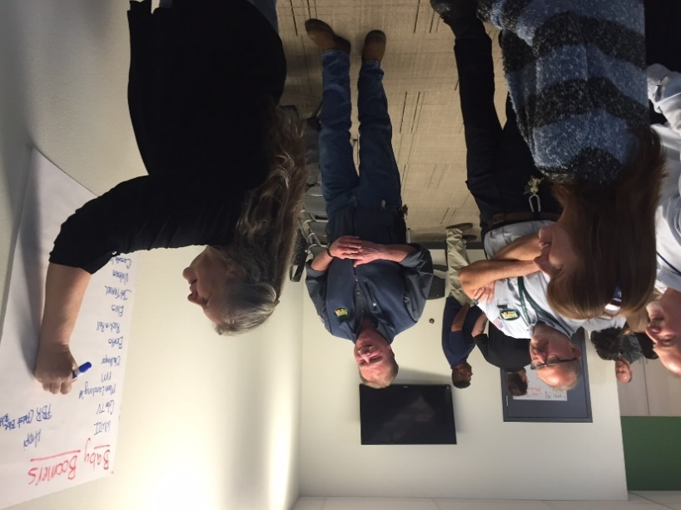
Perceptions across the Generations
Notes:
NAIPTA Leadership Academy program activity divided participants into age groups and asked to make a list of cultural facets and advancements of their generations. And it all came back to TV.
Baby Boomer –
Color TV
FM Radio
Jet travel
Cassettes/A-tracks
Gen X –
Cable TV
MTV
VCRs
Microwaves
Cassettes
Boom boxes
Millennials –
Netflix
Computers
Cell Phones
Social Media

Slide 7
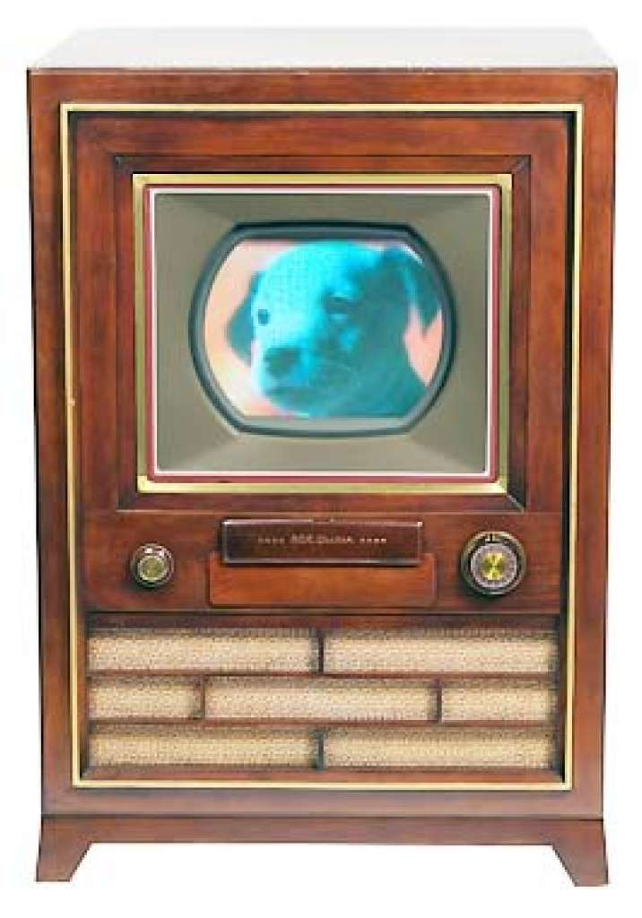
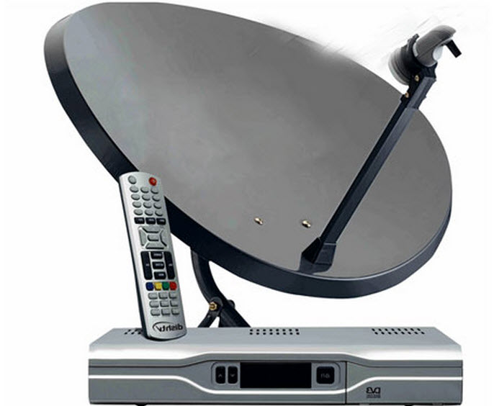

Perceptions across the Generations
Notes:
This is what progress used to look like… the newest model or feature of our inventions - by today it is more like.
This is what progress used to look like… by today it is more like (NETFLIX) – an invention that is not physical but rather a platform – and there are many of these from Hulu, YouTube
AND the TV was invented between the Greatest and Silent Generations, that generation before Baby Boomers

Slide 8
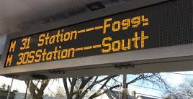


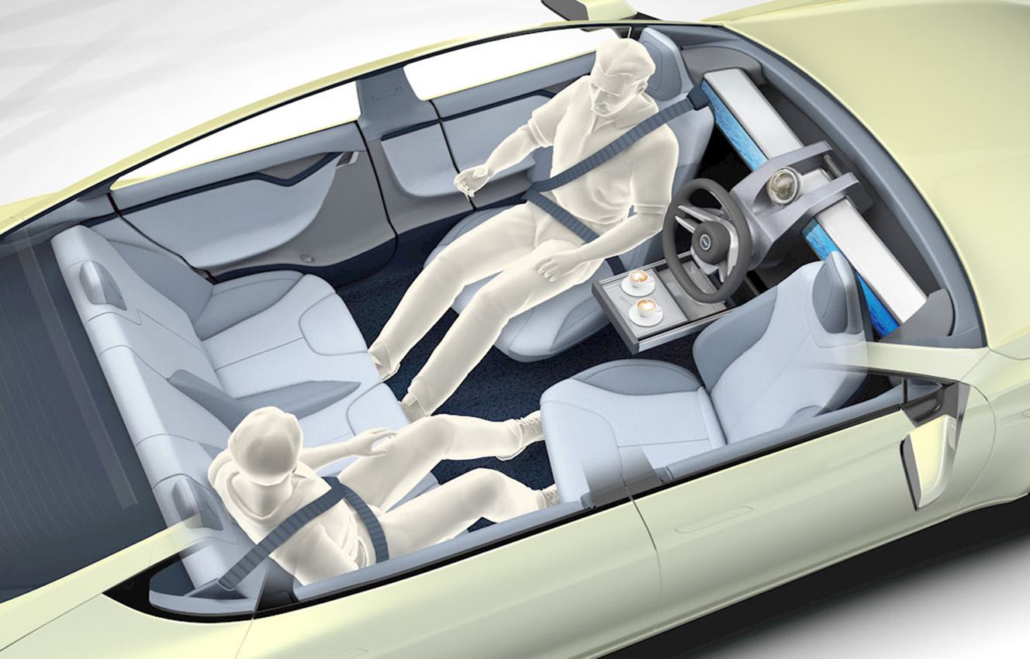
Perceptions across the Generations
Notes:
We are seeing technologies and advancements that are outside of inventions – we are creating new tools and methods of doing the same old things.
So what if we take that idea back to the transportation industry – consider real time arrival, on demand transportation apps, fare technologies, coordinated signal systems, “smart” communications/ features, and more

Slide 9
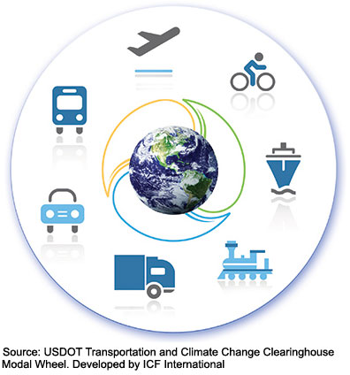
Advancement
The early years:
  boats, horses and wagons
Steam machines:
  steamboats, automobiles and locomotives
Modern Machines:
  submarines, aircraft and spacecraft
Notes:
I’m sure you’re aware of the advancement of transportation – however, what about the advancement of HOW we work in the transportation industry?

Slide 10

Advancement
Notes:
What about the way we work? How about Wi-Fi?
The amount of time you spend consuming media — watching TV, surfing the web on a computer, using an app on your phone, listening to the radio and so forth — continues to go up.
The 2016 average is 10 hours and 39 minutes. (http://www.nytimes.com/2016/07/01/business/media/nielsen-survey-media-viewing.html?_r=0)
Millennials “grew up” if you will in an increasingly media and information oriented environment. AN environment where you really don’t need to know much, except for how to google it. In this new environment, skills in problem solving, creativity, social impact, and innovation are key. Simply having information or a special skill is not as valuable as it previously was. Particularly when you can learn how to do almost anything on YouTube…

Slide 11
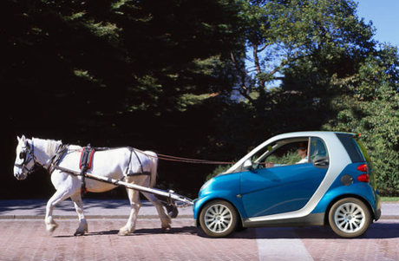
It’s not distance anymore, it’s speed!
Notes:
The newest innovation is the speed in which we can complete tasks – with innovations from smart phones, computers, email, video calling, webinars, and screen-sharing to name a few; the need to be in a face-to-face environment is less necessary than it previously was due to technology. And we can see how social interactions and etiquette have changed over the generations. What about texting? Social media?

Slide 12
Development
What does advancement look like?

Slide 13
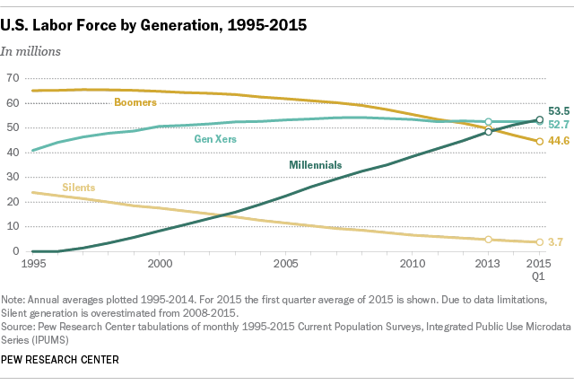
Notes:
http://www.pewresearch.org/fact-tank/2015/05/11/millennials-surpass-gen-xers-as-the-largest-generation-in-u-s-labor-force/

Slide 14
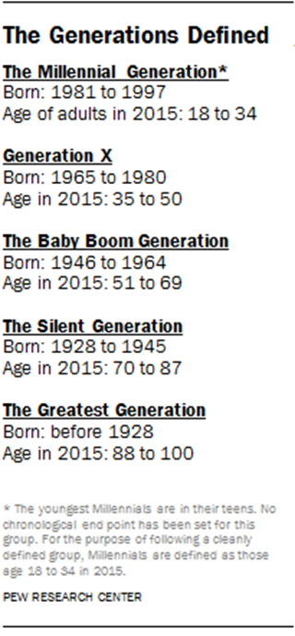
Persons in the Workforce by Generation
2015 Q1; Pew Research Center
Notes:
Millennials have surpassed Gen X as the largest number of persons in the workforce in late 2015

Slide 15
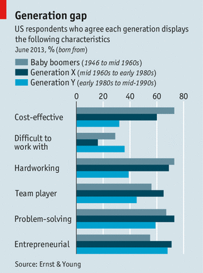
Stereotypes
Self-centered
Unmotivated
Disrespectful
Disloyal
Notes:
Meister, Jeanne C. and Willyerd, Karie. Mentoring Millennials. Harvard Business Review. May 2010. http://hbr.org/2010/05/mentoring-millennials/ar/1
http://genhq.com/millennials-gen-y-in-workplace/
http://link.springer.com/article/10.1007/s10869-010-9172-7

Slide 16
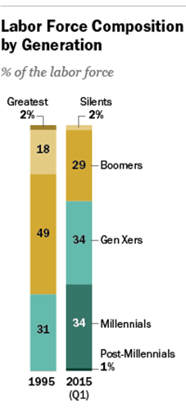
What does that cost?
21% of millennials say they've changed jobs within the past year
3x the number of non-millennials who report the same
$30.5 billion annually across the U.S. economy for millennial turnover costs
Notes:
Particularly if job changes become a larger trend across Millennials while their portion of the workforce also increases, these costs could increase
ATTRACTION AND RETENTION:
For entry-level employees, it costs between 30-50 percent of their annual salary to replace them.
For mid-level employees, it costs upwards of 150 percent of their annual salary to replace them.
For high-level or highly specialized employees, you’re looking at 400 percent of their annual salary.
http://www.gallup.com/reports/189830/millennials-work-live.aspx?utm_source=gbj&utm_medium=copy&utm_campaign=20160512-gbj

Slide 17
There are no traffic jams along the extra mile.
- Roger Staubach
Notes:
Take all of the institutional knowledge from the baby boomers and allow the upcoming leaders to change, adapt and find new ways to do things for the agency.

Slide 18
Institutional Knowledge
With the Baby Boomers retiring, how do agencies retain their knowledge?

Slide 19
Teach, Record and Consult
Before the baby boomers retire, teach the young professionals the tricks of the trade
Incentivize the millennials to get a download of knowledge from the retirees; leadership classes, title promotion, project lead
Consult: Ask retirees to mentor or to consult with the youngsters at the agency
Record! Record! Record! Video or voice tape the retiree -- “how I do my job”

Slide 20
And change….
There’s a way to do it better – Find it.
- Thomas Edison
Notes:
Take all of the institutional knowledge from the baby boomers and allow the upcoming leaders to change, adapt and find new ways to do things for the agency.

Slide 21
Preparing for Greatness
How to develop your millennials into leaders of your agency?

Slide 22
It starts at the top…
Investment into human capital starts with the CEO
  If your actions inspire others to dream more, learn more, do more and become more, you are a leader.
    - John Quincy Adams
Notes:
Seems obvious, but to cultivate an agency of greatness, the CEO needs to be invested in his/her people.

Slide 23
And it starts now…
Download institutional knowledge and invest in the future leaders now
Create an agency-wide culture of “people are the best asset”
Engage with all departments through senior leadership teams and surveys
Don’t wait until the good ones are gone

Slide 24
Examples to create greatness
Leadership Academy
Encourage participation in groups like APTA
Mentorship program – start them early!
Community service and volunteering opportunities
Recognition
  Employee Awards
  Wrap a train or bus with staff who’ve made a different
  Board meeting call-outs or personal notes from CEO
Notes:
Investing money in young people will retain them longer! Start now to keep good people.

Slide 25

Tara Bettale
RTD Denver
Jacob Splan
UTA Salt Lake City
Alicia Becker
NAIPTA Flagstaff

