Slide 1
Introduction to public Transportation
Module 3: Planning & Design

Slide 2
Travel Behavior and Transit Travel Demand
Module 3: Lesson 1

Slide 3
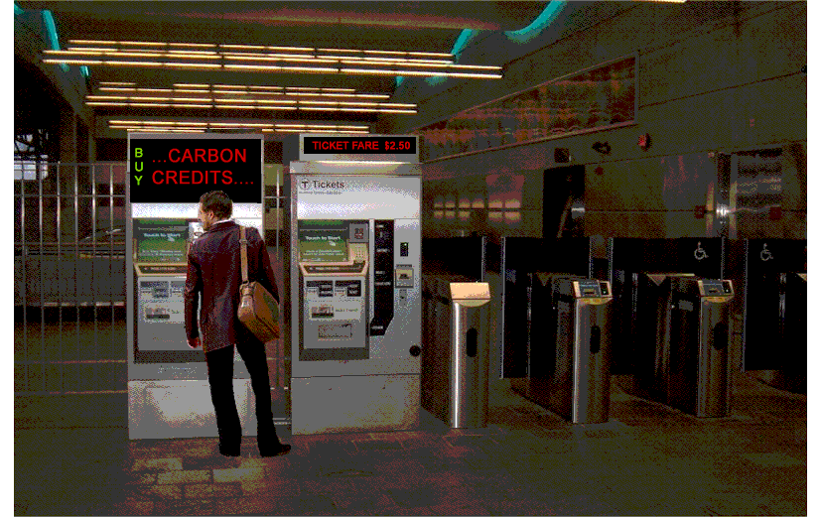

Slide 4
Learning Objectives
Describe fundamental motivations for person travel
Explain the factors that influence travel and mode choice (availability, convenience, image, speed, cost, reliability, safety, comfort, etc.).
Restate the traditional model for thinking about travel demand (trip generation, trip distribution, mode choice, trip assignment)
Review conditions that influence transit mode share
Compare linked versus unlinked trips, round trips, trip tours, etc.
Notes:
Planning for public transportation requires the planners to have an understanding of travel behavior, specifically what characteristics of transit service passengers value and how passengers will respond to various types of service and service characteristics. Thus, understanding customer needs builds the foundation for being able to most effectively respond to those needs through the provision of services and facilities.
This lesson provides an introduction to travel behavior as it relates to public transportation.

Slide 5
Overall Context
Planning for public transportation requires the planners to have an understanding of travel behavior, specifically what characteristics of transit service passengers value and how passengers will respond to various types of service and service characteristics. Understanding customer needs builds the foundation for being able to most effectively respond to those needs through the provision of services and facilities.

Slide 6
Understanding Travel Behavior
To understand travel requires understanding how people make travel decisions
To understand how people make travel decisions requires understanding personal activity patterns
To understand a person’s activity pattern requires understanding household and other context conditions (residential location, vehicle availability, etc).
A given decision about a given trip on a given day is a result of numerous current and historic decisions.

Slide 7
Why Learn about Travel Behavior?
To predict travel requires understanding travel
To influence travel requires understanding travel
To respond to travel demands benefits from an understanding of travel behavior
Whether Proactive or Reactive
Notes:
A common activity for transportation planners is to forecast future travel demand in order to identify facilities or services to include a long-range plans. This prediction activity depends upon an understanding of travel behavior.
An alternative to meeting forecast travel demand needs is to explore policy initiatives that can influence travel behavior, i.e. Alter mode, trip timing, trip destination, etc. Understanding travel behavior enables us to understand how various policy initiatives might impact travel.
Understanding travel behavior enables us to interpret measures of travel demand in terms of services and facilities that can accommodate those commands. Knowing about trip length, trip timing, mode preferences, etc. enables us to develop scenarios that address those demands.

Slide 8
Disclaimer
The level of understanding and the amount of data regarding travel behavior have never been better.
Yet it remains difficult to predict human behavior, new technologies, the economy and natural phenomena that may influence the ultimate demand for travel.

Slide 9
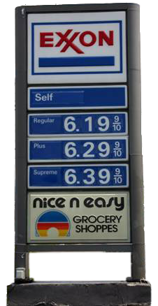
Disclaimer
We haven’t been able to predict
Who will win the next election,
Which movie or TV show will be popular,
What will be the hot Christmas gift, or,
Which stocks (if any) will do well this year.
Therefore we shouldn’t apologize for uncertainty regarding future travel.
We should plan for uncertainty regarding future travel demand.

Slide 10
A Fundamental Need to Travel
Travel is fundamental to the human desire to interact and socialize and pursue personal betterment through commerce.
While people do not necessarily aspire to travel they do aspire to do things that require travel.
Travel enables economic interaction and the transportation of products and is fundamental to the functioning of the economy.

Slide 11
Social and Economic Interactions Create Demand for Travel
Time
Growth in
Income
Knowledge
Specialization in
Employment
Consumption
Social relationships
Time use
Growth in
Person Travel
Commerce
Communication
Polzin, CUTR 2010
Notes:
This graphic characterizes the relationships that influence travel demand. Growth in income and knowledge have historically led to greater specialization in behaviors. This has included specialization in employment (the essence of urbanization and collective behaviors) specialization in consumption, or specialized social relationships and greater diversity in specialization in time use among the population. These characteristics of the developing economy increase travel demand.
This specialization leads to an increase in person travel, greater commerce has specialized workers exchange products and services, and greater communication.

Slide 12
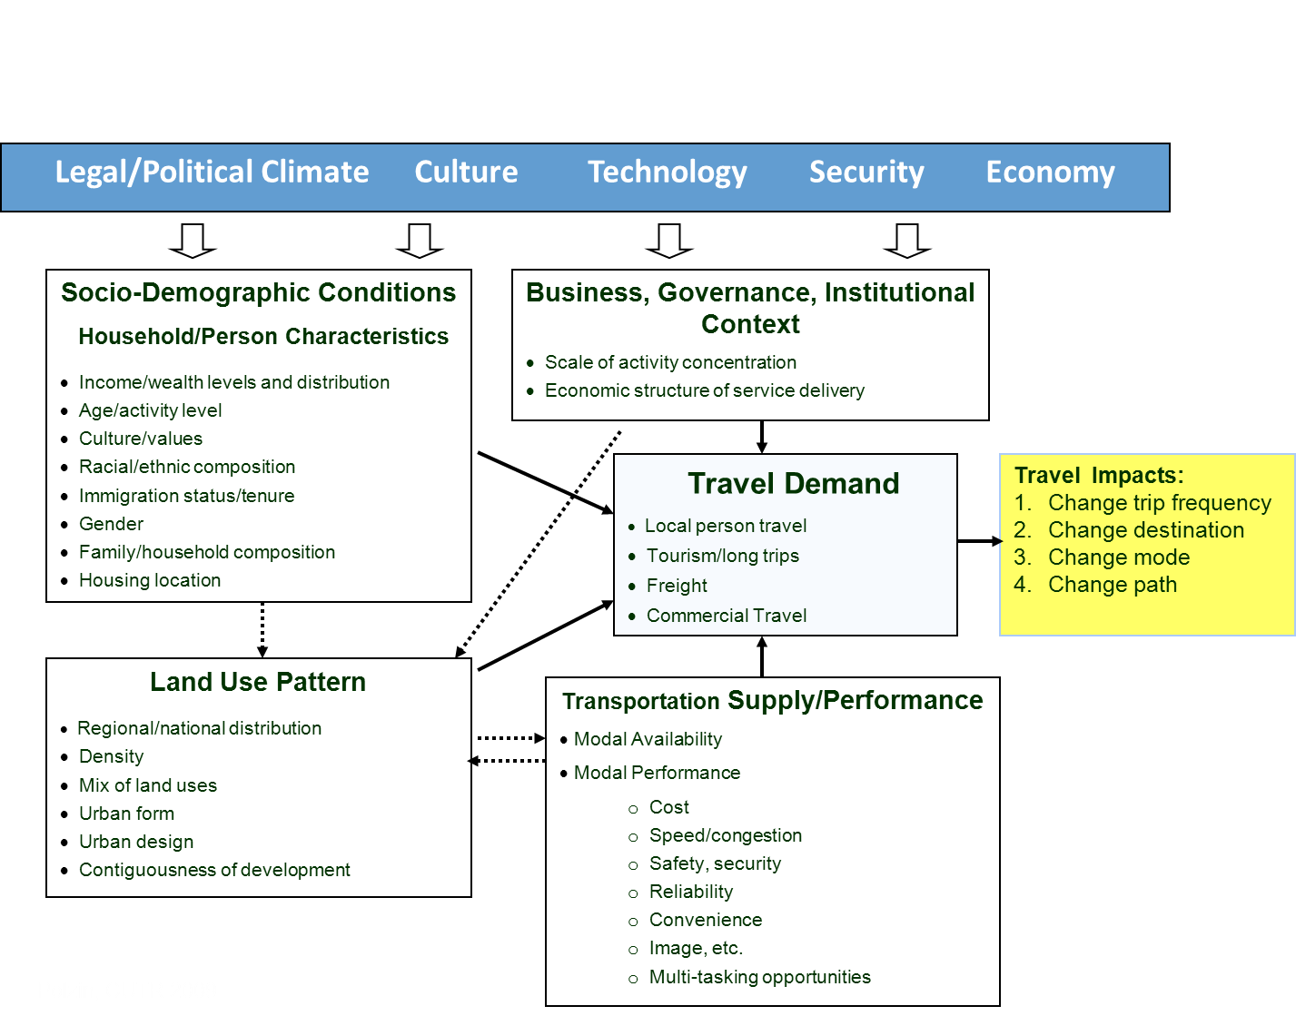
Conceptual Framework for Thinking About Travel Demand
Notes:
This graphic presents a conceptual framework for thinking about travel demand.
Four separate boxes reflect major considerations that influence travel demand. Each of the boxes include numerous elements all of which have been shown to be important factors in impacting travel demand. Collectively these factors produce travel demand that can be characterized as local person travel, tourism or long distance travel, freight travel, and commercial travel (travel associated with carrying out one’s professional occupation).
A common way to characterize travel is to speak of it in terms of trip rate, trip destination, trip mode, and trip path. Each of the prior factors can potentially impact one or more of these characteristics of travel.
Several of these characteristics are described in subsequent graphics that paint a picture of travel behavior and how it is changing.

Slide 13
Interrelationships of Decisions
Time → → → → → → → → → → → → → → → → →
Go to college (1985)
Buy a car (1987)
Get married (1990)
Have children (1994)
Buy home (2000)
Remodel family room (2012)
Go to home improvement center
(This evening)
Notes:
Travel decisions often reflect a composite influence of numerous historic decisions that shape travel. Historic decisions on household composition, auto ownership, homeownership and location, and other factors influence an individual’s travel behavior.
Thus, expectations about changing behavior need to be cognizant of the numerous factors that go into shaping travel behavior.

Slide 14
Socio-Demographic Issues
Aging population
saturation of female labor force participation
Different young adult behaviors
slowing migration, locked in homes/less mobile
Income/wealth impact
Changing household composition
Reduced immigration
Exhaustion of suburbanization?
Notes:
Numerous social demographic characteristics of the population are changing which subsequently influence current and future travel behavior.
Some of the recent and current changes are noted in the slide.

Slide 15
Income is Perhaps Single Largest Factor in Explaining Travel growth
Historically coupled auto availability and ability to afford activity participation and travel cost
Income drives specialization in employment, consumption and socialization
Personal income growth has slowed
Income growth not uniform across income groups
Consumption of savings and incurring debt may have exaggerated the influence of income
Income influences freight, tourism and commercial travel

Slide 16
System Supply Characteristics
Fixed and variable cost
Door-to-door speed
Travel time regularity/reliability
Personal safety, modal safety, security
Image (status)
Schedule flexibility
Destination flexibility
Comfort (air, noise, view, ride quality
Ability to multi-task (eat, talk on phone, listen to music, meet people, etc.
Notes:
Travel behavior is obviously influenced by the travel choices available to travelers. Many of the characteristics of travel choices that have been shown to have an impact on behavior are noted in the slide.

Slide 17
System Supply Issues
Future system supply and speed
Energy and other costs
Environment/climate concerns
Evolving technology impacting travel
Etc.
Notes:
Many critical policy issues such as energy and environmental concerns are among those factors that could significantly influence future travel choice characteristics.

Slide 18
Land Use Issues
Mix of land uses
Urban form
Urban design
Contiguousness of development
Notes:
Land use characteristics both for residential and commercial and other uses are important factors that influence travel behavior. Differences in land use characteristics significantly influence the competitiveness of various travel mode choices.
Public transportation has a growing appreciation of the types of urban physical environments that are most conducive to public transit use.

Slide 19
Person Travel
Average Household (annual)
VMT 19,850
Trips 2,068
Trip Length 9.7
Average Person
VMT 11,651 annual
Trips 3.79 per day
Trip Length 9.75 mi.
Time in Travel 76.4 minutes
Notes:
This slide presents some basic characteristics on person travel. VMT – vehicle miles of travel – average 19,850 per household per year. The average household takes 2,068 trips per year and the average trip length is 9.7 miles.
The average person travels 11,651 miles per year, takes 3.79 trips per day and stands 76.4 min. per day in travel.

Slide 20
Person Travel
Mode Shares
Auto 83.4%
Transit 1.9
Walk 10.4
Other 4.2
Trip Purposes
Work and work related 21.86%
Social recreation 28.22
Education 9.36
Healthcare, personal business 38.67
Personal business 1.90
Notes:
Auto is the dominant mode share in the US carrying 83.4% of trips. Transit carries 1.9% of all trips with walk and other comprising the remaining.
Work and work related travel constitutes approximately 22% of trips. Social recreation comprises 28% of travel, education 9.36%, healthcare and personal business 38.67% and personal business slightly less than 2%. Understanding trip purposes gives insight into understanding traveler travel needs.

Slide 21
Transit Dependency
All Data times (000) Except Ratio | 1969 | 1977 | 1983 | 1990adj | 1995 | 2001 | 2008 | Change 2008-1969
Households | 62,504 | 75,412 | 85,371 | 93,347 | 98,990 | 107,369 | 113,101 | 80.95%
All Population | 197,213 | 213,141 | 229,453 | 239,416 | 259,994 | 277,208 | 283,054 | 43.53%
16+ Population | 137,113 | 158,183 | 175,771 | 182,803 | 198,583 | 211,826 | 238,330 | 73.82%
Drivers | 102,986 | 127,552 | 147,015 | 163,025 | 176,330 | 190,321 | 212,309 | 106.15%
Non Drivers-16+ | 34,127 | 30,631 | 28,756 | 19,778 | 22,253 | 21,505 | 26,021 | -23.75%
0-Vehicle Households | 12,876 | 11,538 | 11,548 | 8,573 | 7,989 | 8,491 | 9,828 | -23.67%
Linked Transit Trips (000) | 4,935 | 4,896 | 5,531 | 4,893 | 6,638 | 6,373 | 7,519 | 52.36%
Linked Transit Trips/Household | 79.0 | 64.9 | 64.8 | 52.4 | 67.1 | 59.4 | 66.5 | -15.80%
Notes:
This table provides some data on the changes over time of key household characteristics that are important to public transit use. Households that are more dependent upon public transportation include those households that do not have vehicles and those individuals who do not have driver licenses. As this data portrays, there have been significant declines in the number of people who are non-drivers and the number of zero-vehicle households that exists nationally. More recently there appears to be a reversal and a growing transit dependency since the 2001 survey. These conditions appear to be related to the economic conditions and are no doubt part of the reason the transit use has been increasing since approximately 1995.

Slide 22
Transit Trips and Transit Dependency Trends
Notes:
This graphic shows the strong relationship between transit trips per household and the changes in zero vehicle and non-driver household numbers over time.

Slide 23
Almost 50 % of Households Nationally Live within 1/2 Mile of a Bus Route
2001 NHTS Analysis
Notes:
This is an example of how to analyze transit access and availability. This figure, developed from 2001 NHTS data, portrays the share of the population living within a given distance of bus service. For example, approximately 42% of the population lives within 0.3 miles of a bus route. This distance is measured as the airline distance to the nearest bus route (not necessarily bus stop).
Access to bus service is a prerequisite to transit use. Only households living within a reasonable distance of bus service are potential bus passengers.

Slide 24
Approximately 10 % of the Nation’s Population Lives within One Mile of a Rail Station
2001 NHTS Analysis
Notes:
This figure portrays similar data for rail stations. Obviously the far more modest level of rail services in the US results in a far more modest share of the population being within walking distance of rail transit.

Slide 25
About 60% of People Work within One-half Mile of a Bus Route
2001 NHTS Analysis
Notes:
This graphic portrays the share of people working within a given distance of bus service. As transit service often focuses on serving employment concentrations and employment tends to be more highly concentrated then does residential activity, the percentage of population working near transit is somewhat higher than is the case for residences.

Slide 26
About 10% of the Population Works within One-half Mile of a Rail Stop
2001 NHTS Analysis
Notes:
This figure portrays employment access to rail stops.

Slide 27
Transit Market Share by Car Availability
Notes:
This figure presents the share of transit trips made by various market segments. The data indicates that nearly a majority of transit trips are made by travelers from households that have zero cars. Interestingly, in 2008 the share of transit trips from zero-car households was slightly higher than was the case in 2001.
While transit provides mobility for choice travelers and persons with access to autos, auto availability is still a critical factor in transit use.

Slide 28
Transit Mode Share by Vehicle Availability
Shortage of Vehicles
Notes:
This figure presents transit mode share (expressed as a percent of all trips) that are made on transit for various market segments. As the figure portrays, households with a shortage of vehicles relative to the number of workers have a much higher rate of use of transit.

Slide 29
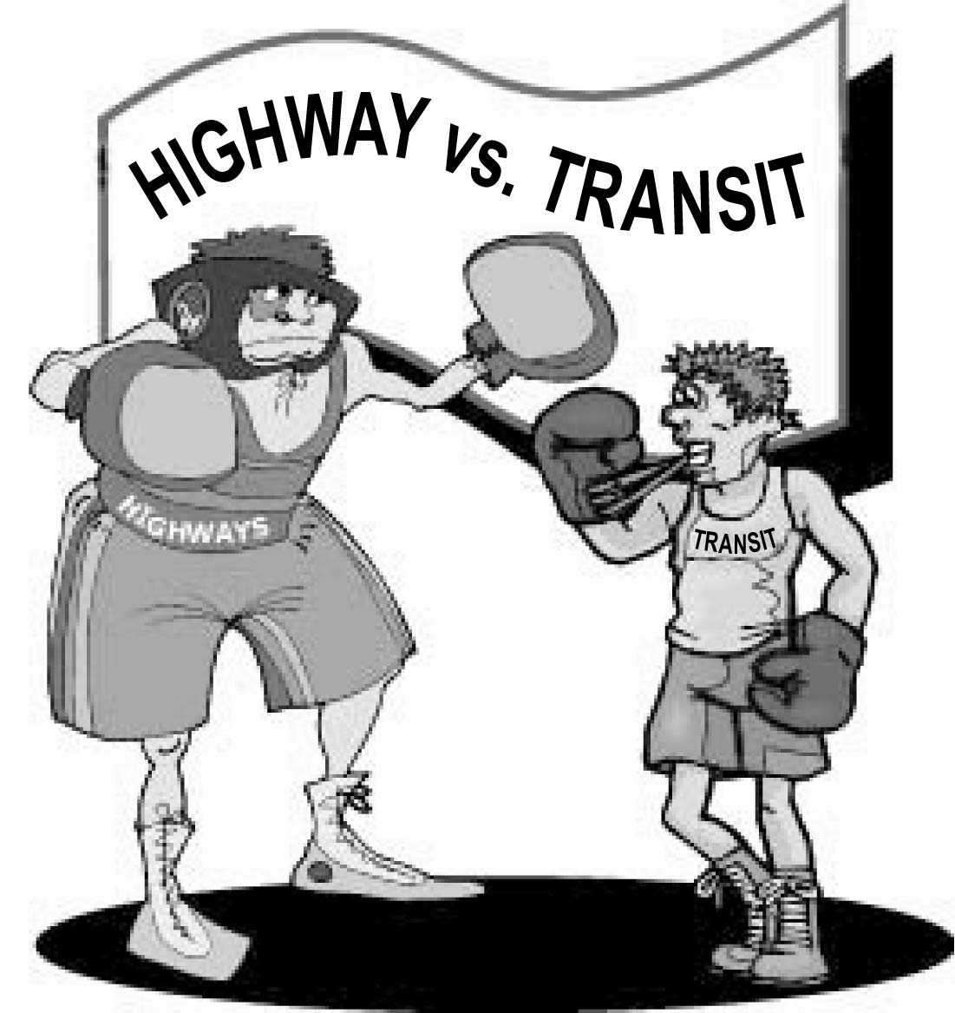
Transit Mode Share by Vehicle Ownership
Notes:
This graphic similarly portrays the much higher mode share on transit for households with zero vehicles. These behaviors have remained relatively consistent over the three prior national surveys.

Slide 30
Transit Mode Share by Income
Notes:
It’s long been recognized to transit use is highly correlated with income. Lower income households are far more likely to depend upon transit. Accordingly, mode share on transit for low income households is dramatically higher.

Slide 31
Transit Mode Share by Home Ownership Status
Notes:
Renters have a far higher likelihood of using transit than do homeowners. This results from a combination of factors including the fact that income is highly correlated with homeownership and the fact that renters often live in a far higher density developments that are more conducive to being served by public transportation.

Slide 32
Transit Mode Share and Driver Status by MSA Size
Notes:
This figure shows the relationship between transit use as a function of both driver status and Metropolitan area size. As one would expect, larger metropolitan areas are stronger transit markets often as a result of both having more and better transit services and also higher shares of the population whose characteristics are conducive to greater transit use.
As expected, respondents indicating they are not a driver have a higher likelihood of using transit.

Slide 33
Transit Mode Share by Medical Condition
Notes:
Individuals indicating they have a medical condition that influences mobility have a higher probability of using transit. Again the influence of urban size is apparent.

Slide 34
Transit Mode Share by Immigration Status
Notes:
Immigrants typically have a higher probability of using public transportation. Immigrants often locate in urban core areas, initially have low incomes and no autos, and may have a cultural willingness and experience in using public transportation that makes them more willing to use it in the US.

Slide 35
Mode Share by Frequency of Use
Notes:
This figure reveals that regular transit users, those using transit two or more times a week, have a far higher transit mode share.

Slide 36
Mode Share by Employment Type
Notes:
Certain employment types are more conducive to using public transportation. Jobs with fixed schedules, positions that don’t require a car for use during work, positions the tend to be clustered in high density employment areas, and moderate or low income positions tend to be more conducive to transit use.
While variations across these major employment classifications are relatively modest, more disaggregate classifications can produce very different probabilities of transit use across employment types.

Slide 37
Mode Share by Distance to Transit
2001 NHTS Analysis
Notes:
This data reveals how dramatically mode share can change as a function of the distance from the bus stop to where the household is located. This suggests that very immediate proximity to transit produces substantially higher mode shares than is the case for individuals living a quarter mile or more away from transit service.

Slide 38
Influence of MSA Scale and Area Type on Transit Market Share
2001 data
Notes:
This graphic shows mode share is a function of both urban area size and urban area type. Not surprisingly more urbanized areas show stronger mode share. In addition, there is a tendency for larger areas to also have a higher transit mode share. This would appear to be related to the fact that in a larger area transit could provide access to enough different activity venues to increase the probability of its use.
Thus, there is a scale effect as well as a density effect.

Slide 39
Ethnicity of Transit Users
Notes:
This figure portrays the share of various ethnic groups in the population and on transit. Nonwhite residents have historically had a higher propensity to use transit. This is attributed to a number of characteristics including higher probabilities that these population segments are concentrated in urban areas, in rental housing, have lower incomes, and are less likely to have autos available – factors that contribute to their probability of using transit. In addition, there is some evidence that when other considerations are accounted for there may be a stronger transit propensity due to cultural attitudes or experiences.

Slide 40
Transit Speed, Mode, Income Relationship
Notes:
This graphic presents data on the mode speeds for various transit technologies as a function of traveler income. This data shows that generally higher income individuals use higher-speed travel modes. This reflects both the relative importance of speed as a function of income as well as, perhaps, some tendency for the services available to vary as a function of the demographics of the markets served. For example, commuter rail targets carrying central business district white-collar employees to and from distant residential areas. These tend to be longer distance trips conducive to faster travel speed modes such as commuter rail or express bus.

Slide 41
Transit Submode Share
Notes:
This figure presents two sets of data on the relative share of transit travel by bus and rail modes. NTD stands for National Transit Data which involves a recording of passenger boardings on the various modes. The NHTS data reflects responses to surveys. While these data sources differ somewhat, they indicate the predominance of bus transit.

Slide 42
Mode Speeds
Notes:
This graphic indicates the differences in travel speed for transit and privately operated vehicles as a function of urban area size for both 2001 and 2008. As the data indicate, transit speeds are dramatically slower than privately operated vehicle speeds. This is a result of several factors including frequent stopping for transit vehicles but also access wait and transfer times as well.

Slide 43
Weekday Transit Trip Distribution
Notes:
Transit travel varies by day of the week as one would expect. There is generally a decline in Friday transit use as often times people plan after work activities on Friday which might reduce their propensity to use transit for work travel.

Slide 44
Hourly Transit Trip Distribution
Notes:
Transit travel is highly peaked in the peak periods reflecting the fact that it is a principal means of travel for work. The evidence of midday increases in transit use in the 2008 survey suggests that perhaps there’s some inroads in transit use for non work travel.

Slide 45
Trip Purpose Distribution of Transit Trips
Notes:
This figure shows the strong work trip market for transit. Work trips, by virtue of the fact that they tend to be regularly scheduled repeat trips often longer than non work trips and occasionally requiring paid parking, are more conducive to transit use. Other literature suggests the work share of transit trips could be even higher – as much as 59% based on onboard survey data.

Slide 46
Transit and Elderly
Person Trips per Day by Age
Share of Transit Trips
by Age Groups
Transit Mode Share by Age
Notes:
Planners frequently speculate on how to meet travel demands of the growing segment of the population that is retirement age and older. As individuals age their overall trip making declines and, as the mode share data suggests, the probability of using transit also declines. Currently person 65+ years old constitute 8.2% of transit trips.

Slide 47
Unlinked Trip
A linked transit trip refers to the total trip from an origin to a destination in order to serve an activity (work, shop, recreate, etc.). It can consist of one or more trip segments (unlinked trips) that may be combined to complete the trip. A trip that involves transferring between two or more vehicles in order to complete a given trip is still considered a single linked trip.
An unlinked trip refers to each boarding of a transit vehicle. Thus, each time a passenger boards a vehicle, he or she is counted as a “trip”, a “passenger”, a “rider”, or an “unlinked trip”.
Notes:
When discussing data and transit use and ridership is important to understand the differences between linked and unlinked trips.

Slide 48
Unlinked Trip
The number of passengers, riders or unlinked trips are often used interchangeably and refer to the number of people counted as boarding a vehicle.
The number of linked trips is less than or equal to the number of unlinked trips.
As a single traveler making a round trip may take 4 or more unlinked trips, the number of persons using transit is a fraction of the number of reported linked trips or a given day.

