Slide 1
Module 3:
Planning & Design
Lesson 2: Modal Characteristics and Impacts

Slide 2
Learning Objectives
Understand the wide range of modes available and the diversity of features and characteristics within each
Discuss which mode fits the required role
Describe the importance of providing data on characteristics in a way that encourages input from stakeholders

Slide 3
Overall Context
There are a number of service modes to choose from in the planning process
Deciding on which mode(s) to include is based on passengers, the operator and the community itself

Slide 4
Service Continuum
Bus (including bus rapid transit and commuter bus)
Commuter Rail
Heavy Rail
Light Rail (including streetcar and hybrid rail)
Demand Response
High Speed Rail
Ferryboat
Notes:
Review modes covered in Module 1, Lesson 1.
Add photos from that presentation as needed for review of what the different modes look like.

Slide 5
Transit Mode Criteria
Passengers
  Availability, frequency, punctuality, speed, comfort, convenience, security, fare, image.
Operator
  Coverage, reliability, cycle time, capacity, flexibility, safety, cost (capital and operating), attraction.
Community
  Ridership, cost, availability, energy consumed, image, environmental impact, long-range impacts.
Notes:
Vuchic Chapter 11, section 11.3 provides detailed background. Most of these criteria will be discussed in more detail in other parts of the class, but each mode brings its own set of impacts in all of these diverse dimensions. The lesson here is to recognize that all of these factors come into play when talking about transit modes.
Availability – is the service available close to where I begin and end my trips.
Frequency – how often does it run at various times of day and during the week (how long do I have to wait, do I need to consult a schedule)
Punctuality – is the service dependable, predictable, and consistent
Speed – how long does it take
Comfort – ride quality, noise, etc.
Convenience – other items such as information being readily available and understandable, parking, possible to be productive during wait and ride
Security – do I feel safe riding and waiting?
Fare – out of pocket cost to use
Image – [not mentioned in Vuchic] this is the image the rider experiences from being associated with the mode (some people have a negative image of bus riding and may not want to associate themselves with it_

Slide 6
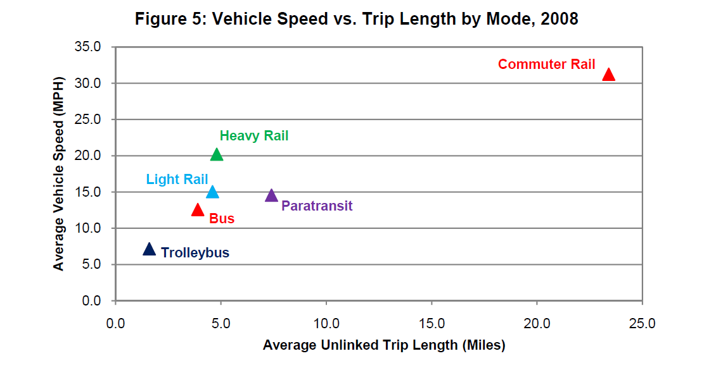
From APTA Fact Book
Notes:
APTA Fact Book 2010, page 12. Very basic introduction to characteristics of different modes. Rail modes tend to be higher speed and longer length in general. Note that APTA uses “Heavy Rail” not “Metro”. Within buses, the “bus” category includes local and express buses, and express buses tend to have higher trip lengths and speeds. Trolleybuses are a special category of buses using electric wires and are limited only to very dense urban areas, thus they are at the low end of the bus spectrum for both speed and trip length. Commuter rail is a special form of rail service designed for long trips between city centers and distant suburbs. Paratransit trips include rural transit which can be fairly long trips at relatively high speeds.

Slide 7
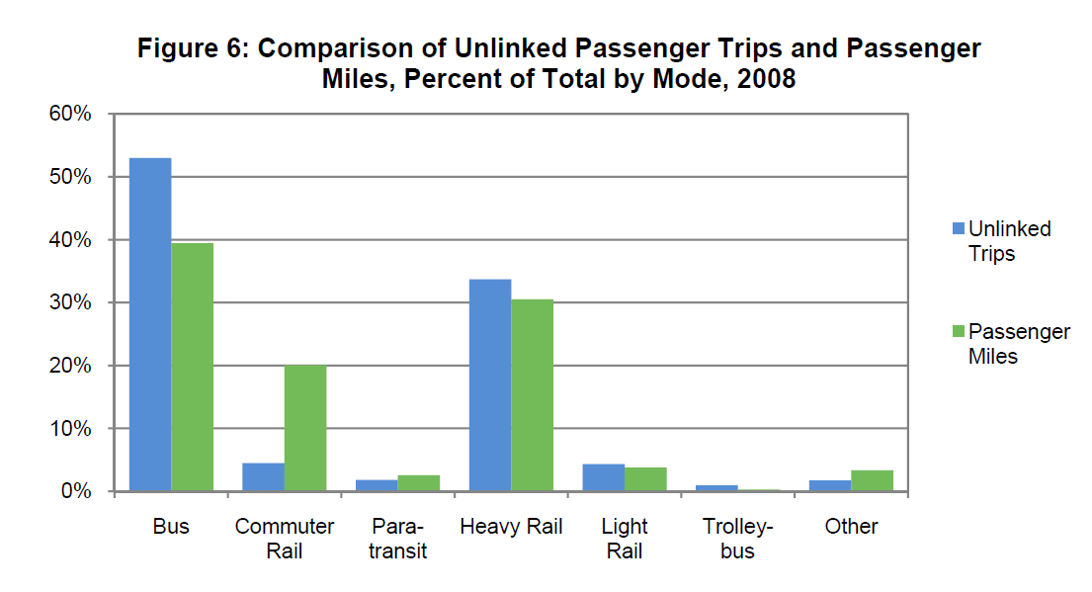
From APTA Fact Book
Notes:
APTA Fact Book 2010 page 13. Buses are over 50% of passenger boardings (unlinked trips) while less than 40% of passenger miles. Heavy rail is present in only a few cities but account for about 30% of nation’s transit use (and 70% of that is New York City). The commuter rail data is largely the three systems serving NYC (LIRR, Metro-North, NJ Transit), plus Philadelphia, Chicago, Boston, along with several newer smaller systems.

Slide 8
Transportation Modes: Density Served
Densities – lower to higher
Origin/Destination pairs – spread to concentrated
  Auto/taxi
  Carpool/shared taxi/vanpool
  Jitney/publico/demand-response minibus
  Fixed Route bus
  Bus Rapid Transit (BRT)
  Light Rail
  Metro/rail rapid transit (incl. automated guideway and monorail, and, to some extent, commuter/regional rail*)
Notes:
All transportation modes included here, not just transit. Blending of private and public providers. Very common to think of the modes as being appropriate for certain densities. Density of demand is the key, which is related to residential and commercial density (trip generation and attraction) and the desire lines between them.
* for commuter rail means it is hard to categorize because it is usually serving a relatively low density on one end with a very concentrated and high density on the other end.

Slide 9
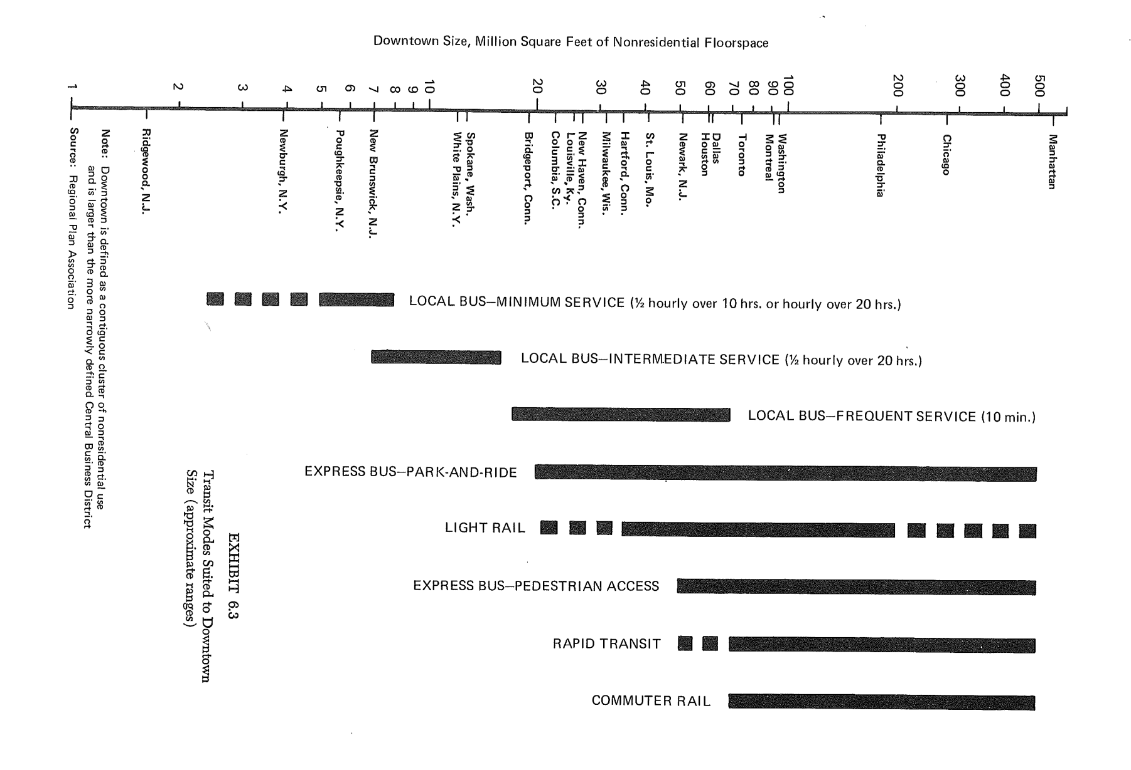
Transit Modes and Downtown Size
Notes:
Boris S. Pushkarev and Jeffrey M. Zupan.
Public Transportation and Land Use Policy.
Indiana University Press, Bloomington, IN, USA, 1977.
This table shows how different sized downtowns can support more intensive modes. Of course, these are very approximate values, but it illustrates how the spectrum of transit modes can be applied across different service areas.
For example, express bus service works for many different-sized downtowns, but for smaller ones, can only support a few routes and auto access is needed to assemble a bus load of people. For larger city’s downtowns, more lines can be supported and therefore park and ride is not essential to getting adequate ridership.
This can also be viewed as a historical table – thinking from 20-30 years ago, that attempted to lay out where modes are appropriate. Lines are being blurred more now.

Slide 10
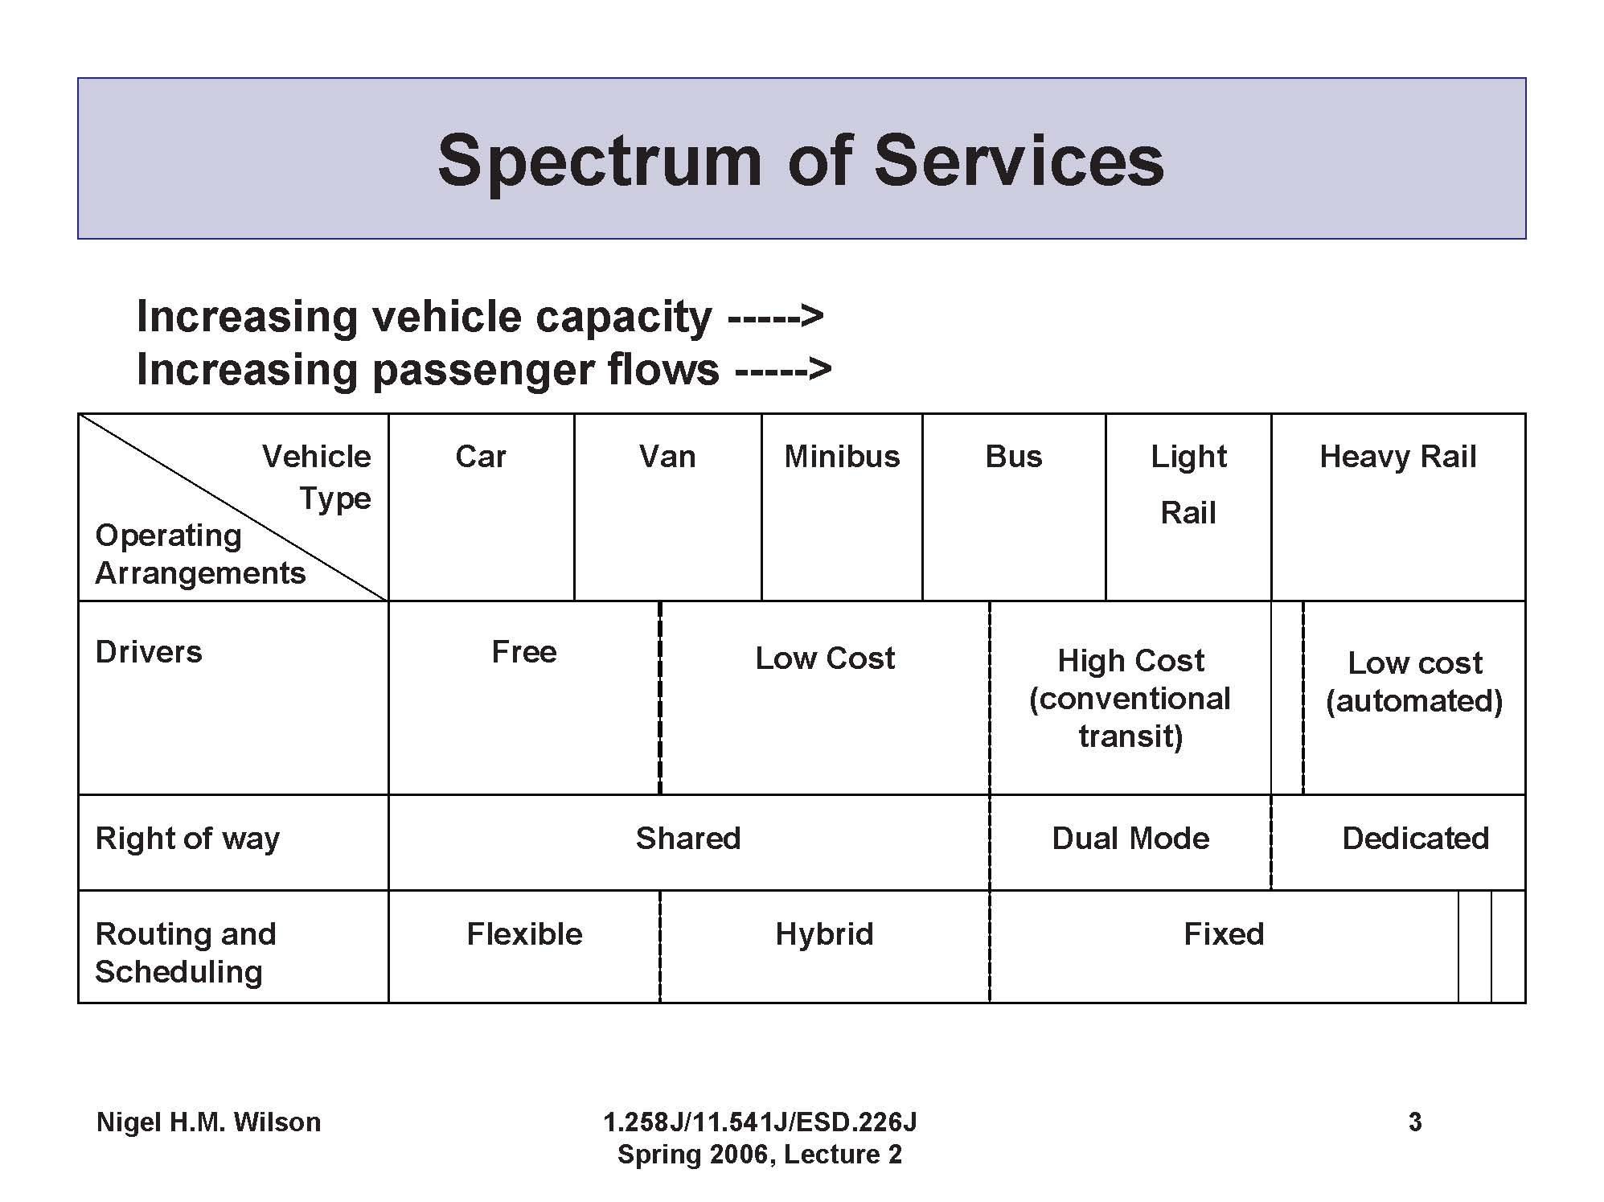
F
Notes:
Slide from from Nigel Wilson MIT course 1.258J (Open Courseware). This slide is a is a quick summary of several Vuchic tables and should be attributed to Nigel Wilson, or we can create our own version. For full discussion and background, see Chapter 12 of Vuchic, Urban Transit – Operations, Planning, and Economics.

Slide 11
Elements of Transit Modes
Right of Way
  C : street with mixed traffic
    Shared street space (most buses, streetcar, some LRT)
    Signal priority possible
  B : partially separated
    Separate running lane/track with at-grade crossing (most light rail, some BRT)
  A: fully separated
    Underground or aerial (heavy rail / metro, some LRT)
Notes:
Summarized in Vuchic Table 12.1 – full discussion section 12.1.1.

Slide 12
Elements of Transit Modes (cont.)
Vehicle Support
  Steel wheels on rail vs. rubber tires on road surface
    Some Metros (Paris, Montreal) are rubber-tired
Vehicle Guidance
  Steered vs. Guided
    Rail vehicles are laterally guided by track
    Rubber-tired vehicles can also be guided
Notes:
Summarized in Vuchic Table 12.1 – full discussion section 12.1.2.1 and 12.1.2.2.

Slide 13
Elements of Transit Modes (cont.)
Propulsion
  Internal Combustion
    Diesel (incl. Bio-diesel), CNG, LNG, etc.
  Electric
    Via external power (overhead wire, third rail, etc.)
    Electric/Hybrid via on-board generator, fuel cell, etc.
Driving Control
    Manual (observe and obey signals)
    Automatic Train Operation (with driver assist / override)
    Fully automated
Notes:
Summarized in Vuchic Table 12.1 – full discussion section 12.1.2.3 and 12.1.2.4.

Slide 14
Bus (Defined)
Vehicle operating as a single unit with rubber tires on pavement, with manual control of movement forward and laterally.
  Size/capacity has very wide range (minibus to double-articulated).
  Can run on any type of ROW (fully shared to exclusive), high or low-floor, fare collection on board or off board.
  Can use any type of propulsion (ICE, electric, hybrid)

Slide 15
Light Rail (Defined)
Vehicle operating as a single unit or in 2-4 car trains with electric motors and overhead power, steel wheels on rail.
  Size can vary from rigid streetcar to double articulated.
  Can run on any type of ROW (fully shared to exclusive), high or low-floor, fare collection on board or off board.
  All levels of automation possible, as appropriate for ROW. More commonly manual.
Notes:
For light rail at the high end of investment – including exclusive ROW – Vuchic uses the term Light Rail Rapid Transit.

Slide 16
Metro (Defined)
Vehicle operating in trains with electric motors on fully separated rights of way with level boarding and off-board fare collection.
  Train lengths up to length of platforms, with single operator (or automated).
  Power more typically from below (e.g. 3rd rail), which is possible because ROW is exclusive.
  High level of automation up to full automation.
  ROW can be above or below grade or fenced at grade.
Notes:
Can also use this slide to discuss monorails. “Futuristic” technology from the 1950s but sleek look is still very appealing to public. Monorails used for single lines, including longer distance, but have many operational limitations, especially related to switching (crossing) as would be necessary in a rail network.

Slide 17
AGT (Defined)
Automated Guideway Transit
Highest degree of automation
Driverless vehicles operating as individual units (or pods) or as multiple unit trains
Usually rubber-tire along concrete elevated guideway.
  Short distance (Miami, Detroit, Jacksonville)
  Long distance (Vancouver SkyTrain)
People-Mover vs. Personal Rapid Transit
Notes:
This type of “futuristic” system has actually been around since 1974 – DFW inter-terminal shuttle. Many examples of these systems in airports for short travel, but there are also an increasing number of longer-distance ones in operation (in 1980s and 1990s). The “people mover” systems are well-established as both medium and high capacity systems, simply taking an metro to the level of full automation, allowing extremely high frequency. Personal Rapid Transit is a less-established concept of small pods that will take you to a specific destination. Morgantown, WV, PRT was built in 1975 to demonstrate the feasibility of this concept, but it was limited to just a few destinations. Vuchic says PRT proven to be operationally and economically infeasible, but new systems are being built. Heathrow Airport was a test concept that is in operation, and this is going to be implemented on a much larger scale in Amritsar, India. PRT also functioning in Masdar City, UAE.

Slide 18
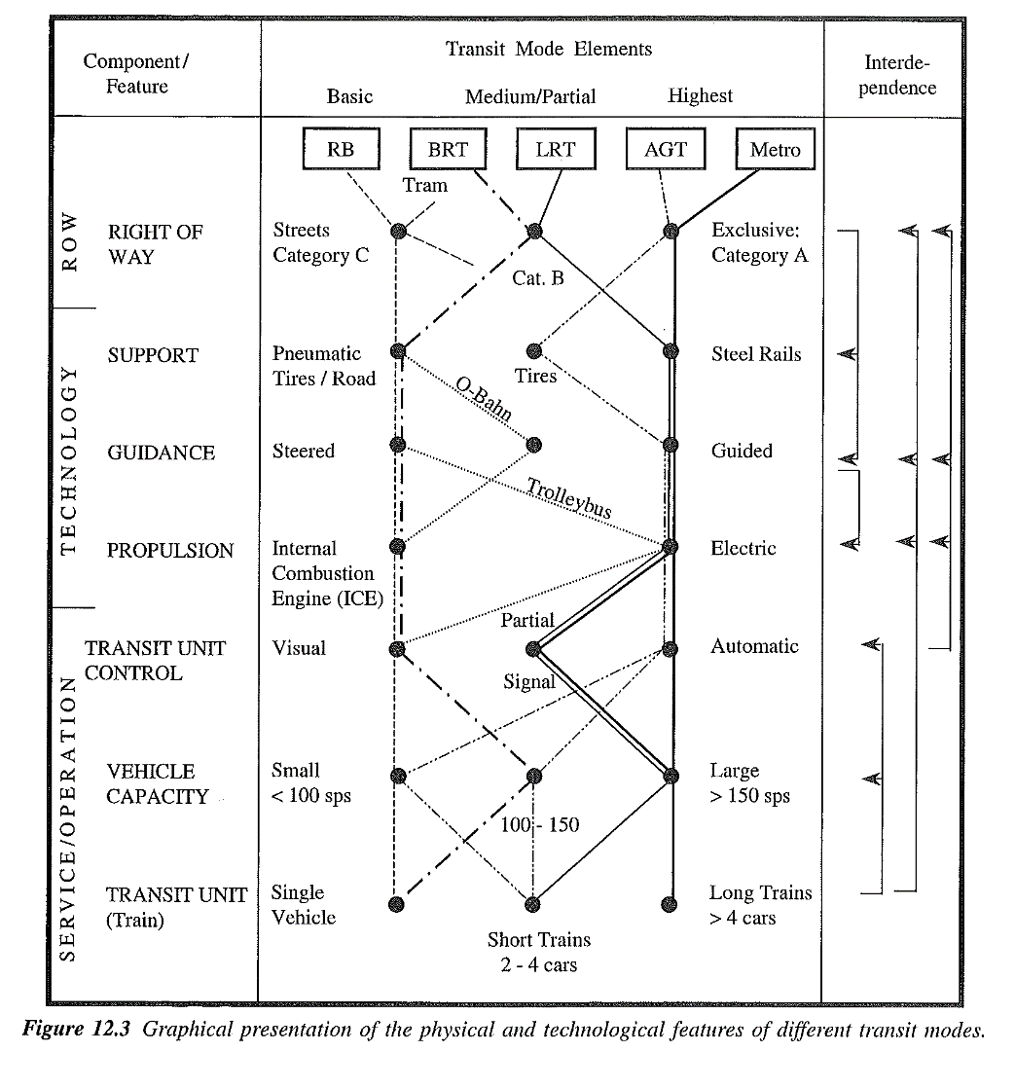
Notes:
Using Vuchic figure 12.3 (pg 567) to illustrate mixing of elements in different modes. Discuss how the lines between modes is constantly evolving with new technologies. It is not static.

Slide 19
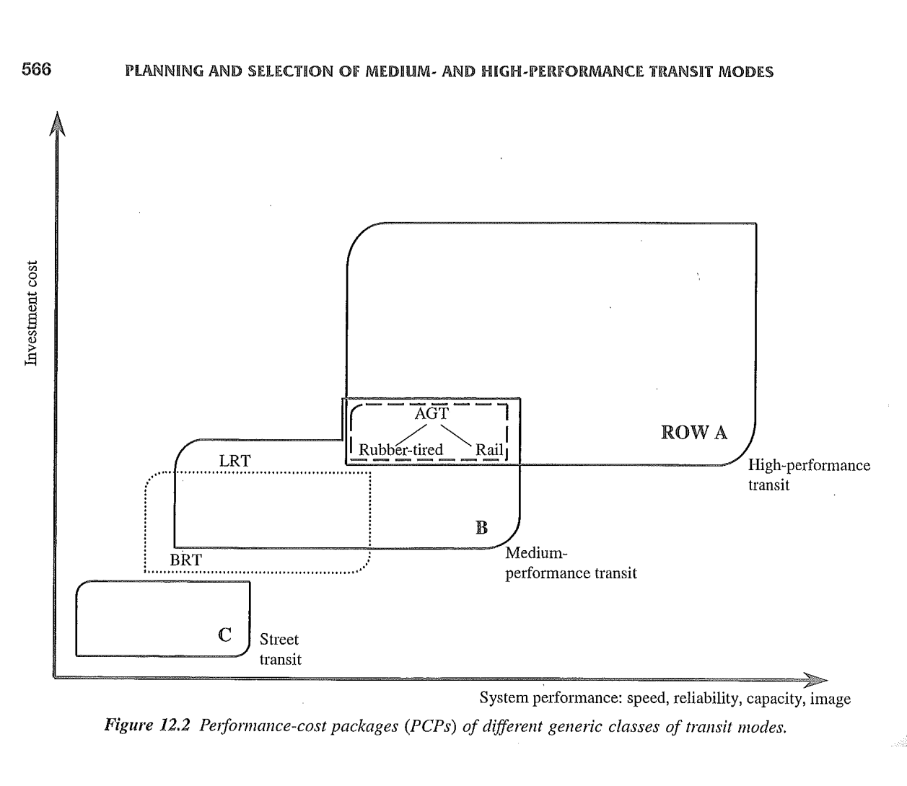
Cost vs Performance (Vuchic)
Notes:
Need permission for use. Urban Transit – Operations, Planning, and Economics, Vuchic, Figure 12.2, page 566.
Line Capacity stats from Table 12.4 (“spaces” per hour):
Bus – 3000-6000 Tram – 10,000-20,000
BRT – 6000-24,000 Light Rail – 10,000-24,000 AGT – 6000-16,000
LRRT – 10,000-28,000 Metro – 40,000-70,000 Regional Rail – 25,000-40,000

Slide 20
Speed vs. Accessibility (Meyer)
Notes:
Need permission for use. From Urban Transportation Planning, Meyer and Miller, Figure 3.4, page 99. Speed vs Accessibility (where access is not ADA but where individuals can access the mode). This is yet another way to think of how the different modes relate to each other.

Slide 21
Modal Comparisons
Higher Investment Modes (e.g., Rail)
  Higher capacity
  Lower operating cost per passenger
  Higher quality of service
  Stronger image of permanence and land use influence
  Fewer negative impacts from operation
Lower Investment Modes (e.g., Buses)
  Lower capital cost (shared public investment)
  Wider coverage
  More flexibility
  Easier to update to modern technologies
Notes:
Vuchic Chapter 12 has several summary boxes providing advantages and disadvantages of systems using different modal characteristics.
Rail: “lower operating costs per passenger” is dependent on the rail system being located in a high demand environment such that the ridership is sufficient to bring down the average cost per passenger. Note that the capital cost is clearly higher for rail and the operating costs are high too, but, with sufficient ridership, the cost advantage of rail is being able to absorb very high levels of ridership at relatively low marginal cost. Without high ridership, rail has higher operating costs per passenger.
Rail: “higher quality of service” is referring to ride quality, comfort, and safety (from reduced of interaction with other vehicles).
Rail: “image of permanence” – people see stations and tracks at all times (unlike a bus which is only seen when it is running) and know they are not going away. In addition, the transit system maps usually show rail lines as thicker and more visible lines.
Rail: “fewer negative impacts” – rail usually powered by electricity with no vehicular emissions and quieter motor. Also, subways are underground and do not impact surface traffic flow.
Bus: “shared public investment” is referring to the streets that buses use for their right of way.
Bus: “Wider coverage” is getting at geographic coverage. One lesson from South American and Australian BRT systems is that they have implemented multiple lines of service for a full network for the cost of a single rail line. More general point is that bus can cover wider area because very little additional investment is needed (capital cost for a single bus and the operating cost to run it).
Bus: “Flexibility” is both in time and space. One of the selling points of the 1950s shift from rail to bus lines was that the buses could go around obstructions like double-parked trucks or minor construction, while rail vehicles were stuck. Being able to re-route over time is important, too, if a new development locates near a bus line, it can be extended. However, that is also the flip side of the rail positive “stronger land use influence”. The permanence of rail is a positive because a bus line can be here today and gone tomorrow. Similarly, transit operations are more efficient if the new development locates adjacent to the service rather than further away with the hope that service will be changed to accommodate it.
Bus: “Easier to Update”: Shorter life requires life cycle costing to compare capital costs but enables updating to most current technologies and design features more often.

Slide 22
Cautions about Generalizations
Level of Service characteristics associated with modes may not always apply
  Speed – based on exclusivity, stop spacing, topography, propulsion, system condition (example: Express Bus vs. streetcar)
  Frequency – based on capacity, demand, and operating resources
For any mode, higher quality typically requires higher cost
  Tradeoffs between aspects of quality
Notes:
The first point is to note that rail is not necessarily faster than bus. In fact, the average speed for express bus service is considerably higher than for streetcars. What affects speed are the conditions noted. A bus operating in an exclusive ROW with wide stop spacing will be faster than a rail car in mixed traffic and close stops. The reason we assume rail service is faster than buses is because of the system characteristics rather than the mode itself.
Similarly, the perception may be that rail service is more frequent than bus service but that is generally because rail serves very dense travel corridors which require a high frequency of service.

Slide 23
Image is a Very Significant Element
Rail as first class / Bus as second class
Bus Rapid Transit attempts to make image of bus more positive (in some cases by not calling it a “bus”)
Competition between cities
Modern looking vehicle = forward thinking region
Historic look streetcar can appeal to nostalgic/touristy image
Notes:
In addition to these points, note that alternative fuel or hybrid “badging” on buses can appeal to environmental sensitivities.

Slide 24
Summary
Wide range of modes available
Diversity of features and characteristics within modes
Key is to find the mode to fit the role
  Provide data on characteristics in a way that encourages input from stakeholders
  Each element can be considered independently
    ROW, Support, Guidance, Propulsion

