Slide 1
Introduction to Public Transportation
Instructor: Dr. Jill Hough
Module 1 – Lesson 1

Slide 2
Introduction to Public Transportation
Module 1, Lesson 1
Notes:
Ask students to write a definition of public transit - give them five minutes to do so then ask for responses.

Slide 3
Module 1: Introduction to Public Transportation
Lesson 1: What is Public Transportation?
Lesson 2: The History of Public Transportation
Lesson 3: The Business of Public Transportation
Notes:
This course consists of seven modules. This first module contains three lessons. The first lesson will focus on “what is public transportation?”; The second lesson will provide a history of public transportation; and the third lesson will focus on the “business of public transportation.”

Slide 4
Learning Objectives
Describe the components of public transportation
Identify the transit options available in your community
Illustrate ways communities view public transportation
Recognize that there is no universal structure for transit
Notes:
These learning objectives of this lesson are that you will be able to describe public transportation; Identify the transit options available in your community; Illustrate ways communities view public transportation; and recognize that there is no universal structure for transit. Each system differs because of many factors.
illustrate that this intro is a quick review – and is provided after students first define what public transit is …and these slides will help enhance their understanding of the range of services in the definition. The assignment that follows asks students to research public transportation in their communities and in cities of varying sizes…The learning builds upon their homework throughout the sessions for Module 1.

Slide 5
Overall Context
Public transportation, and its many components and options, is at the center of a community’s ability to function, not just in recent time, but across decades.

Slide 6
What is Public Transportation?
In 2011 there were 7,100 public transportation service systems that provided transportation rides in the U.S., by various modes.
Of those, 825 were operating in Urbanized Areas and 1,440 were in Rural.
There were 10.7 billion public transit trips taken in 2013
Passengers traveled 54 billion miles; average trip length was 5.4 miles.
Source: American Public Transportation Association.
Public Transportation Fact Book – 2013 and www.apta.com
Notes:
Data taken from APTA 2013 Fact Book check for availability of 2014, not available until this fall.
MTA New York City Transit carried passengers on 3.3 billion trips for 12.1 billion miles.
60% of trips taken on buses
38% of trips taken on rail vehicles
$47 billion industry; employs more than 370,000 people
2012 Fact Book still in Progress……

Slide 7
Transit Modes
Bus (including bus rapid transit and commuter bus)
Demand Response
Commuter Rail
Heavy Rail
Light Rail (including streetcar and hybrid rail)
High Speed Rail
Ferryboat
Notes:
Transit is made up of the following modes and can be broken down into Rail and Non-Rail:
Demand Responsive/ Paratransit/ Taxi
Bus
Light Rail
Heavy Rail
Commuter Rail
High Speed Rail

Slide 8
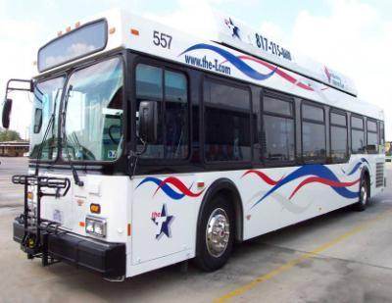
Bus
The most common form of mass transit service provided throughout the United States
Buses operate on fixed routes and schedules over existing roadways
Buses must be in compliance with mass transit rules including Americans with Disabilities Act (ADA) provisions
Notes:
Buses can be operated in fixed or flexed configuration and include commuter buses and intercity buses.
Most widespread form of transit given that it represents the mode with the largest number of systems (1,206 as of the September 2012, APTA Fact Book) and largest passenger trips and miles constituting 52% and 38.9% by mode respectively.
Bus is a mode of transit service (also called motor bus) characterized by roadway vehicles powered by diesel, gasoline, battery, or alternative fuel engines contained within the vehicle. Vehicles operate on streets and roadways in fixed-route or other regular service. Types of bus service include local service, where vehicles may stop every block or two along a route several miles long. When limited to a small geographic area or to short-distance trips, local service is often called circulator, feeder, neighborhood, trolley, or shuttle service. Other types of bus service are express service, limited-stop service, and bus rapid transit (BRT).

Slide 9
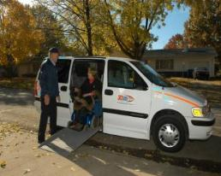
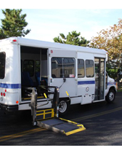
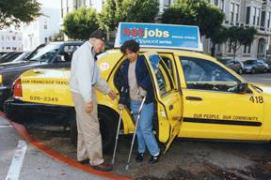
Demand Response Paratransit
9
Service (passenger cars, vans or small buses) provided upon request to pick up and transport passengers to and from their destinations
Typically, a vehicle may be dispatched to pick up several passengers at different pick-up points before taking them to their respective destinations and may be interrupted en route to these destinations to pick up other passengers

Slide 10
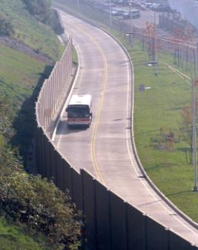
Bus Rapid Transit
Is an innovative, high capacity, lower cost public transit solution that can significantly improve urban mobility, according to NBRT.
Number of BRT sites are increasing.
National Bus Rapid Transit Institute is located at the University of South Florida.
Notes:
What is Bus Rapid Transit? from NBRT site - http://www.nbrti.org/
BRT is an innovative, high capacity, lower cost public transit solution that can significantly improve urban mobility. This permanent, integrated system uses buses or specialized vehicles on roadways or dedicated lanes to quickly and efficiently transport passengers to their destinations, while offering the flexibility to meet transit demand. BRT systems can easily be customized to community needs and incorporate state-of-the-art, low-cost technologies that result in more passengers and less congestion
Definition of bus rapid transit on this slide ….various levels all the truly characteristics designated lane on off boarding etc. not look the same

Slide 11
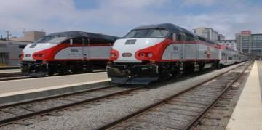
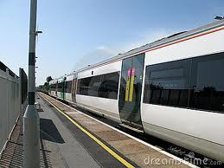
Commuter Rail
Local (short-distance) travel operating between a central city and adjacent suburbs
Service is provided on regular schedules, moving commuters within urbanized areas or between urbanized areas and outlying areas
Multi-trip tickets and specific station-to-station fares characterize commuter rail service, with one or two stations in the central business district
Notes:
In 2011, 28 systems operated commuter rail compared to 18 in 1979.
127 miles under construction
886 miles proposed
Definition: Commuter Rail - http://heritagetrolley.com/defCommuterRail.htm
Commuter rail refers to passenger trains operated on main line railroad track to carry riders to and from work in city centers. The trains are normally made up of a locomotive and a number of passenger coaches. The coaches are dimensionally similar to intercity (Amtrak) coaches, but typically have higher density seating as the average ride is shorter. Commuter rail lines normally extend an average of 10 to 50 miles from their downtown terminus. In some cases service is only offered in rush hours. In other cities, service is operated throughout the day and evening and on weekends. Service rarely is offered more frequently than one train every 30 minutes and station spacing is typically measured in miles. Commuter rail systems (some electrified, some diesel hauled) are traditionally associated with older industrial cities such as Boston, New York, Philadelphia, and Chicago, but in recent years new diesel powered commuter rail systems have been inaugurated in cities as diverse as Los Angeles and Burlington, Vermont, as traffic congestion has made auto commutes much more difficult. Many additional cities are planning commuter rail lines currently. Commuter rail lines can be relatively inexpensive to build as they normally operate over existing rail lines. However, typical planning challenges are negotiating use of the tracks with very busy freight rail operators and finding adequate funding both for construction and for operating subsidies.

Slide 12
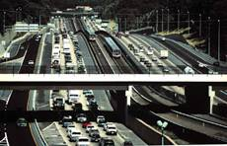
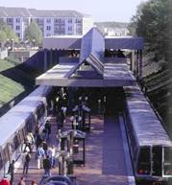
Heavy Rail
Heavy rail service is characterized by high-speed and rapid acceleration passenger rail cars operating singly or in multi-car trains on fixed electric rails, with separate rights-of-way from which all other traffic is excluded
Has sophisticated signaling, high platform loading and a heavy passenger volume
Notes:
Definition: Heavy Rail - http://www.heritagetrolley.com/defHeavyRail.htm
Heavy rail refers to traditional high platform subway and elevated rapid transit lines. Principal characteristics are operation over rights of way that are completely segregated from other uses, with the track placed in subway tunnels, on elevated structures, or on fenced surface rights of way, free of grade crossings with roads. Trains consist of anywhere from two to 12 cars, each with its own motors, and drawing power from a third rail (or in some cases from overhead wire). Boarding is from high platforms that are even with the floor level of the car, allowing large numbers of people to enter and leave rapidly. Before World War II, true heavy rail rapid transit systems existed only in Boston, New York, Philadelphia, and Chicago. Since the war, new systems have been opened in Cleveland, Baltimore, Washington, the San Francisco-Oakland region, Los Angeles, Atlanta, and Miami, plus Montreal and Toronto in Canada.
Heavy rail systems are extremely expensive to build due to the need to build tunnels, elevated structures, or other fully segregated rights of way and to accommodate more gentle curves and grades than are needed for light rail or streetcars. Given the high costs and the recent huge overruns of the Los Angeles rapid transit construction, funding of new heavy rail systems in the United States has become much less likely.
In 2011, there were 15 heavy rail systems in 15 metro areas including San Juan, Puerto Rico. An additional 103 miles have been proposed.

Slide 13
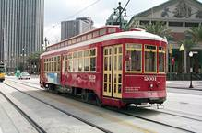
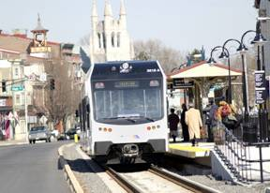
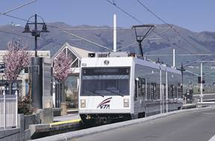
Light Rail
An electric railway that operates local service in mixed traffic with road vehicles, or has grade crossings with roadways
Characterized by short trains of one to four cars and by relatively short distances between stops for local service within a city and the immediate suburbs
Notes:
Increased from 9 systems in 1979 to 27 systems in 2011
More than 190 miles of light rail currently under construction;
More than 300 miles proposed
Include list in Resources:
http://www.wordiq.com/definition/List_of_light-rail_transit_systems#United_States
United States

Slide 14
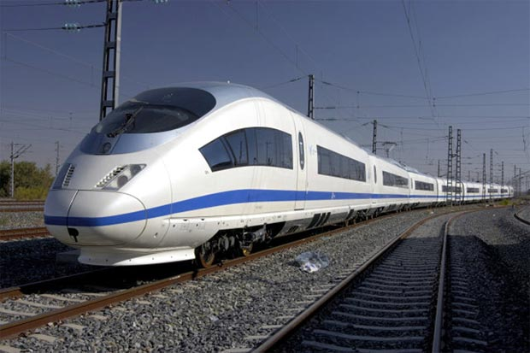
High Speed Rail
The U.S. government considers high-speed rail service to be rail service of 110 miles per hour (180 km/h) or higher
The only operational high-speed train in the U.S. would be Amtrak’s Acela Express
A federal allocation of $8 billion for high-speed rail projects was part of the 2009 stimulus package
The first dedicated high-speed rail
in the U.S. will likely be in California
Notes:
On April 16, 2009, President Obama, together with Vice President Biden and U.S. Transportation Secretary Ray LaHood, announced a new vision for developing high-speed intercity passenger rail in America, calling for a collaborative effort by the federal government, states, railroads, and other key stakeholders to help transform America’s transportation system through the creation of a national network of high-speed rail corridors. To achieve this vision, FRA published the High-Speed Rail Strategic Plan in April 2009 and launched the High Speed Intercity Passenger Rail (HSIPR) Program in June 2009.
To realize President Obama’s vision of giving 80% of Americans access to high-speed rail within the next 25 years, Congress made $8 billion available through the American Recovery and Reinvestment Act of 2009 (ARRA). Congress continued to build upon the Recovery Act by making available an additional $2.1 billion through annual appropriations for FY 2009 and 2010, using the framework initially established by the Passenger Rail Investment and Improvement Act of 2008 (PRIIA), bringing the total program funding to $10.1 billion.

Slide 15
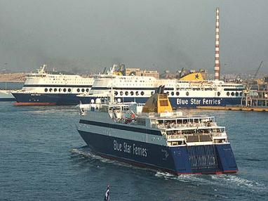
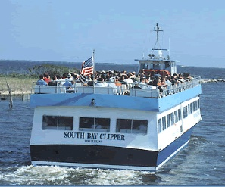
Ferries
Vessels carrying passengers, and in some cases vehicles, over a body of water
They are generally steam or diesel-powered
Notes:
Ferry Boat is a transit mode comprising vessels carrying passengers and in some cases vehicles over a body of water, and that are generally steam or diesel-powered. When at least one terminal is within an urbanized area, it is referred to as urban ferryboat service. Such service excludes international, rural, rural interstate, island, and urban park ferries.
In 1979, 16 systems offered Ferry Boat Transit services, in 2010, that number had increased to 51.

Slide 16
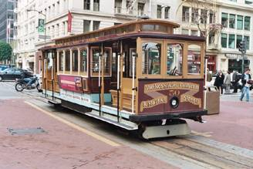
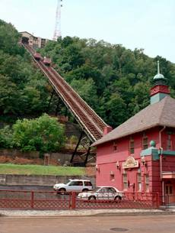
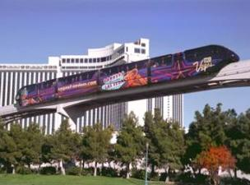
Other
Notes:
A Cable Car can be described as a railway with individually controlled transit vehicles attached while moving on guard rails located below the street surface and powered by engines or motors at a central location not on board the vehicle.
Inclined Plane is a railway operating over exclusive right-of-way on steep grades (slopes) with powerless vehicles propelled by moving cables attached to the vehicles and powered by engines or motors at a central location not on board the vehicle. The special tramway type of vehicles has passenger seats that remain horizontal while the undercarriage (truck) is angled parallel to the slope.
Aerial Tramway is electric system of aerial cables with suspended powerless passenger vehicles. The vehicles are propelled by separate cables attached to the vehicle suspension system and powered by engines or motors at a central location not on board the vehicle.
Monorail is an electric railway of guided transit vehicles operating singly or in multi-car trains. The vehicles are suspended from or straddle a guide way formed by a single beam, rail, or tube.
A People Mover is a fully automated, grade-separated mass transit system. It is generally used to describe systems serving relatively small areas such as airports, downtown districts or theme parks, but is sometimes applied to considerably more complex automated systems. Larger people movers are also called “automated guideway transit.”

