Slide 1
The Business of Public Transportation
Module 1, Lesson 3
Introduction to Public Transportation

Slide 2
Learning Objectives
Examine the social and economic benefits of public transportation
Analyze the role of public transportation in the livability of a community and quality of life of residents
Illustrate the benefit of public transportation for non-riders
Capture the vital role that public transportation plays in the delivery of community services, economic development, quality of life and the enhancement of the livability of a community.

Slide 3
Overall Context
Public transportation helps promote economic prosperity and competitiveness through the movement of goods and people.
It increases an individual’s mobility and quality of life
Promotes environmental sustainability

Slide 4
Challenges Facing America
Higher energy prices/higher gas prices
Congestion
Population growth
  U.S. Census: nearly 420 million people living in U.S. by 2060
Population aging
  U.S. Census: projects that Americans age 65 and older is expected to more than double between 2012 and 2060, from 43.1 million to 92.0 million
  More than 1 in 5 Americans age 65 and older do not drive
Notes:
The nation’s total population would cross the 400 million mark in 2051, reaching 420.3 million in 2060. (Press release from Census.gov, 12/12/12: http://www.census.gov/newsroom/releases/archives/population/cb12-243.html)
The points on this slide need to be:
Population shifts – From 2000 to 2010, regional growth was much faster for the South and West (14.3 and 13.8 percent, respectively) than for the Midwest (3.9 percent) and Northeast (3.2 percent). Nevada was the fastest-growing state, followed by Arizona, Utah, Idaho and Texas. Rhode Island, Louisiana and Ohio were the slowest. (http://www.census.gov/prod/cen2010/briefs/c2010br-01.pdf)
Climate change and cost of automobile
Congestion

Slide 5
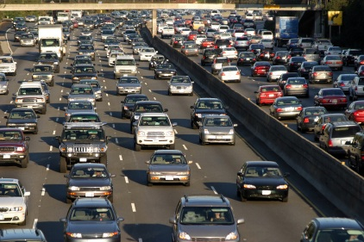
Notes:
Lecture notes – Public transportation mitigates congestion

Slide 6
Reduces Congestion; Costs Would Have Been Worse
Billions of Dollars
Congestion delay cost: $78.2 billion
If no public transit: additional $10.2 billion (TTI)
Notes:
Update ??????????

Slide 7
Overview of U.S. Public Transportation –
The Big Picture update
U.S. ships 19 billion tons of freight annually
15,000 ton miles of freight is shipped per person per year
Americans take 410 billion trips per year covering 5.5 trillion miles
(equal to 30,000 round trips to the sun each year)
Notes:
The economic reasons for public transportation begins with the understanding of goods movement to economic well being and then transit’s ability to take cars off the road and mitigate the impact of transportation on the environment for example
CHECK AND UPDATE NUMBERS– BUREAU OF TRANSP STATS?

Slide 8
Overview of U.S. Transportation
The Future
Demand for transportation is expected to continue to grow rapidly – National Surface Transportation Policy and Revenue Study Commission
Population – expected to grow by nearly 120 million by 2050
Vehicle Miles Travelled (VMT) – expected to grow 1.72% annually through 2050
Freight – expected to grow from 15 billion tons in 2004 to
29 billion tons in 2035 – a 90% increase

Slide 9
Transit Decreases Dependence on Foreign Fuel; Conserves Energy
Households near public transit drive an average of 4,400 fewer miles annually – saving 4.2 billion gallons of gasoline – more than
3 times the amount of gas imported from Kuwait
Oil
Consumption
Drops

Slide 10
It Shouldn’t be Surprising Most Travel is by Private Vehicles
National Transportation Statistics Survey – U.S. DOT

Slide 11

Public Transportation Benefits
Riders – Saves Money
Individuals who switch from driving to taking public transit can save, on average, $9,854 a year
Access to bus and rail lines reduces driving by 4,400 miles per household annually.
Americans living in areas served by public transportation save 785 million hours in travel time and 640 million gallons of fuel annually in congestion reduction alone.
Without public transportation, congestion costs
would have been an additional $19 billion.
Notes:
Transit Savings Report August 2012 (http://www.publictransportation.org/tools/transitsavings/Pages/default.aspx)
And Transit Facts at a Glance
http://www.publictransportation.org/news/facts/Pages/default.aspx

Slide 12
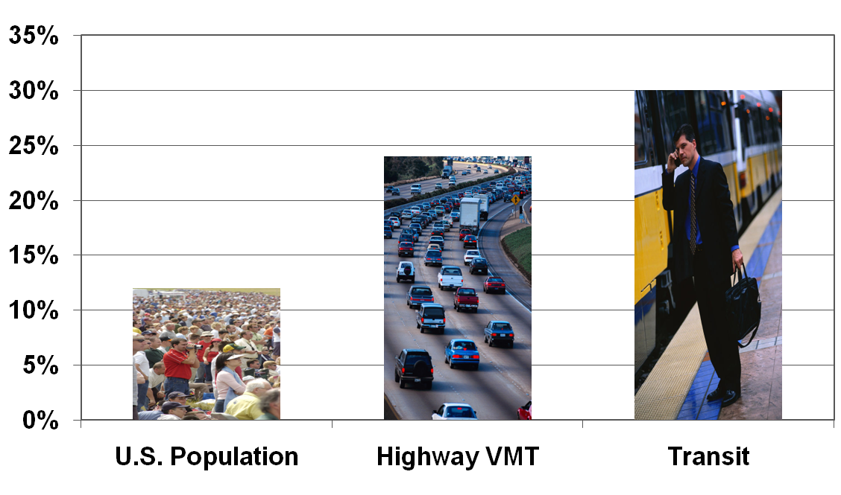

Transit Use Growing Faster Than Highway Use (1995 – 2009)
(14%)
(24%)
(32%)
Notes:
Table 1-36: Roadway Vehicle-Miles Traveled (VMT) and VMT per Lane-Mile by Functional Classª (check folder).
VMT 1995 =1489534
VMT 2009 = 1974583
% CHANGE =(1974583-1489534)/1489534* 100 = 32.5
From Census bureau:
http://www.census.gov/popest/data/historical/2000s/vintage_2009/index.html
Population July 1, 2009 = 307,006,550
Population July 1 1995 = 262,803,000
% change=(307,006,550-262,803,000)/262,803,000 *100 = 16.8
http://www.apta.com/resources/statistics/Documents/Ridership/1996_q4_ridership_APTA.pdf
Unlinked trip
Transit use (000)
Jan-Dec 1995 =7863163
Jan-Dec 2009 =10194507
%change = (10194507-7863163)/7863163*100 = 29.6

Slide 13
Reduces Greenhouse Gases
Communities that invest in public transit reduce the nation’s carbon emissions by 37 million metric tons annually.
One person switching to public transit can reduce daily carbon emissions by 20 pounds, or more than 4,800 pounds in a year.
A single commuter switching his or her commute to public transportation can reduce a household’s carbon emissions by 10% and up to 30% if he or she eliminates a second car. When compared to other household actions that limit CO2, taking public transportation can be 10 times greater in reducing this harmful greenhouse gas.
Notes:
Data from: http://www.publictransportation.org/news/facts/Pages/default.aspx

Slide 14
Increases Mobility
For people with limited auto access
  Seniors – number will more than double by 2060
  Of the older Americans who cannot drive, 63% in rural areas stay home on a given day vs. 51% in urban areas
  People with disabilities – more than 40 million
Notes:
Taken from Aging Americans: Stranded Without Options, April 2004
http://www.apta.com/resources/reportsandpublications/Documents/aging_stranded.pdf

Slide 15
View of Transit
Social Access Transportation Economic Quality
Service to Jobs Development of Life

Slide 16
Promotes Safety
  The National Safety Council (NSC) estimated 34,700 deaths in private passenger vehicle crashes in 2010
  A total of 430,000 medically consulted motor-vehicle injuries were observed from Jan-Feb 2011 alone
  Associated costs including wage and productivity losses, medical and Admin expenses, employer cost and property damage was estimated at $30.2 billion
National Safety Council, 2011

