Slide 1
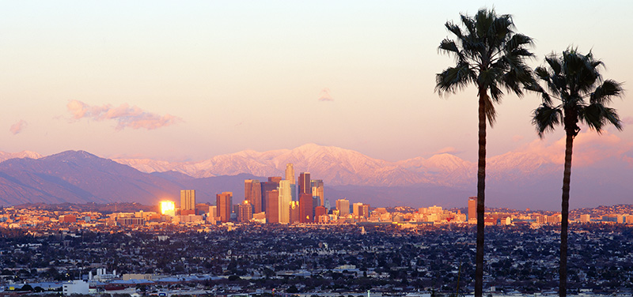

Los Angeles Metro
Technology Assessment
ZERO AND NEAR ZERO
BUS OPTIONS
APTA Webinar
June 30, 2016
Dana Lowell
M.J. Bradley & Associates, LLC

Slide 2
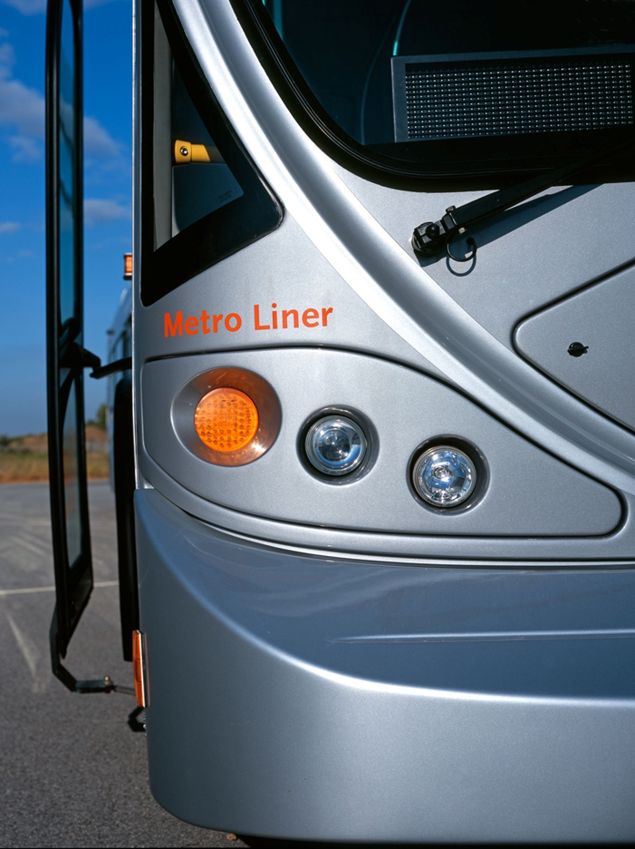
Background
California Air Resources Board has proposed a “Zero Emission Bus” (ZEB) rule
  Applicable to all California Transit Agencies
  All buses must be “zero emission” by 2040
  Only electric & fuel cell buses qualify as ZEB
LACMTA commissioned this study to:
  Evaluate cost of compliance with the ZEB rule
  Evaluate the costs and benefits of “near zero” emission options that are based on the continued use of natural gas

Slide 3
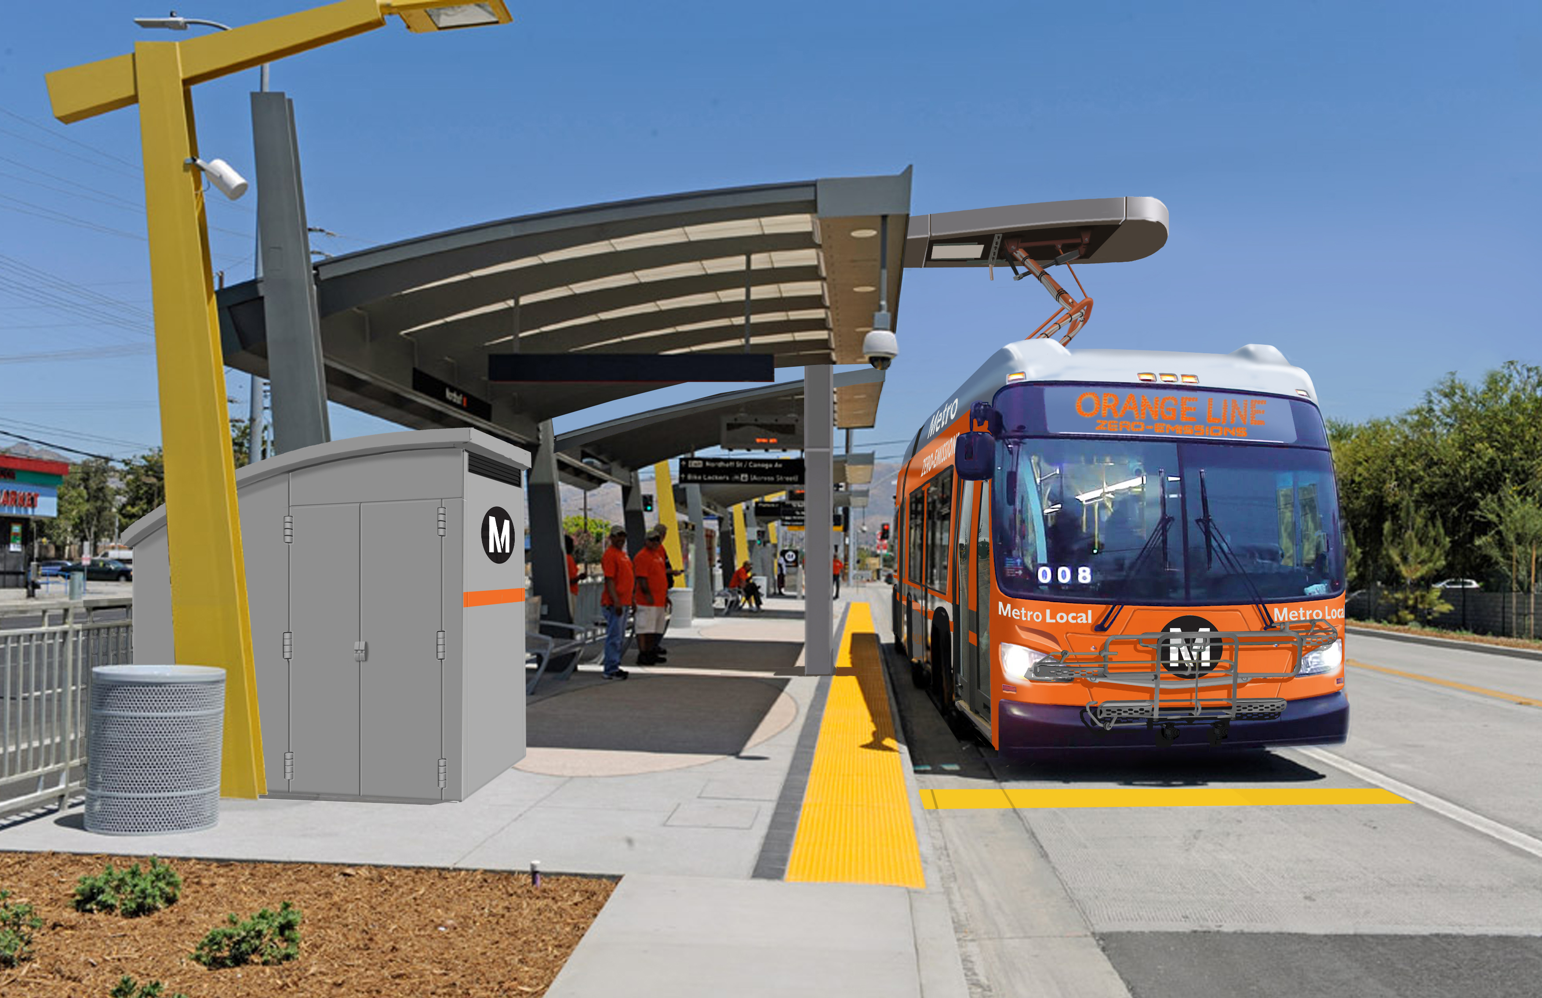
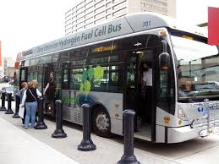
ZERo emission BUS options
BATTERY ELECTRIC BUS
Depot-only charging, or
Depot and in-route charging
HYDROGEN FUEL CELL BUS
Hydrogen fuel produced from electricity (electrolysis), or
Hydrogen fuel produced from natural gas (steam methane reforming)

Slide 4


“Near Zero” BUS Option
RENEWABLE NATURAL GAS (RNG)
  Produced by landfills, wastewater treatment plants, animal manure – anaerobic digestion
  Processed to remove water, sulfur, CO₂ - can be injected into pipelines, used in NG engines
LOW NOx NATURAL GAS ENGINE
  Commercially available from Cummins; based on ISLG platform used in transit
  90% lower tailpipe NOx than required by EPA/CARB; 70% lower tailpipe CH₄

Slide 5
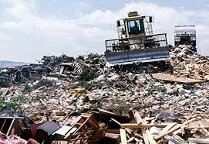
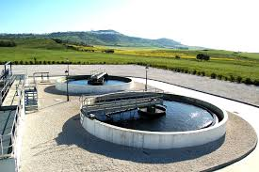

rENEwable natural gas
  RNG captures & uses a resource that is normally wasted
  This results in significant life cycle GHG reductions compared to petroleum NG

Slide 6
What did we do?
Estimated total fleet costs and “wells-to-wheels” fleet emissions from 2015 – 2055 under three bus technology/fuel options, compared to baseline business as usual:
  BASELINE: continue to buy “standard” CNG buses and conventional natural gas
  LNOx Bus + RNG: Starting in 2016 purchase Renewable Natural Gas and in 2018 start transitioning fleet to Low NO_{x} CNG engines
  ELECTRIC BUSES: In 2025 start transitioning fleet to electric buses
  FUEL CELL BUSES: In 2025 start transitioning fleet to hydrogen fuel cell buses

Slide 7
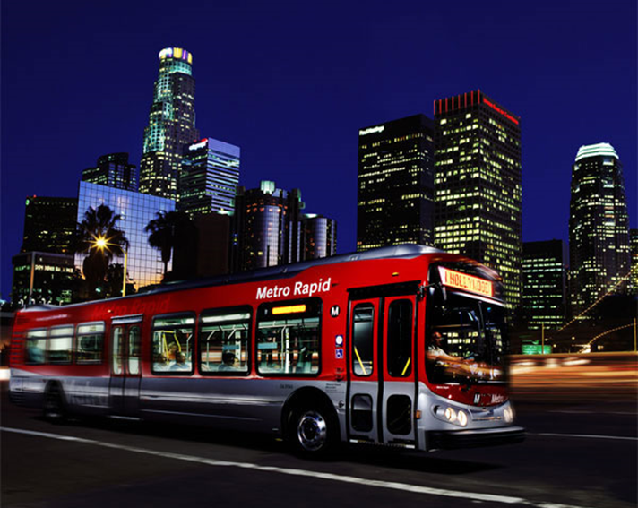
2016 LACMTA Fleet
All buses are CNG
  1,212 40-ft transit
  625 45-ft transit (composite)
  356 60-ft articulated
  2,194 total
75% of fleet has MY2007+ engines that meet most stringent EPA/CARB standards (0.2 g/bhp-hr NO_{x})
Approximately 7% of fleet (178 buses) are retired and replaced with new buses each year

Slide 8
Bus Technology/Fuel Scenarios
 | LNOx + RNG | ELECTRIC | FUEL CELL
FLEET REPLACE-MENT | Purchase 178 new buses/yr with LNO_{x} engines beginning in 2019 Repower 178 old buses/yr with LNO_{x} engines beginning in 2018 | Purchase 178 – 240 ¹ new electric buses/yr beginning in 2025. | Purchase 178 new fuel cell buses/yr beginning in 2025
FUELING | RNG provided through utility pipeline; fueling at existing CNG fuel stations | Depot based charging or Depot and In-route charging | Hydrogen fuel produced on-site by electrolysis of water or steam reforming of natural gas (SMR)
NEW INFRA-STRUCTURE | None required | Depot and In-route chargers. Depot expansion for expanded fleet, and for depot chargers | Hydrogen production and fueling stations Upgraded ventilation, H₂ sensors at depots
¹ Due to daily range restrictions 1.35 electric buses replace one existing CNG bus if charging is only at the depot

Slide 9
Major Cost Assumptions
 |  | BASELINE | LNOx + RNG | ELECTRIC | FUEL CELL
BUS PURCHASE | 2015 | $490,000 | $500,000 | $760,000 | $920,000
 | 2045 | $490,000 | $495,000 | $692,000 | $506,000
MID-LIFE OVERHAUL | 2015 | $35,000 | $38,000 | $281,000 | $335,000
 | 2045 | $35,000 | $38,000 | $237,000 | $135,000
DAILY RANGE | 2015 | NA | NA | 125 mi | NA
 | 2045 | NA | NA | 175 mi | NA
FUEL USE | 2015 | 0.48 therm/mi | 0.49 therm/mi | 2.1 kWh/mi | 0.16 kg/mi
 | 2045 | 0.48 therm/mi | 0.49 therm/mi | 1.9 kWh/mi | 0.14 kg/mi
FUEL COST |  | $0.78/therm | $0.78/therm | $0.006/kWh $0.028/kWh | $1.60/kg $4.62/kg
All costs in 2015 $, and do not include inflation. Inflation assumed to be ~2%/year
Fuel Costs: Higher electricity cost ($/kWh) for in-route charging, lower for depot charging. Higher hydrogen cost ($/kg) for electrolysis, lower for SMR
Costs for CNG, RNG, Electricity, and Hydrogen are net of Low Carbon Fuel Standard (LCFS) Credits

Slide 10
Major Cost Assumptions (cont)
 |  | BASELINE | LNOx + RNG | ELECTRIC | FUEL CELL
MAINT COST | 2015 | $0.850/mi | $0.865/mi | $0.808/mi | $0.867/mi
 | 2045 | $0.850/mi | $0.850/mi | $0.808/mi | $0.859/mi
FUEL INFRA-STRUCTURE |  | Future upgrade costs included in $/therm NG cost | Future upgrade costs included in $/therm NG cost | $41,000/bus (depot chargers) $14,000/bus (in-route chargers) | $105,000 /bus (H₂ production and fuel station)
DEPOT MODS |  | NONE | NONE | $36,000/bus (depot expansion) | $28,000/bus (H₂ sensors & ventilation)
All costs in 2015 $, and do not include inflation. Inflation assumed to be ~2%/year

Slide 11
Depot vs In-route Charging
LACMTA buses average 130 miles/day
  To be reliably used on ALL routes, need to have ~170 mile range per charge (30% operational reserve)
Current 40-ft electric buses have 325 kWh battery pack
  Can achieve ~125 mi/charge in Metro service (80% depth of discharge)
  With depot-only charging would need 1.35 electric buses for every CNG bus replaced, and dead-head mileage would increase due to in-service bus swaps
Alternative: Depot and In-route charging
  CNG buses can be replaced one-for one, no increase in dead-head mileage
  One or more chargers required at every bus lay-over (310 system-wide); assume 10 minutes charge time for every hour of driving

Slide 12
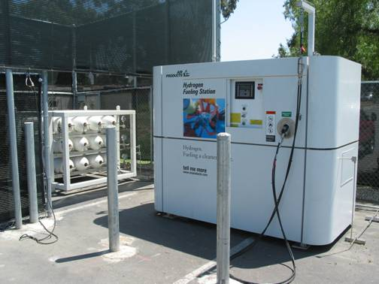
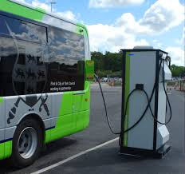
Infrastructure
Electric Bus
In-route Chargers
30 kW x 310
“no plug”
Electric Bus Depot Chargers
23 kW x 2000
“plug-in”
Fuel Cell Bus
On-site H₂ production via electrolysis or SMR
Sized based on H₂ throughput
Sized based on daily energy use and available charging time

Slide 13
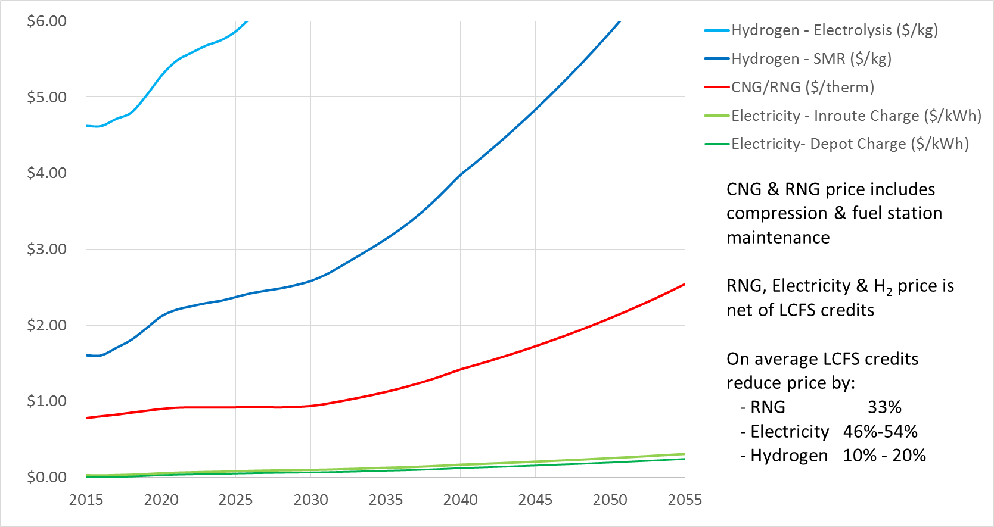
Fuel Costs
In-route charging higher cost because more during peak periods

Slide 14
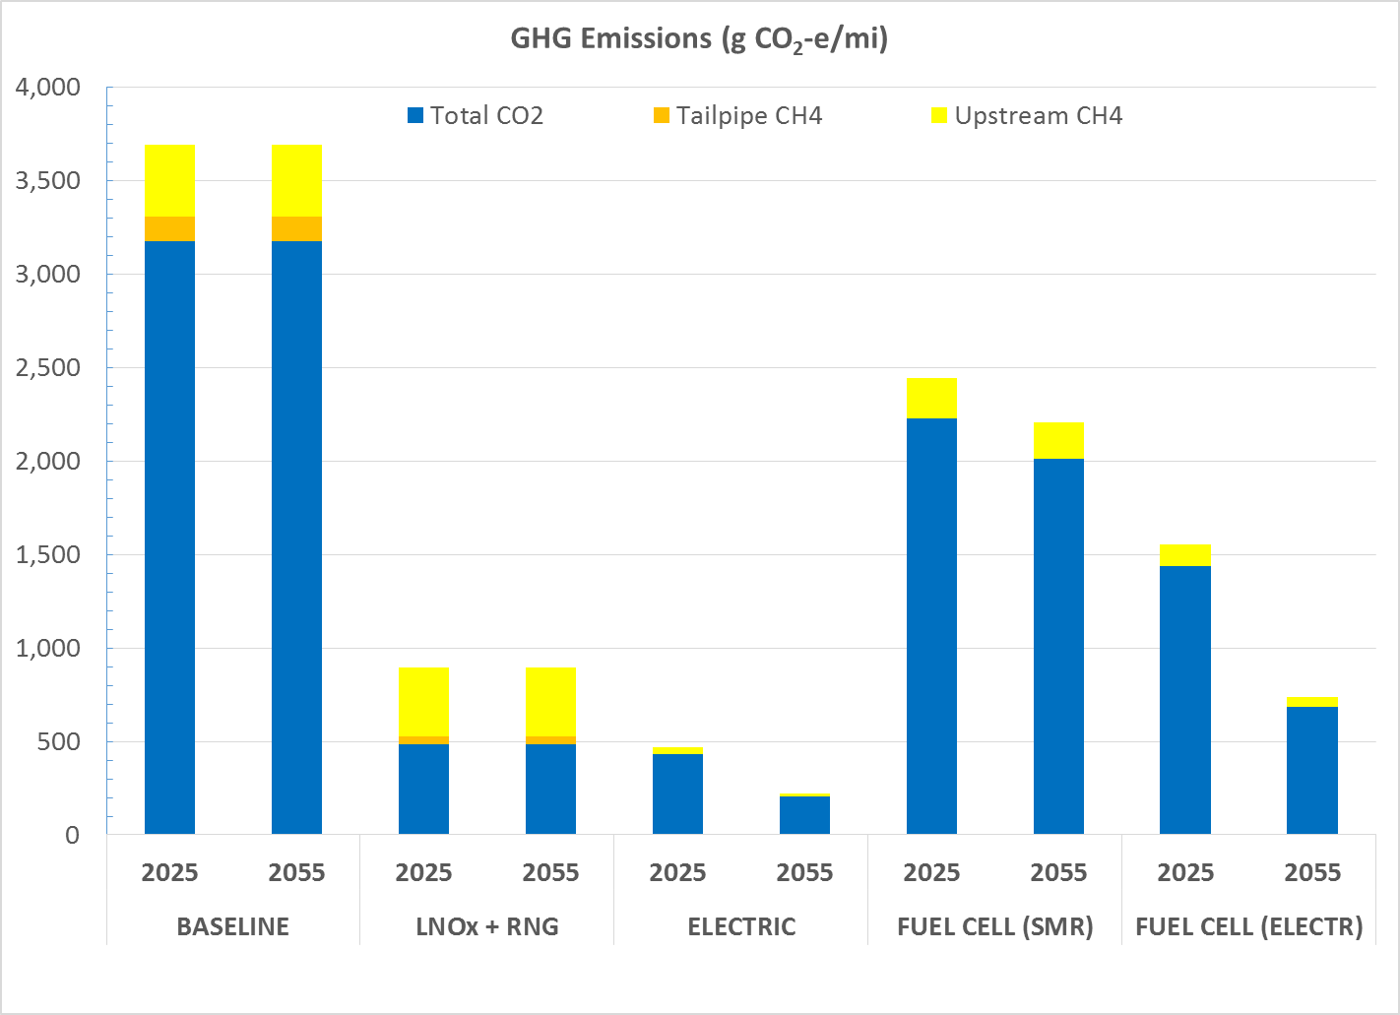
GHG Emissions (g CO₂-e/mi)
Tailpipe emissions per EMFAC2014 emissions model.
Upstream emissions per CA GREET.
CO₂ shown in chart is total tailpipe plus upstream
RNG assumed to be 100% landfill gas.

Slide 15
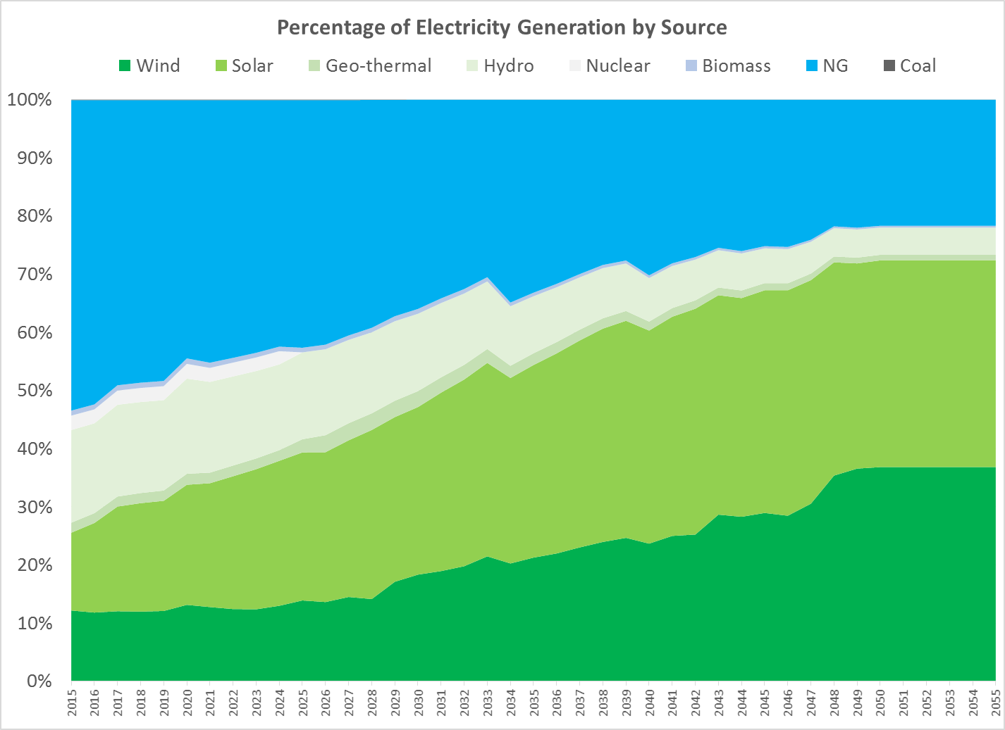
Electricity Grid Mix
ARB targets for future generation
78% zero emission generation by 2050

Slide 16
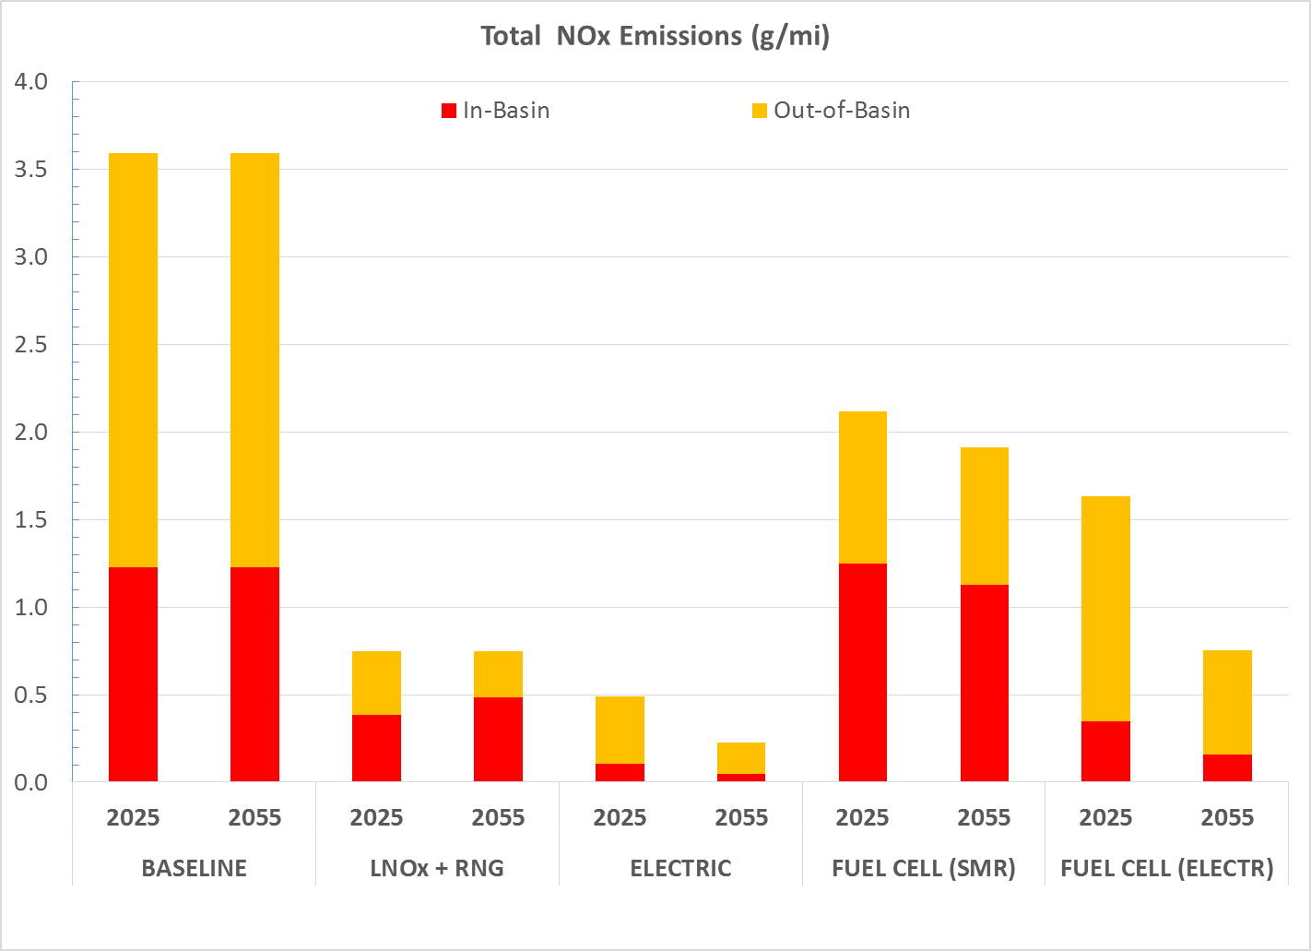
NO_{x} Emissions (g/mi)
Tailpipe emissions per EMFAC2014 emissions model.
Upstream emissions per CA GREET.
RNG assumed to be 100% landfill gas.

Slide 17
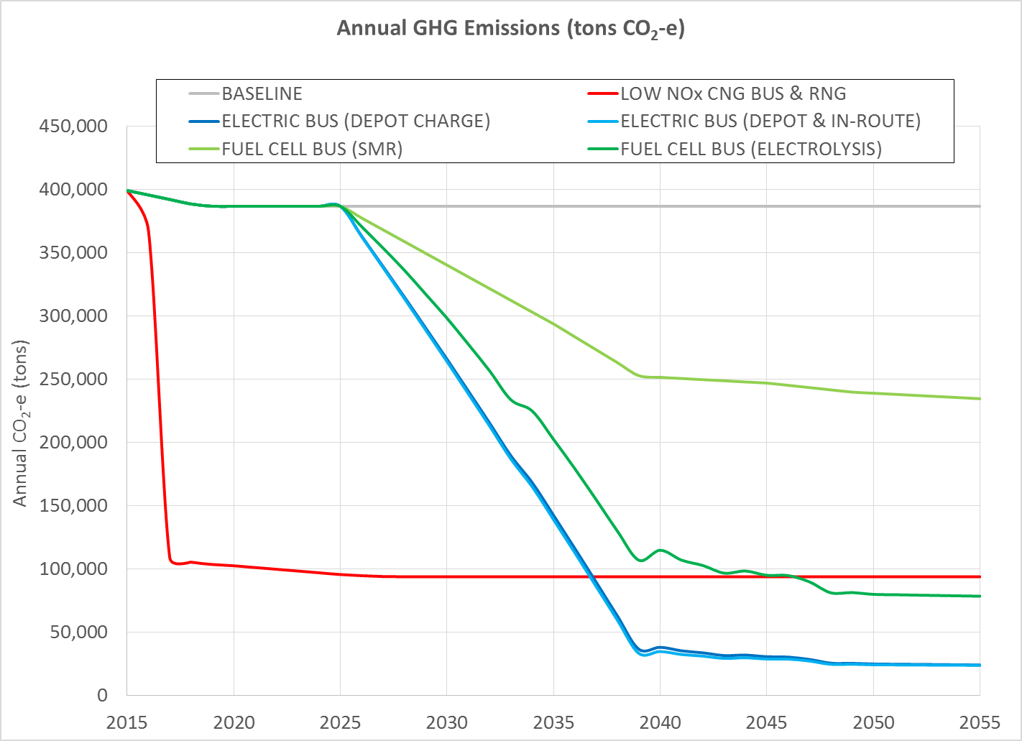
Projected Annual Fleet GHG
(tons CO₂-e)
Significant early reductions from RNG use. Low NOx engine gives minor reduction due to lower tailpipe CH₄
Emissions from H₂ produced by SMR significantly higher than other options

Slide 18
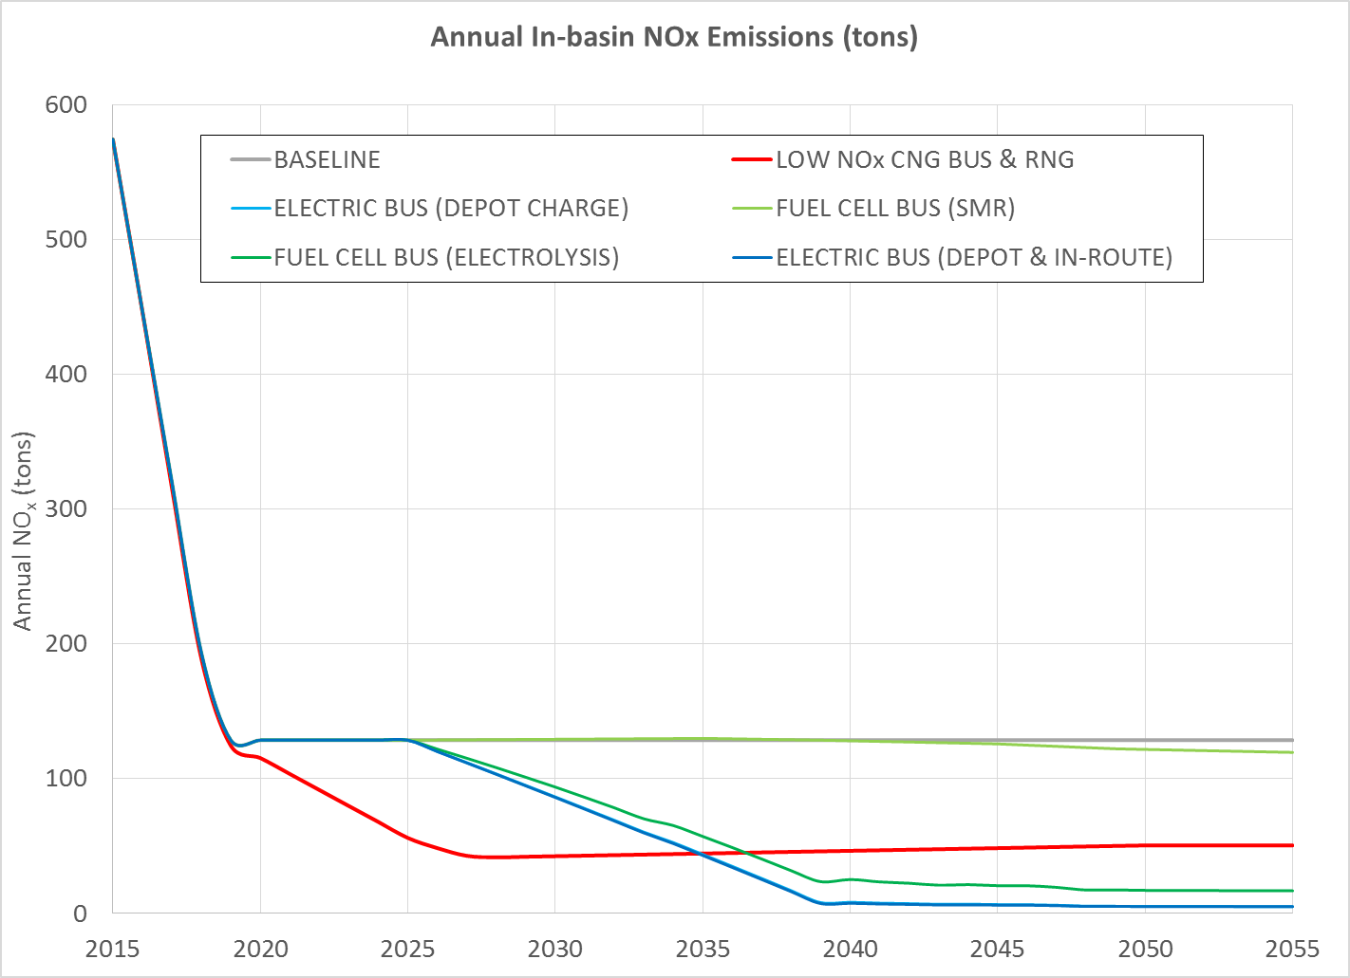
Projected Annual Fleet NO_{x}
(In-basin tons)
Significant reductions under baseline as fleet turns over to 2010+ engines.
Low NOx engine further reduces emissions
Emissions from H₂ produced by SMR similar to baseline

Slide 19
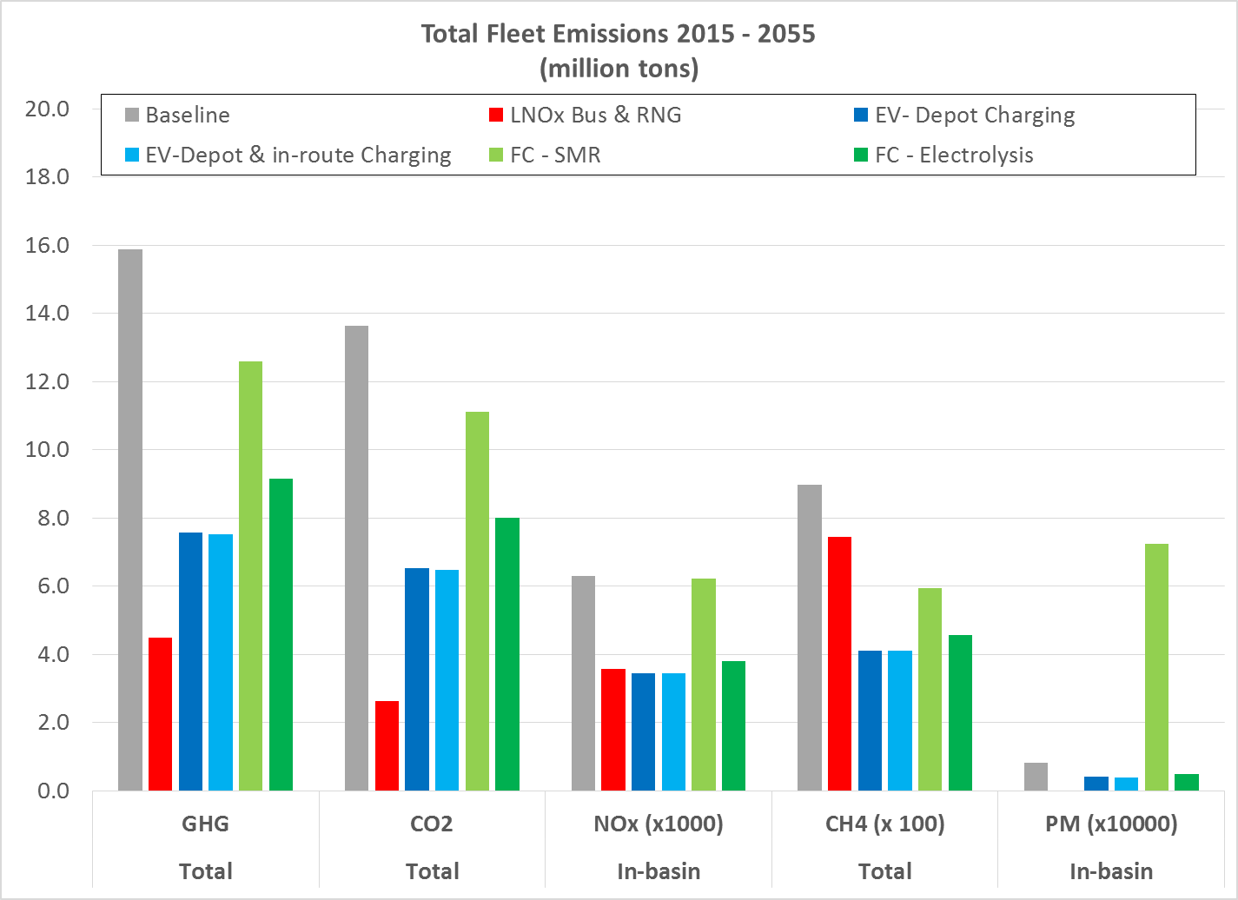
Projected TOTAL Fleet Emissions
2015 – 2055 (million tons)

Slide 20
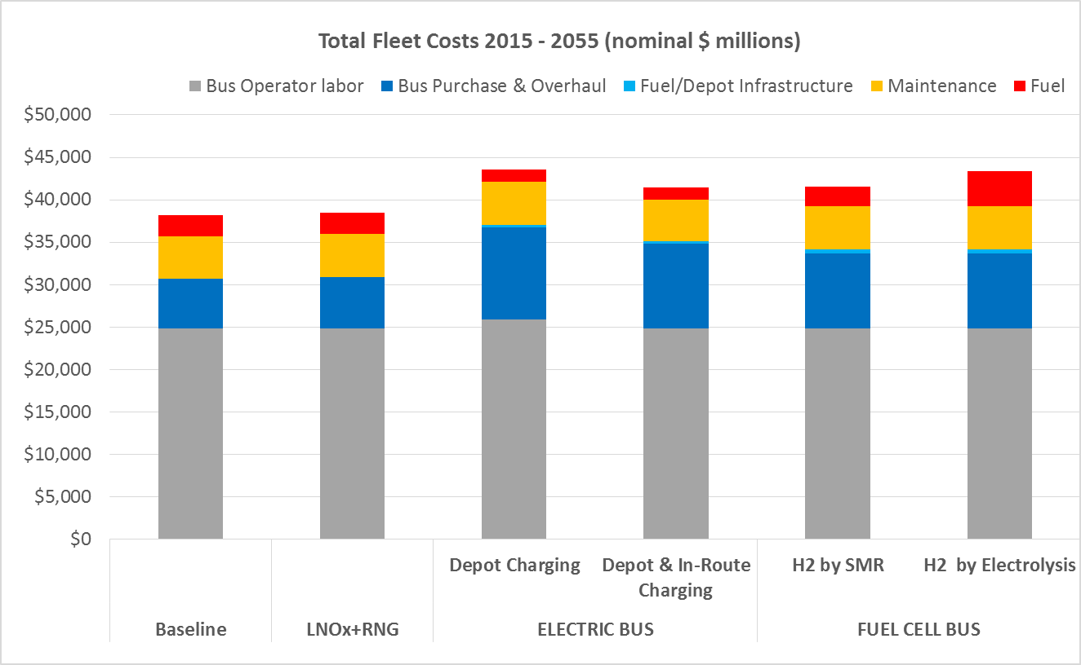
Projected TOTAL Fleet Costs
2015 – 2055 ($ MillionS)

Slide 21
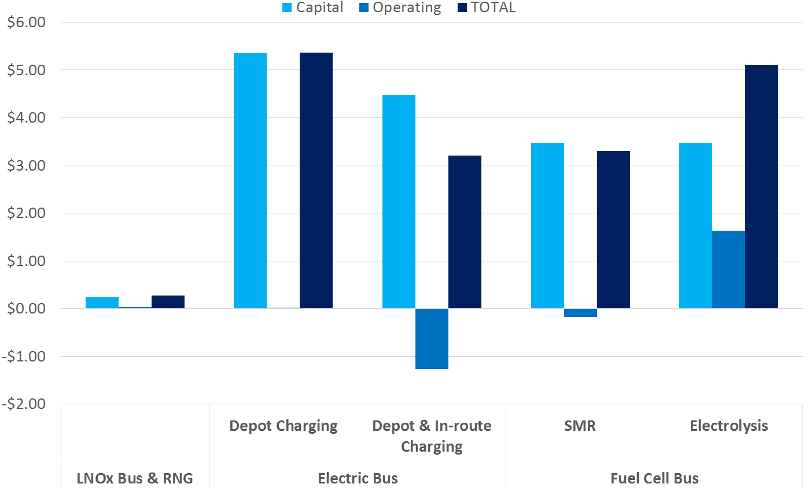
Projected INCREMENTAL Fleet Costs
2015 – 2055 ($ billionS)
Compared to baseline:
LNOx+RNG +1%
Electric Bus +8%-14%
Fuel Cell Bus +9%-13%

Slide 22
Emission Reduction Cost Effectiveness 2015 – 2055 ($/ton)
 |  |  | LNOx + RNG | ELECTRIC BUS |  | FUEL CELL BUS
 |  |  |  | Depot Charge | Depot & In-route | SMR | ELECTR
Compared to Baseline | Cost Increase (NPV $ million) |  | $161.3 | $2,154.9 | $1,224.5 | $1,420.7 | $1,992.4
 | GHG Reduction (million tons) |  | 11.4 | 8.3 | 8.4 | 3.3 | 6.7
 | In-basin NO_{x} Reduction (tons x 000) |  | 2.7 | 2.9 | 2.9 | 0.1 | 2.5
Cost Effectiveness ($/ton) ¹ |  | GHG | $14 | $259 | $146 | $432 | $296
 |  | IB NO_{x} | $59,000 | $755,000 | $427,000 | $20 mill | $795,000
¹ Assumes that 100% of cost increase attributed to each pollutant

Slide 23
Summary
Over the next 40 years the use of RNG and transition to Low NO_{x} CNG engines will be:
  More effective at reducing GHGs from the LACMTA fleet than transition to either Electric or Fuel Cell buses
  More effective at reducing in-basin NO_{x} emissions than transition to fuel cell buses, and almost as effective as transition to electric buses
  Significantly less expensive than transition to either electric or fuel cell buses
Emission reductions of both GHG and NO_{x} from LNO_{x} engines and RNG are an order of magnitude more cost effective than reductions from transition to electric or fuel cell buses

Slide 24
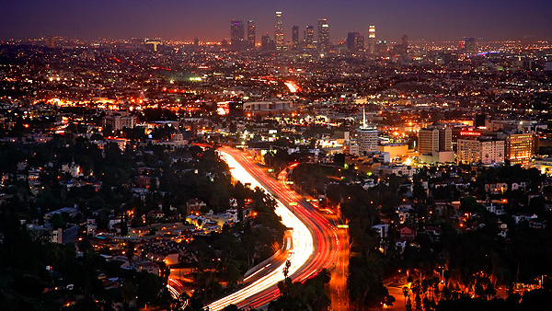
THANK YOU
John Drayton
Los Angeles Metro
One Santa Fe Ave
MS 63-1-1, Suite 100
Los Angeles, CA 90013
213-617-6285
Draytonj@metro.net
Dana Lowell
M.J. Bradley & Assoc. LLC
47 Junction Square Drive
Concord, MA
978-405-1275
dlowell@mjbradley.com
Julia Lester
Ramboll/Environ
707 Wilshire Boulevard
Suite 4950
Los Angeles, CA 90017
213-943-6329
JLester@ramboll.com

