Slide 1
APTA Webinar with Congressional Transit Staff– Overview of the FAST Act
January 20, 2016

Slide 2
APTA Webinar on FAST Act
Welcome!
Rob Healy
Vice President - Government Affairs
APTA

Slide 3
Questions?
Submit via GoToWebinar
Or send an email to webinarquestions@apta.com
- (This is a temporary email for only this week)
We will do our best to answer as many questions as we can at the end of the webinar

Slide 4
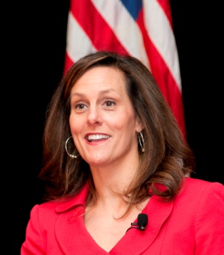
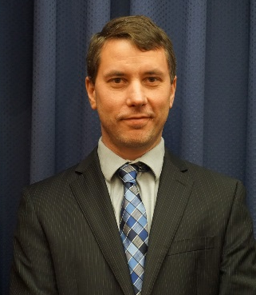
Congressional Transportation Staff
Shannon Hines
U.S. Senate Committee on Banking, Housing & Urban Affairs (Republican staff)
Homer Carlisle
U.S. Senate Committee on Banking, Housing & Urban Affairs (Democratic staff)
Caryn Moore Lund
House Committee on Transportation & Infrastructure (Republican staff)
Auke Mahar-Piersma
House Committee on Transportation & Infrastructure (Democratic staff)

Slide 5
FAST Act Timeline
7/30/2015 – Senate passes DRIVE Act
11/5/2015 – House passes STRR Act
12/1/2015 – House-Senate Conference Committee reports out FAST Act
12/4/2015 – President Obama signs FAST Act

Slide 6
FAST Act Overview
Long-term Bill, 5 Years Fully Funded
Highways, Transit and Rail
$280 billion (HTF)
$305 billion including General Fund Authorizations

Slide 7
FAST Act Transit Title Funding
$48.9 Billion over 5 years from MTA
Transit funding from the Mass Transit Account increases by 8.76 percent in FY16
and 18 percent over 5 years.
$61.1 Billion in Total transit funding, including funds from the General Fund
Total Transit funding increases by 10.23 percent in FY16 and 17.74 percent over 5 years.
General Fund authorizations increase by 16.28 percent in FY16 and remain flat for the remainder of the Authorization bill

Slide 8
Bus and Bus Facilities
Bus Program – $695 M in FY16 to $808 M in FY2020
Total Bus and Bus Facilities funding increases by 62.5 percent in FY16 and 89 percent over 5 years.
Authorizes $3.75 Billion over 5 years
Conference agreement includes a competitive grant program, similar to House and Senate approved bills
Competitive Grant program = $1.52 billion over 5 years
38.5 percent of total bus funding in FY16
42.5 percent of total bus funding in FY20
40.5 percent of total bus funding over 5 years

Slide 9
Bus and Bus Facilities Competitive Grants
Eligible Projects: replacing, rehabilitating, purchasing, or leasing buses or related equipment; and rehabilitating, purchasing, constructing, or leasing bus-related facilities.
Criteria: The Secretary shall consider the age and condition of buses, bus fleets, related equipment, and bus-related facilities
Statewide Applications permitted
10% Rural Set-aside
5307/5311 Grant Requirements apply
Requirements for FTA: (1) Disclose all metrics and evaluation procedures to be used in considering grant applications upon issuance of the notice of funding availability (NOFA); (2) Publish a summary of final scores for selected projects, metrics, and other evaluations used in awarding grants.

Slide 10
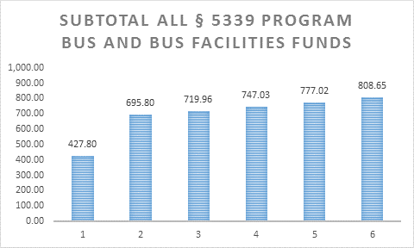
Bus and Bus Facilities

Slide 11
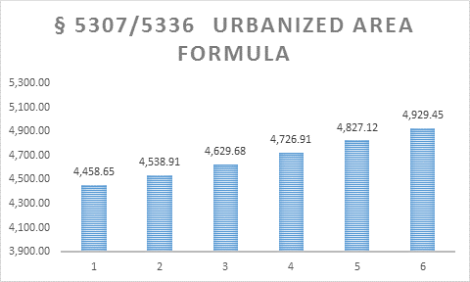
Urban formula

Slide 12
Growing States and High Density States Programs
Both programs continue in the FAST Act, funded at a combined $536M in FY 2016
The Growing States tier increases by 14.3 percent over five years of the bill
The High Density tier increases by a little over 2 percent total over five years

Slide 13
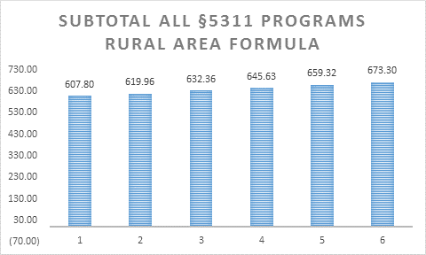
Rural area formula

Slide 14
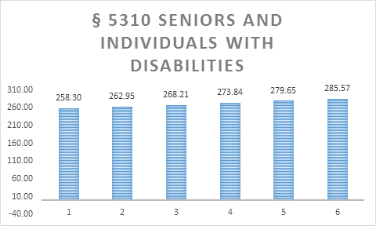
Enhanced Mobility for Seniors and People with Disabilities

Slide 15
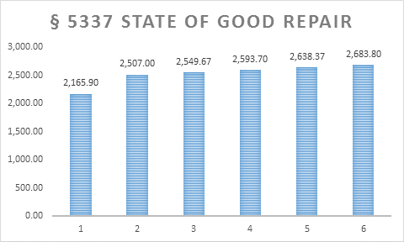
Fixed Guideway State of Good Repair

Slide 16
New Starts/Small Starts/ Core Capacity
New starts/core capacity/small starts remains at status quo regarding “flex” funds and matching funds except the new starts FFGA threshold is now 60 percent.
80 percent total federal share
STP, CMAQ, TIFIA, TIGER, etc.
New Starts Authorization increased to $2.3 billion in FY16 and held flat over 5 years
Program of Interrelated Projects
Expedited Project Delivery for Capital Investment Projects

Slide 17
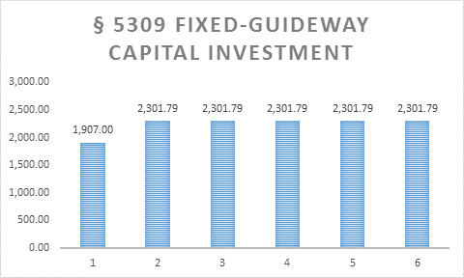
New Starts/Small Starts/ Core Capacity

Slide 18
Questions?
Submit via GoToWebinar
Or send an email to webinarquestions@apta.com
- (This is a temporary email for only this week)
We will do our best to answer as many questions as we can at the end of the webinar

Slide 19
Public Transportation Safety
Clarifies FTA’s authority regarding safe operation of rail fixed guideway public transportation systems.
Requires a review of safety standards and protocols to evaluate the need to establish federal minimum safety standards in public transportation and requires the results to be made public
Rulemaking on Operator Assaults
Study of evidentiary protections for safety data

Slide 20
Public Transportation Innovation/Transit Research
TCRP will be funded at $5 Million annually through the Highway Trust Fund/Mass Transit Account (HTF/MTA), but as a subset within Sec. 5312 Public Transportation Innovation program.
Research funded under both HTF/MTA and General Fund
Zero emission buses eligible under research and bus

Slide 21
General Provisions
Buy America
Increases domestic content requirements from current 60% of components and subcomponents to 65% by 2018 and 70% by 2020
Language on Iron and Steel content
Language requiring DOT to justify waiver denials
Procurement
State Schedules
Pilot Program for “nonprofit cooperative purchasing organizations”
Joint Procurement Clearinghouse
Innovative Leasing

Slide 22
Other issues
Human Resources and Training at $4 million annually, and National Transit Institute at $5 million annually, both from the MTA
TOD eligibility added to TIFIA and RRIF program

Slide 23
Questions?
Submit via GoToWebinar
Or send an email to webinarquestions@apta.com
- (This is a temporary email for only this week)
We will do our best to answer as many questions as we can at the end of the webinar

