Slide 1



Slide 2
What is TCRP DAY?
The TCRP DAY is a national event aimed at:
Creating awareness of the program.
Showcasing its research in action.
Increasing the number of transit professionals involved in the program.

Slide 3

What Is TCRP?
The Transit Cooperative Research Program (TCRP) was established in 1992 to provide an ongoing medium for applied research to transit problems.
The program is carried out under a three-way agreement among:
  Transportation Research Board
  American Public Transportation Association
  Federal Transit Administration

Slide 4
How Does TCRP Work?
TCRP solicits statements of public transportation problems in need of research.
TCRP’s Transit Oversight and Projects Selection (TOPS) Commission reviews problem statements, identifies the highest priority projects, and defines funding levels and expected research products.
Research products are disseminated throughout the public transportation industry.

Slide 5
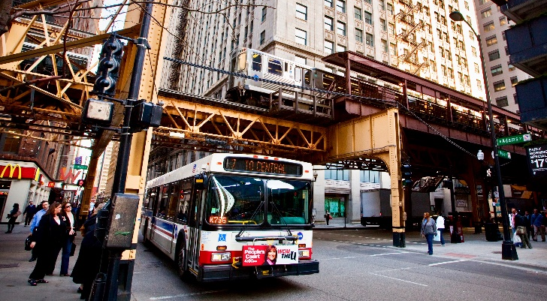
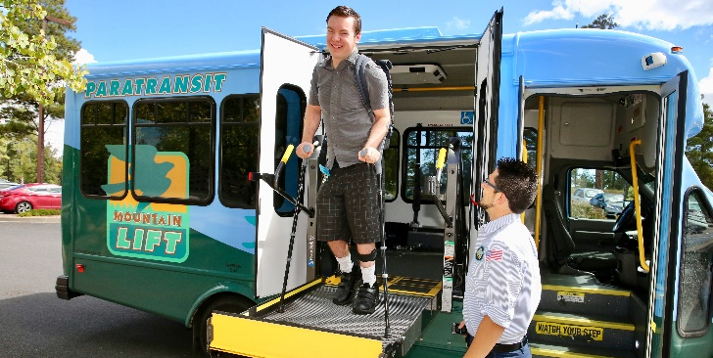
What Topics Does TCRP Cover?
TCRP research spans a comprehensive array of topics in public transportation:
Operations
Service Configuration
Engineering of Vehicles and Equipment
Fixed Facilities
Maintenance
Human Resources
Administration
Policy and Planning

Slide 6
What Are the Benefits of Participating in TCRP?
Meet and network with industry peers.
Raise your professional profile and that of your organization.
Share your expertise and knowledge on specific topics by participating on a project panel.
Participate in webinars to broaden your knowledge base.
Attend TRB’s Annual Meeting, which addresses topics of interest to transportation practitioners from all modes.

Slide 7
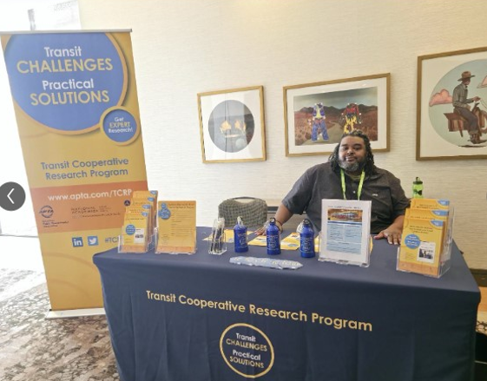
How Can Public Transit Professionals
Get Involved in TCRP?
Propose research topics. Submit a problem
statement to TCRP identifying needed research.
Serve on a project panel.
Become a TCRP Ambassador.

Slide 8
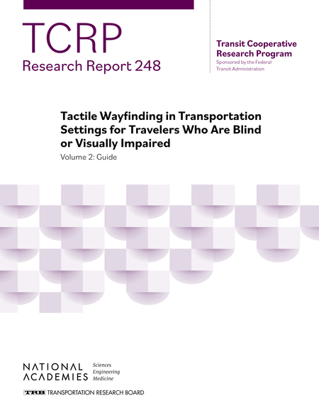
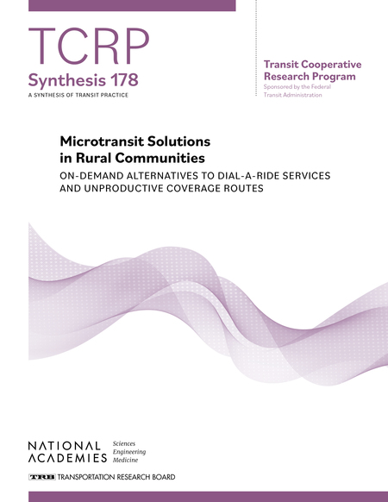
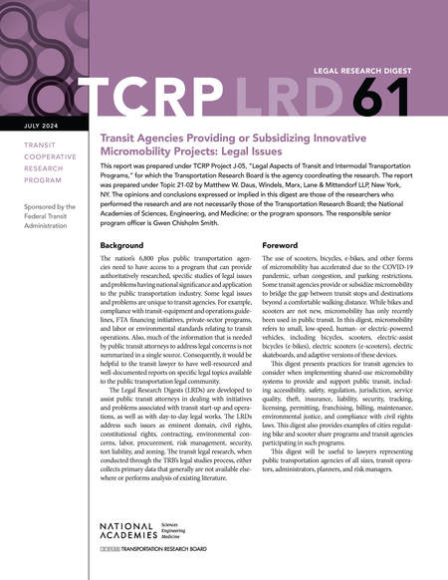
What Types of Research Products
Does TCRP Produce?

Slide 9
Popular TCRP Reports,
Based on Recent Downloads

Slide 10
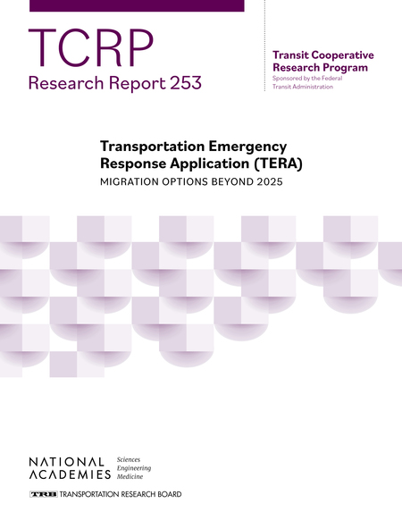
Report 253:Transportation Emergency Response
Application (TERA): Migration
Options Beyond 2025

Slide 11


Report 248:Tactile Wayfinding in Transportation
Settings for Travelers Who Are Blind
or Visually Impaired: Volume 1:
Conduct of Research

Slide 12
Synthesis 178: Microtransit Solutions in Rural
Communities: On-Demand
Alternatives to Dail-a-Ride Services
and Unproductive Coverage Routes

Slide 13
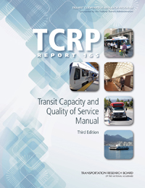
Report 165: Transit Capacity and Quality of Service Manual, Third Edition

Slide 14
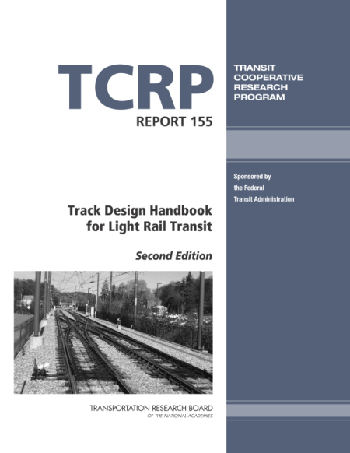
Report 155:Track Design Handbook for Light Rail
Transit, Second Edition

Slide 15

Where Can You Get More Information?
For the most up-to-date and comprehensive information on TCRP, visit:
trb.org/TCRP

Slide 16
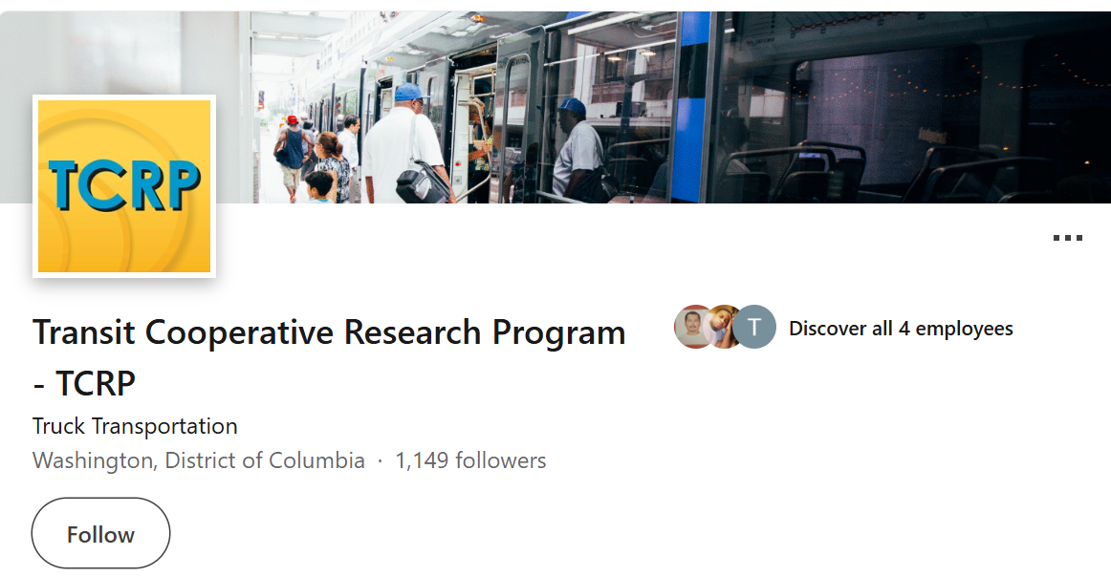
Connect with TCRP on LinkedIn

