Slide 2
What is TCRP DAY?
The TCRP DAY is a national event aimed at:
Creating awareness of the program.
Showcasing its research in action.
Increasing the number of transit professionals involved in the program.

Slide 3
What Is TCRP?
The Transit Cooperative Research Program (TCRP) was established in 1992 to provide an ongoing medium for applied research to transit issues.
The program is carried out under a three-way agreement among:
Transportation Research Board
American Public Transportation Association
Federal Transit Administration

Slide 4
How Does TCRP Work?
TCRP solicits statements of public transportation problems in need of research.
TCRP’s Transit Oversight and Projects Selection (TOPS) Commission reviews problem statements, identifies the highest priority projects, and defines funding levels and expected research products.
Research products are disseminated throughout the public transportation industry.

Slide 5
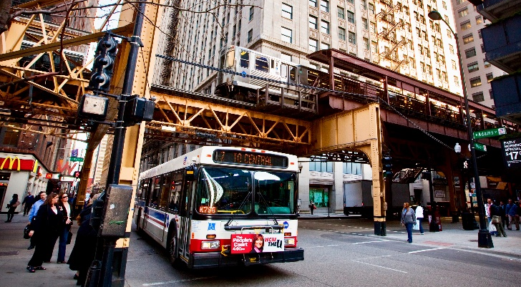
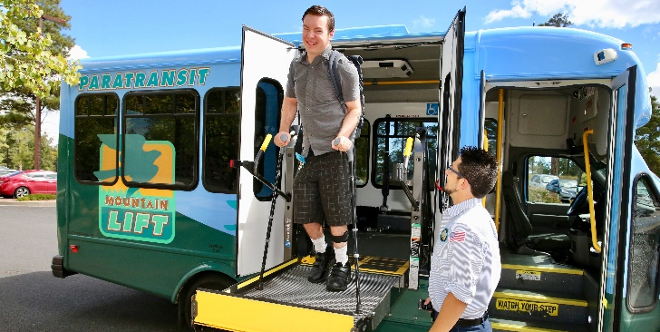
What Topics Does TCRP Cover?
TCRP research spans a comprehensive array of topics in public transportation:
Operations
Service Configuration
Engineering of Vehicles and Equipment
Fixed Facilities
Maintenance
Human Resources
Administration
Policy and Planning

Slide 6
What Are the Benefits of Participating in TCRP?
Meet and network with industry peers.
Raise their professional profile and that of their organization.
Share their expertise and knowledge on specific topics by participating on a project panel.
Participate in webinars to broaden their knowledge base.
Attend TRB’s Annual Meeting, which addresses topics of interest to transportation practitioners from all modes.

Slide 7
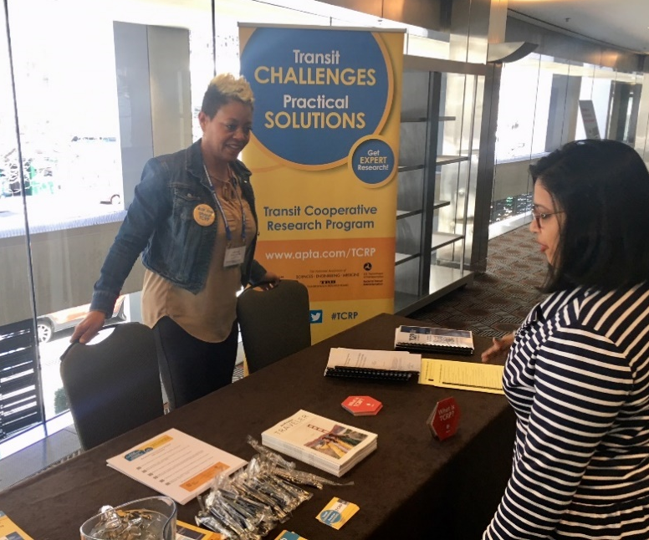
How Can Public Transit Professionals Get Involved in TCRP?
Propose research topics. Submit a problem statement to TCRP identifying needed research.
Serve on a project panel.
Become a TCRP Ambassador.

Slide 8
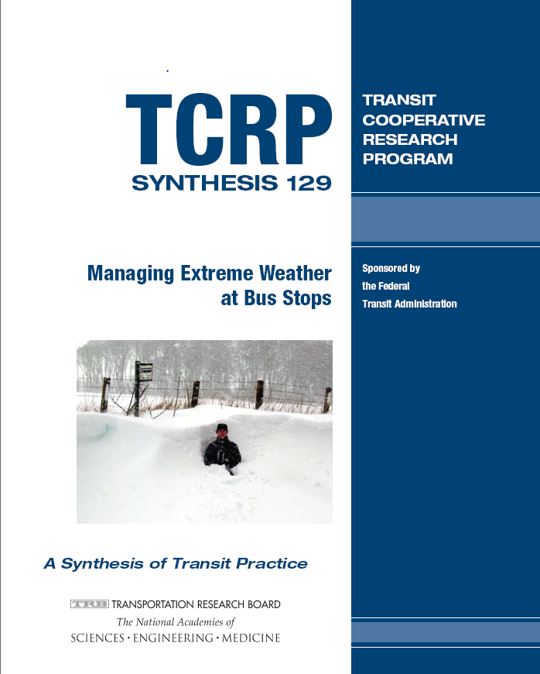
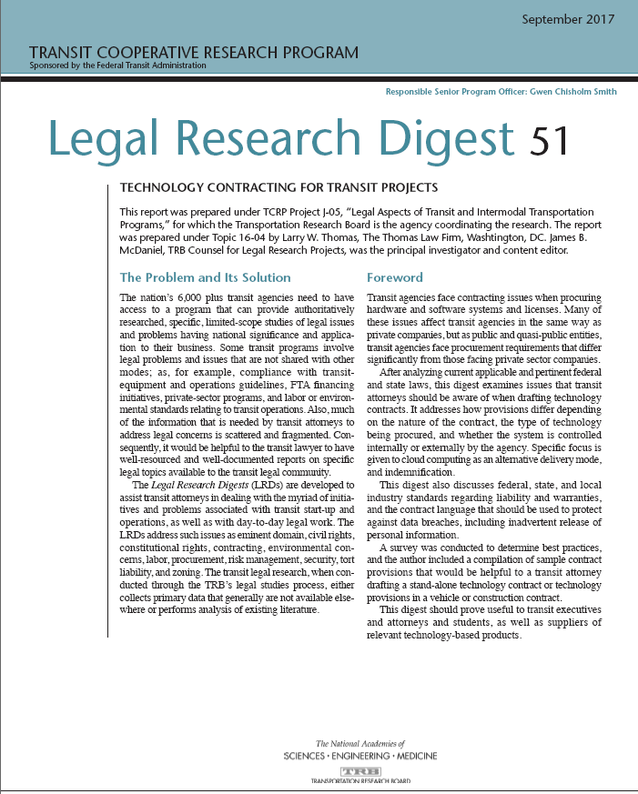
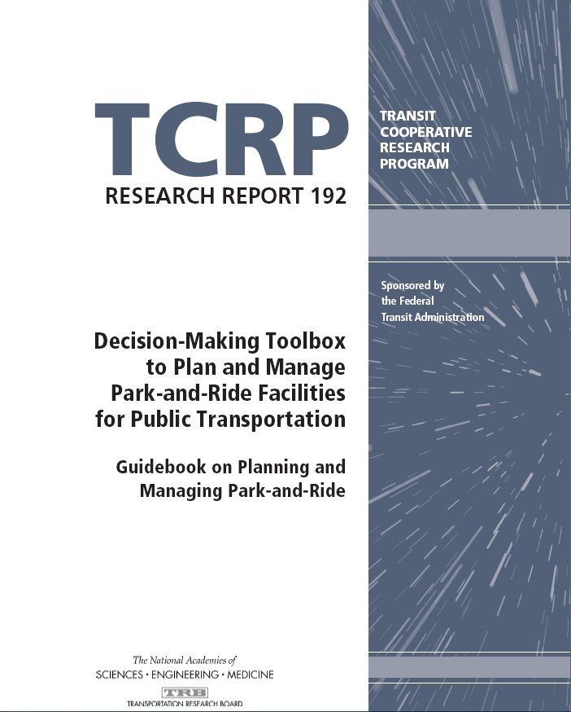
What Types of Research Products Does TCRP Produce?

Slide 9
Top Five Most Popular TCRP Reports,
Based on Recent Downloads

Slide 10
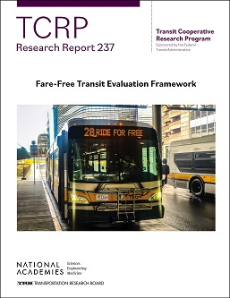
#5
Report 237:Fare-Free Transit Evaluation Framework

Slide 11
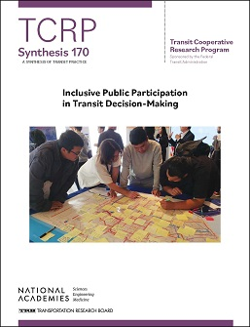
#4
Synthesis 170: Inclusive Public Participation in
Transit Decision-Making

Slide 12
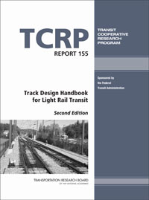
#3
Report 155: Transit Design Handbook for
Light Rail Transit, Second Edition

Slide 13
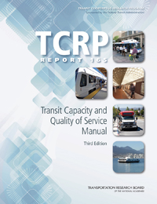
#2
Report 165: Transit Capacity and Quality of Service Manual, Third Edition

Slide 14
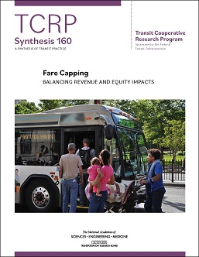
#1
Report 160: Pedestrian and Bicycle Safety in Bus Rapid Transit and High-Priority Bus Corridors: A Synthesis of Transit Practice

Slide 15
Where Can You Get More Information?
For the most up-to-date and comprehensive information on TCRP, visit: trb.org/TCRP

Slide 16
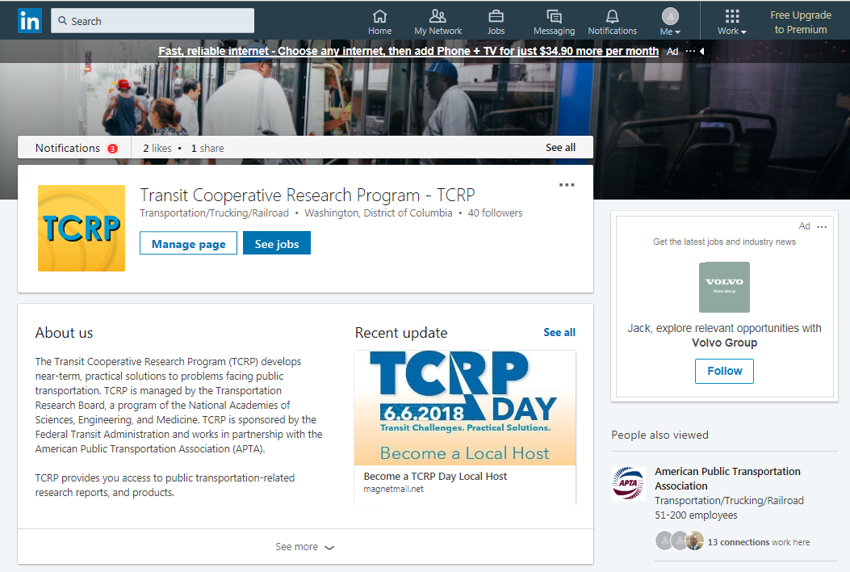
Connect with TCRP on LinkedIn

