Slide 1

Public Transit and Social Responsibility: Homelessness
Leadership APTA Graduation
September 25, 2018
Notes:
Good afternoon,

Slide 2
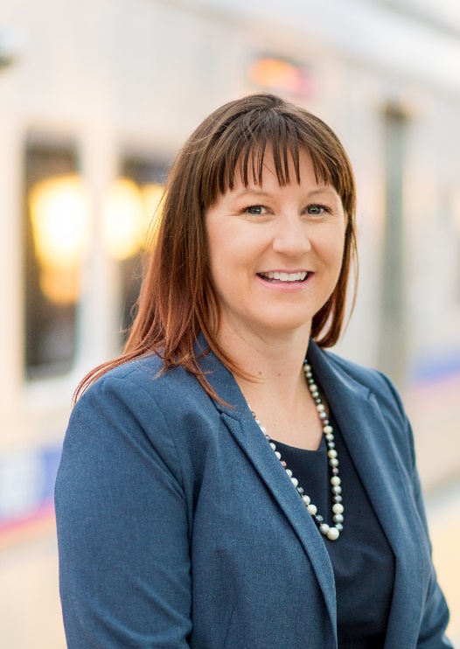

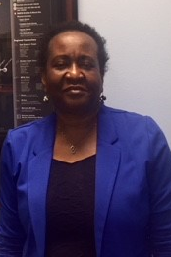


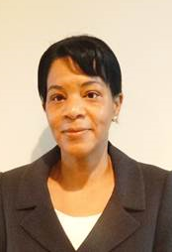
Lacy Bell
Sound Transit
Gabriel Beltran
Dallas Area Rapid Transit (DART)
Elayne Berry
Metropolitan Atlanta Rapid Transit Authority (MARTA)
Derik Calhoun
AC Transit
Tera Hankins
Bay Area Rapid Transit (BART)
Laura Hester
New Jersey Transit
Notes:
There is a lot that happens around the world we cannot control. We cannot stop earthquakes, we cannot prevent droughts, and we cannot prevent all conflict, but when we know where the hungry, the homeless and the sick exist, then we can help.
This short video shows what transit providers see on their systems every day.

Slide 3


Slide 4
Public Transit and Social Responsibility: Homelessness
Why transit systems are attractive to homeless individuals
How agencies are balancing ridership and the homelessness epidemic
Biggest challenges for transit providers
Call to Action for the industry
Notes:
Our project included extensive research to learn how transit agencies are creating partnerships to help change the negative issues surrounding homelessness.
Through this presentation we will answer the following:
- Why are homeless individuals attracted to transit systems?
- What are agencies doing to balance ridership and homelessness?
- What are the biggest challenges for Transit providers?
- What is our call to action?

Slide 5

WHY ARE TRANSIT SYSTEMS ATTRACTIVE TO HOMELESS INDIVIDUALS?

Slide 6

Transit Facilities Provide Basic Needs
Shelters not always an option
Police presence
Food and clothing donations
Public restrooms
“Homeless individuals would rather be at transit facilities because they know they are protected by the police.”
– Gary Denamen, New Jersey Transit Police Outreach Officer
Notes:
WHY ARE TRANSIT SYSTEMS ATTRACTIVE TO HOMELESS INDIVIDUALS?
Homeless individuals are at transit facilities because they get their basic needs met and the transit systems are often more accessible than a shelter. Shelters have a limited number of beds and can include age or other requirements to stay there.
Transit stations can provide many of the same basic amenities as a shelter. And, homeless individuals often find transit systems safer than a shelter because of the police presence.

Slide 7



























































Survey and Interview Organizations
GNHTD
Notes:
Our group conducted a survey to understand how homelessness is impacting transit agencies. We received responses from 51 agencies.
In addition, we interviewed executive leaders at over 20 organizations including transit agencies, private sector transit providers and social service organizations.

Slide 8
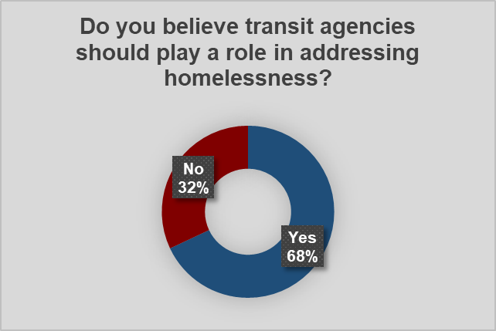
Survey Findings: Impact on Transit
Homelessness is an issue that impacts nearly all agencies
  78% say homelessness impacts ridership
Desire for agencies to be a part of collective solutions
Two Different Viewpoints:
“Homeless individuals can make others feel uncomfortable, thereby deterring choice riders”
“Homeless individuals ride transit for shelter, thereby adding ridership”
Notes:
The majority (78%) of the agencies surveyed said homelessness impacts ridership with two distinct viewpoints:
Homeless individuals can make others feel uncomfortable, thereby deterring choice riders
Homeless individuals ride transit for shelter, thereby adding ridership
Most of the respondents (68%) said that they believe transit agencies should be involved in addressing the homelessness epidemic.

Slide 9
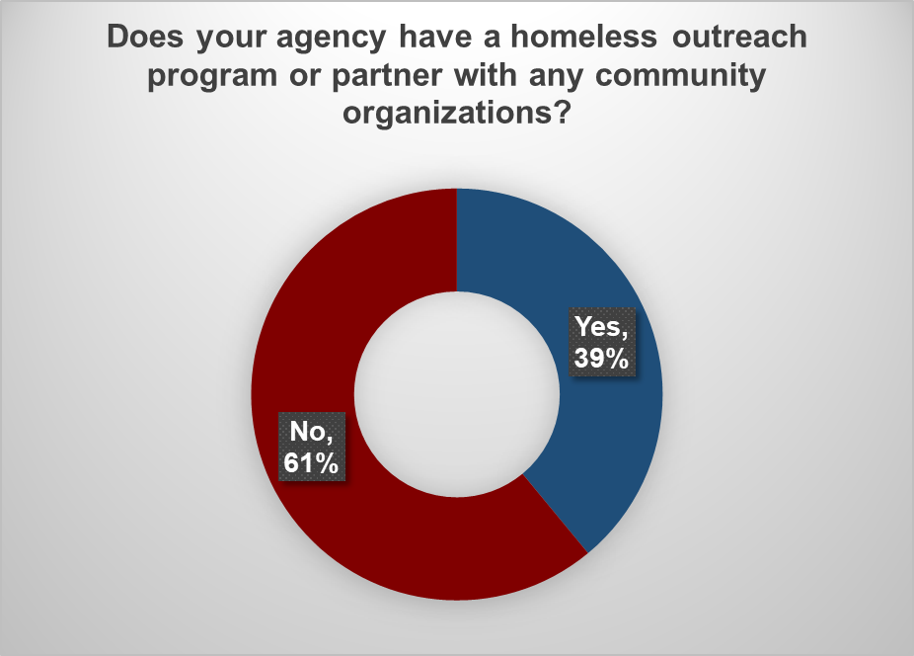
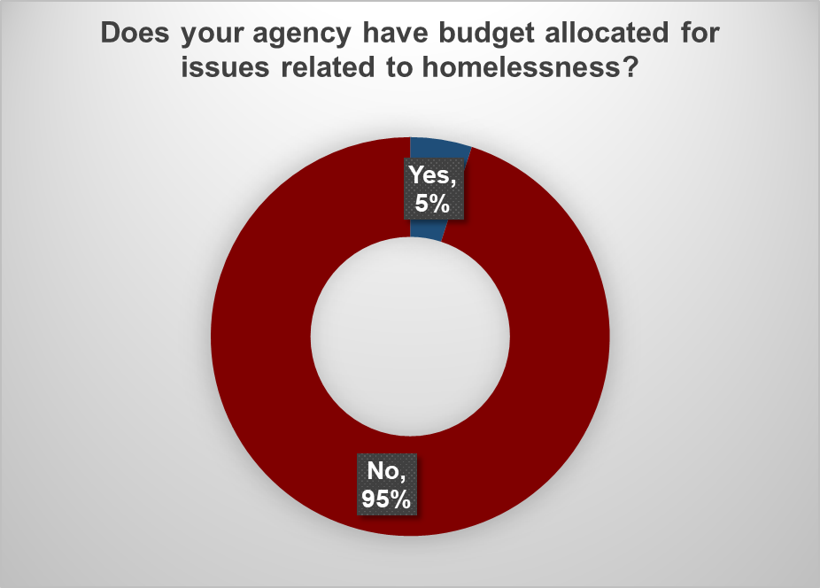
Survey Findings: Resources
Notes:
While most agencies say they are being impacted by homelessness and believe that the industry should be involved in addressing the problem, most agencies do not have resources for this issue. Only 39% of the agencies have a homeless outreach program or partner with community organizations for a similar program
And only 5% of the agencies have funding specifically allocated for this issue.
Now I will turn it over to Tera Hankins to talk about what are agencies doing to balance ridership and homelessness?

Slide 10
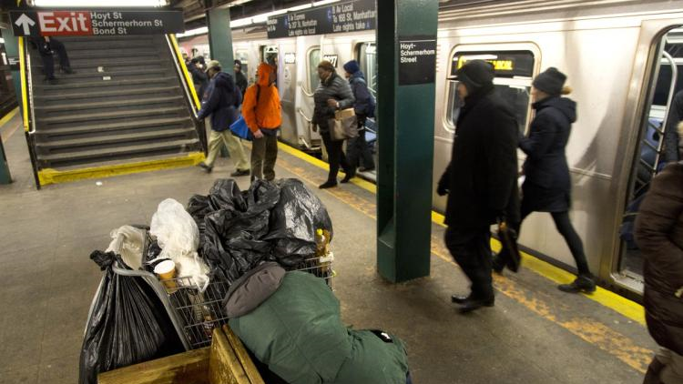
WHAT ARE AGENCIES DOING TO BALANCE RIDERSHIP AND HOMELESSNESS?

Slide 11
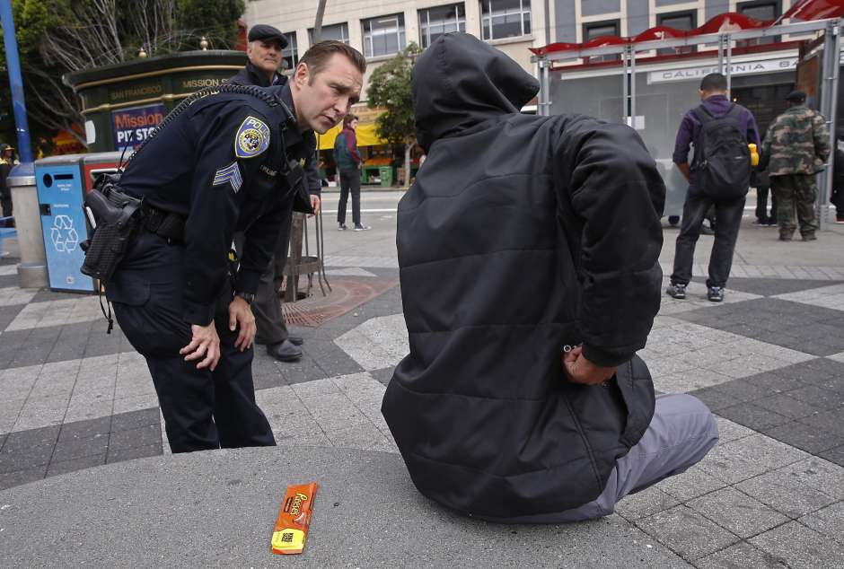
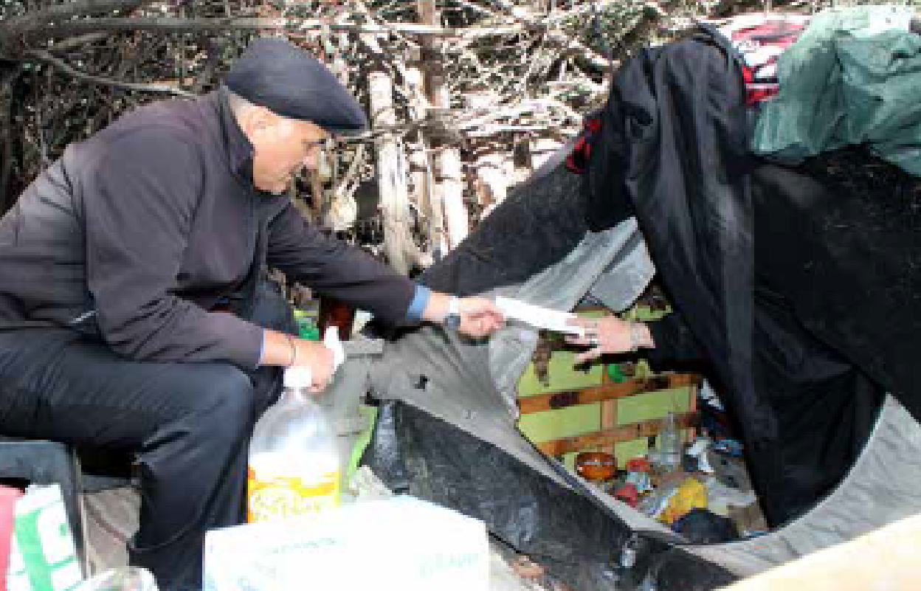

BART Police Crisis Intervention Training
Community Outreach Specialist Armando Sandoval providing contact information for available resources to a resident of a homeless encampment on BART property
Notes:
Crisis Intervention Training (CIT) is a law enforcement program based on having specially trained ofﬁcers who can respond to crisis calls involving populations with special needs, such as mentally ill individuals, the homeless or those with drug and alcohol addictions.
The primary goals of CIT are to de-escalate crisis situations and reduce the use of jail time for mentally ill persons, to decrease recidivism and reduce symptom severity.
Law enforcement ofﬁcers are usually the ﬁrst responders to a crisis situation and may be able to intervene effectively to assure the safety and diversion of mentally ill or homeless persons to treatment centers and/or programs when appropriate.
The CIT training develops sensitivity and understanding regarding these issues. This will increase ofﬁcer safety and provide a proactive method for resolving these sensitive situations.
BPD is a leader in having a full time Crisis Intervention Training and Homeless Outreach Coordinator, Armando Sandoval, on staff.
Sandoval acts as a liaison with public and private mental health communities to create greater collaboration between community mental health groups and BPD.
This collaboration ensures that BPD personnel are prepared to assist in the most appropriate and culturally responsive manner.

Slide 12
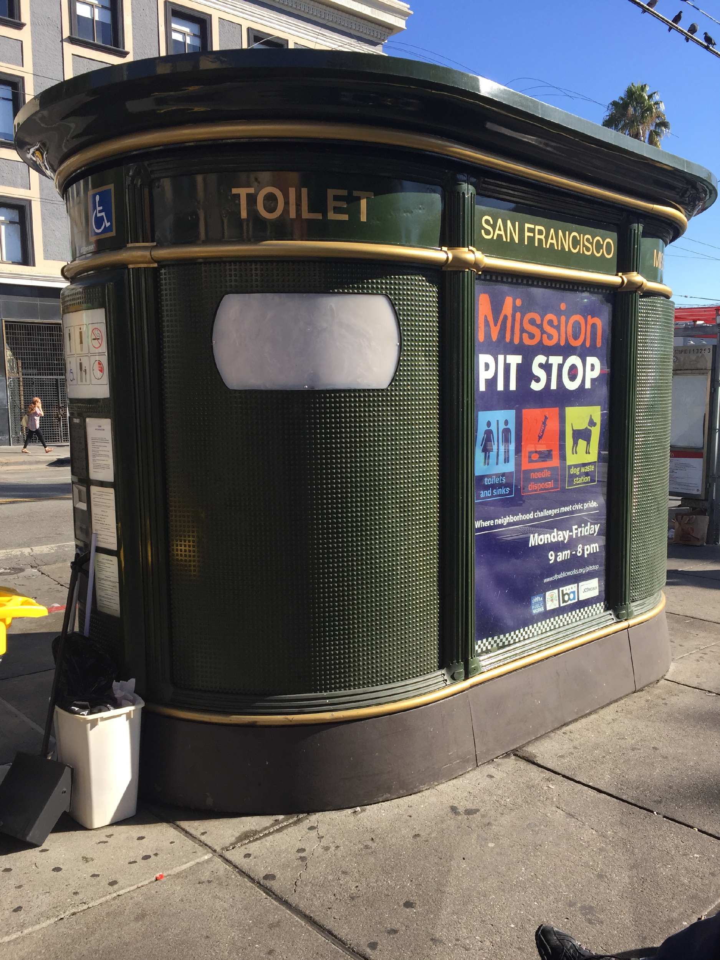
Pit Stop Restrooms
Notes:
BART helped fund the restrooms and are informing our customers and non-customers of this amenity.
Positioning new, fully attended Pit Stop bathrooms above ground at major station entrances and exits in Downtown San Francisco to provide safe and clean access to restrooms for the public.

Slide 13

New Jersey Transit: Crisis Intervention Officers
New Jersey Transit Police Department (NJTPD) has two crisis intervention officers specifically to work with homeless individuals
Partner with Volunteers of America and other social service organizations
Includes a safe surrender partnership with the courts
Notes:
Two crisis intervention officers specifically to work with homeless individuals
Partner with Volunteers of America and other social service organizations
Includes a safe surrender partnership with the courts

Slide 14

New Jersey Transit: Success Stories
Ms. Lillian McRae
  Regular at the Trenton Transit Center
  Refused social services many times
  NJTPD contacted Adult Protective Services and County Social Service office
  Planned Intervention
  Resulted in housing in a long term nursing facility
Notes:
Met her at the train station and agreed that mentally she could not care for herself
Worked with the courts to get her admitted to a long term nursing facility

Slide 15



Mid-Size Agency Strategies and Partnerships
TARC (Louisville, KY) and Madison Metro (Madison, WI)
Partnerships with social service agencies and homeless shelters to provide discount fare media
Inclement weather strategies
Source: Wisconsin State Journal
Notes:
Partner with social service agencies and homeless shelters to provide discount fare media
Provide free transportation to shelters during times of inclement weather
Regardless of the size of the organizations some have collected data, obtained customer feedback in order to start pilot programs, find money and make the case for future programs

Slide 16
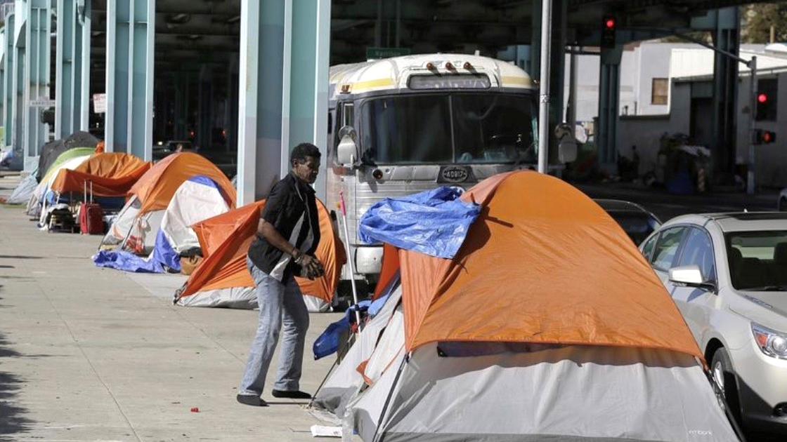
WHAT ARE THE BIGGEST CHALLENGES FOR TRANSIT PROVIDERS?

Slide 17
Recognition of Responsibility: Why Should We Care as an Industry?
Selling public transportation to areas beyond those currently served
Ensuring the safety of customers and cleanliness of facilities
Homelessness is projected to keep growing
Notes:
As simple as it may seem, the biggest challenge we face in addressing homelessness is recognizing that we should take action at all
·
If we are going to survive as an industry, we must ensure our
agencies are attractive to those areas w/o public transportation. Taking
the initiative to address the homeless epidemic now will pay dividends in the
future.
·
Although untrue, one of the more prominent arguments against
public transportation is that it is unsafe and unclean. Making a
concerted effort to get those affected by homelessness to the places that can
truly help them will improve the
public's perception about the safety and cleanliness of our facilities and
vehicles.
·
At any given moment, there are over half a million-people
considered homeless within the United States. And in large urban cities
like NY and SF where the average cost of a 900 sq ft apartment is $3,500, the
numbers will continue to go up. It’s important to address these issues
and have procedures in place because our facilities will continue to attractive
to those affected by homelessness.

Slide 18
Providing a System that Supports the Entire Community
“If we’re here for just the transit dependent population, we won’t be here for long. Addressing the homeless population is a must to maximize expansion opportunities.”
Gary C. Thomas, President/Executive Director, Dallas Area Rapid Transit
“We must collect big data to tell the story of the human experience as it relates to homelessness.”
Curtis Koleber, CEO and Executive Director, CAT (Savannah, GA)
“Match good intentions with adequate funding.”
Chuck Kamp, General Manager, Madison Metro (Madison, WI)
Notes:
Providing a system that supports the entire community can pose to be a challenge for transit providers as well.
· Here you can see some thoughts from leaders within our industry. Whether it is the foresight from Mr. Thomas at DART or highlighting the importance of collecting data to tell the human experience by Mr. Koleber at CAT, thinking outside the normal realm of operations must occur for us to make a positive change on this issue.

Slide 19
Call to Action
Notes:
We have taken on a project that most agencies are doing a lot to address, the homeless epidemic. Through our survey, executive and agency interviews. The following presentation will outline our research on homelessness and how agencies across the country are creating partnerships, community outreach groups and programs to help change the negative issues surrounding homelessness.
Through this presentation we will answer the following:
-Why are homeless attracted to transit systems?
- What are agencies doing to balance ridership and homelessness?
- What are the biggest challenges for Transit providers?
- What is our call to action?

Slide 20
Call to Action
Treat all individuals with dignity and respect. Serve the entire community including homeless individuals.
Incorporate outreach officers with law enforcement to connect individuals with services.
Align transit service with social service destinations to help ensure services are received.
Notes:
TREAT ALL INDIVIDUALS WITH DIGNITY AND RESPECT - It’s important that we don’t discriminate against individuals because they are homeless or appear to be homeless. If we do, it’s pure discrimination. Rather, policies and enforcement should be based on the behaviors of our customers.
INCORPORATE OUTREACH OFFICERS WITH LAW ENFOCEMENT - Law
enforcement shouldn’t be expected to operate in a vacuum when dealing with the
homeless problem. Having outreach
officers assisting transit police are essential to ensure they are relocated to
the appropriate facilities.
ALIGNING TRANSIT SERVICE WITH SOCIAL SERVICE DESTINATIONS – is an innovative proactive approach that can assist in providing transit to health and social service organizations with the goal of improving their situation

Slide 21
Call to Action
Partner with local municipalities & the private sector to identify funding opportunities
Develop creative solutions that do not require funding such as hiring a homeless individual for an entry level position.
Notes:
PARTNERING WITH LOCAL MUNICIPALITIES & THE PRIVATE SECTOR IS A
MUST – No one industry caused the homeless epidemic, however we all are or will
be affected by it. Partnerships are key
to successfully addressing this issue.
·
DEVELOPING CREATIVE SOLUTIONS THAT DO NOT REQUIRE FUNDING CAN PAY
BIG DIVIDINDS - and it can be as simple
as hiring a homeless individual to an entry level position.

Slide 22
